Slide 1
5th International Workshop on High-Order CFD Methods: CI1 - Inviscid bow shock
  Andrew Corrigan, Andrew Kercher, David Kessler
Laboratories for Computational Physics and Fluid Dynamics
AIAA SciTech 2018
Kissimmee, Florida
January 8-12, 2018

Slide 2
DG-FEM Code Overview
    Dimensions:
      1-4
    Cell shapes:
      Simplex, Cuboid, Prism
    Arbitrary polynomial degree:
      0, 1, 2, 3, 4, …
      Isoparametric, subparametric, superparametric,
    Numerical Integration:
      Project fluxes to a polynomial space
      Integrate variational form exactly
    Nodes:
      Equispaced, Gauss-Lobatto
Standard DG Formulation
    Convective Flux:
    Roe, Rusanov, HLLC, Exact
    Diffusive Flux:
    SIPG, BR2
    Time Integration:
      Explicit RK
      Steady-Newton (with Backward-Euler)
      Spacetime
    Linear Solvers:
      GMRES, CG, MINRES, LSQR, …
      Multigrid in progress
    Nonlinear Solvers:
      Newton
      Gauss-Newton
      Levenberg-Marquardt
      KKT/Lagrange-Newton
    Preconditioners:
      Diagonal, Mass, Polynomial
    Parallelism
      MPI, OpenMP, TBB, CUDA
    Physics
      Linear Advection, Burgers, Compressible, Incompressible, Reacting Navier-Stokes

Slide 3
MDG-ICE Discretization Scheme
  Moving Discontinuous Galerkin with Interface Condition Enforcement
    Detect and solve for interfaces
      Enforce conservation law and interface condition separately, within a unified finite element weak formulation
      Solve for flow and grid simultaneously
    Avoids shock capturing
      Preserves a high-order accurate representation
    General:
      Dimensionality
      Steady, unsteady flow
      Physics
      Curved interface geometry
      Non-trivial interface topology
    Not just for shocks/interfaces:
      Move the grid to resolve the flow, e.g., boundary layers

Slide 4
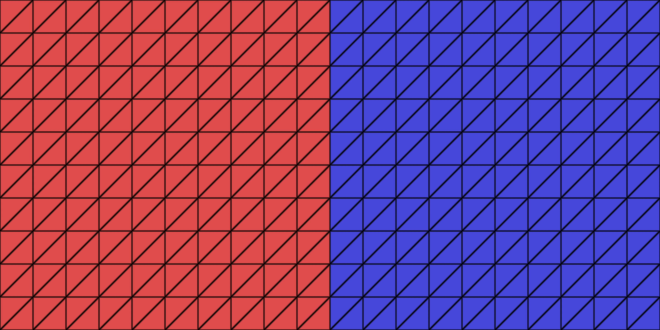
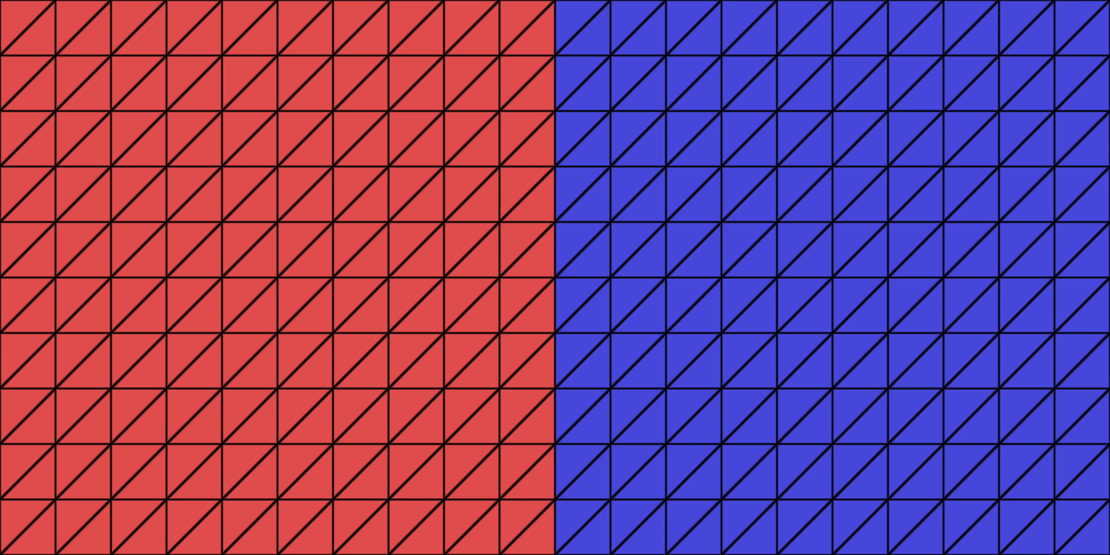
MDG-ICE Discretization Scheme
  Moving Discontinuous Galerkin with Interface Condition Enforcement
    2D Steady Linear Advection
    Velocity = (0.1, 1)
    Velocity = (1.5, 1)
    MDG-ICE solves for the flow field and grid simultaneously

Slide 5
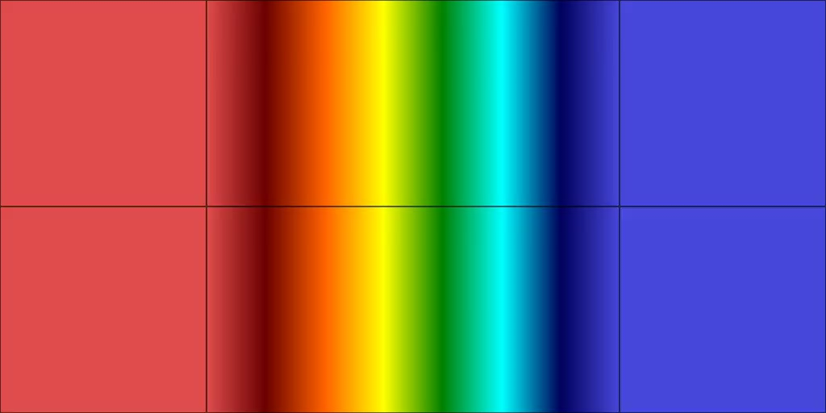
MDG-ICE Discretization Scheme
  Moving Discontinuous Galerkin with Interface Condition Enforcement
    Spacetime Burgers Shock Formation
    MDG-ICE handles:
      Unsteady flow via a spacetime formulation
      Dynamic interface topology
      Singularities, in conjunction with cuboid degeneration

Slide 6


MDG-ICE Discretization Scheme
  Moving Discontinuous Galerkin with Interface Condition Enforcement
    Sod Shock Tube
    MDG-ICE handles different types of discontinuities:
      Shock, contact, derivative discontinuities

Slide 7
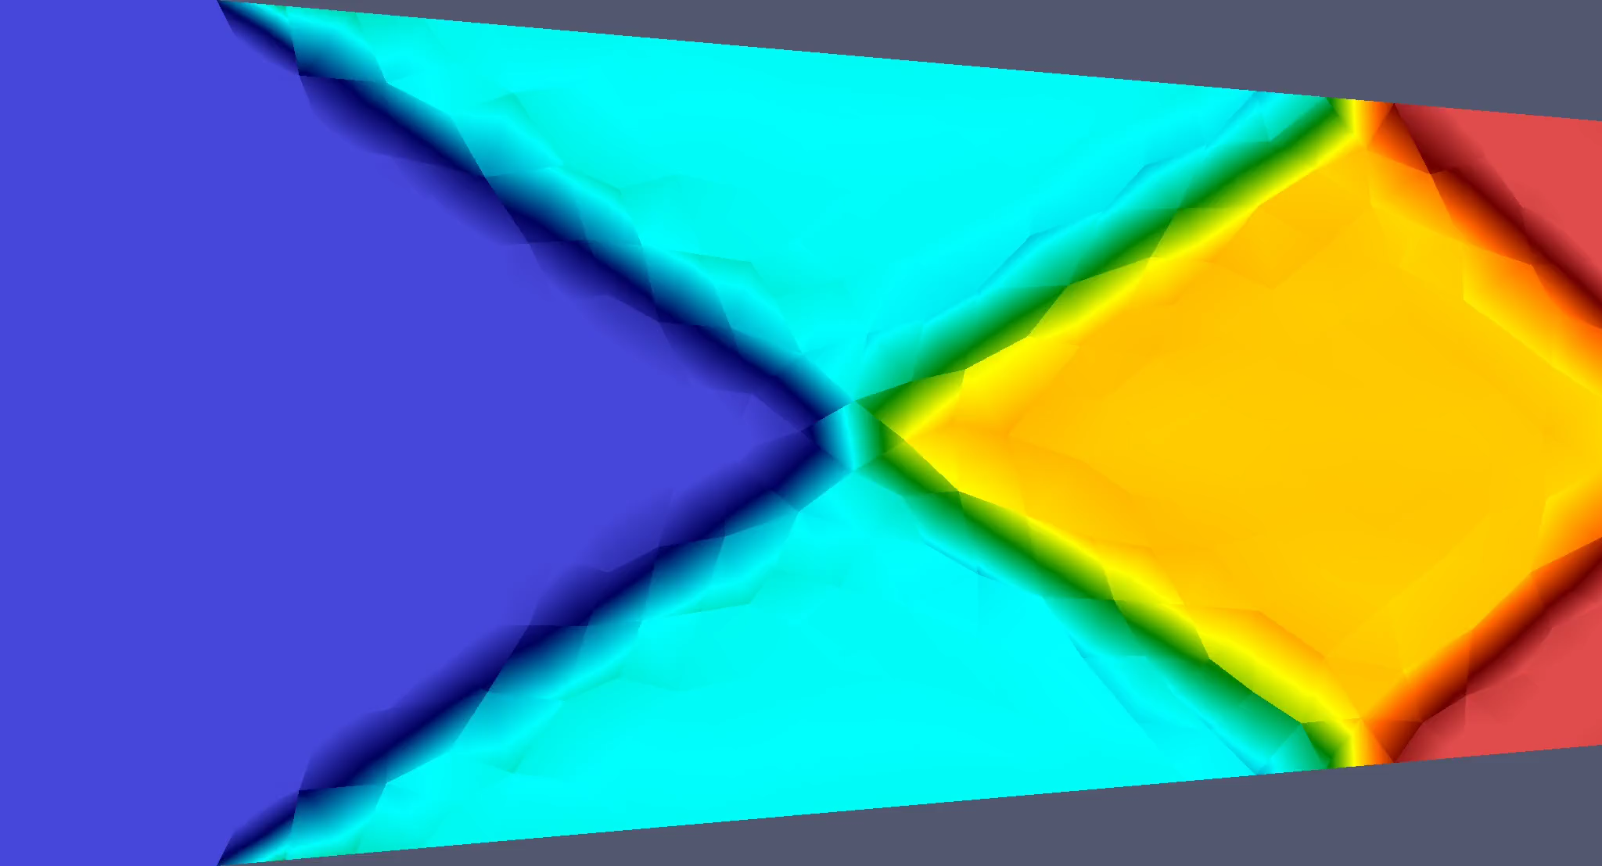
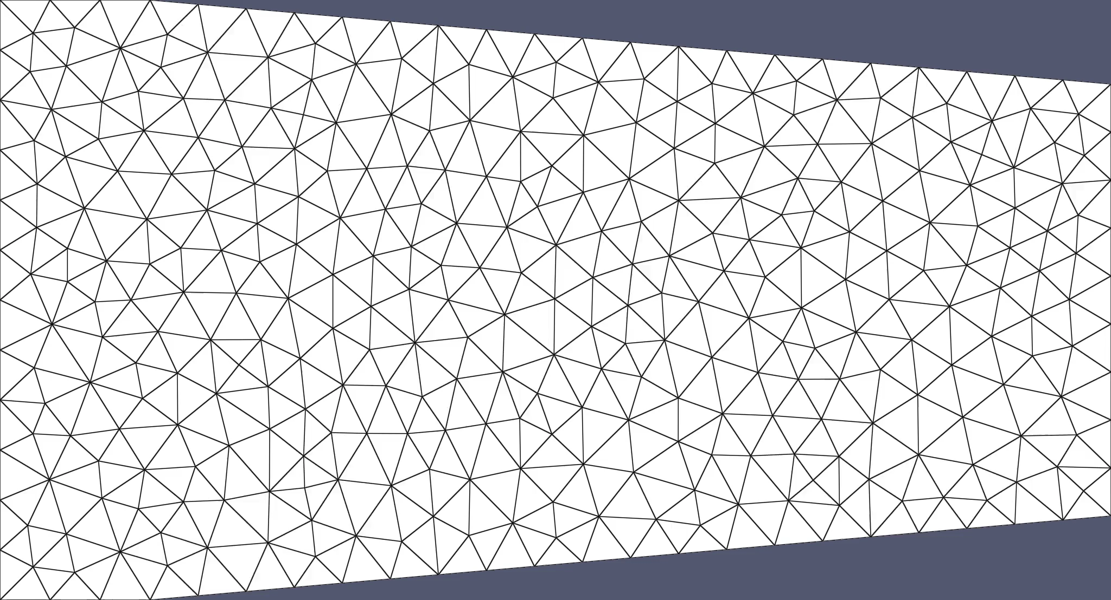
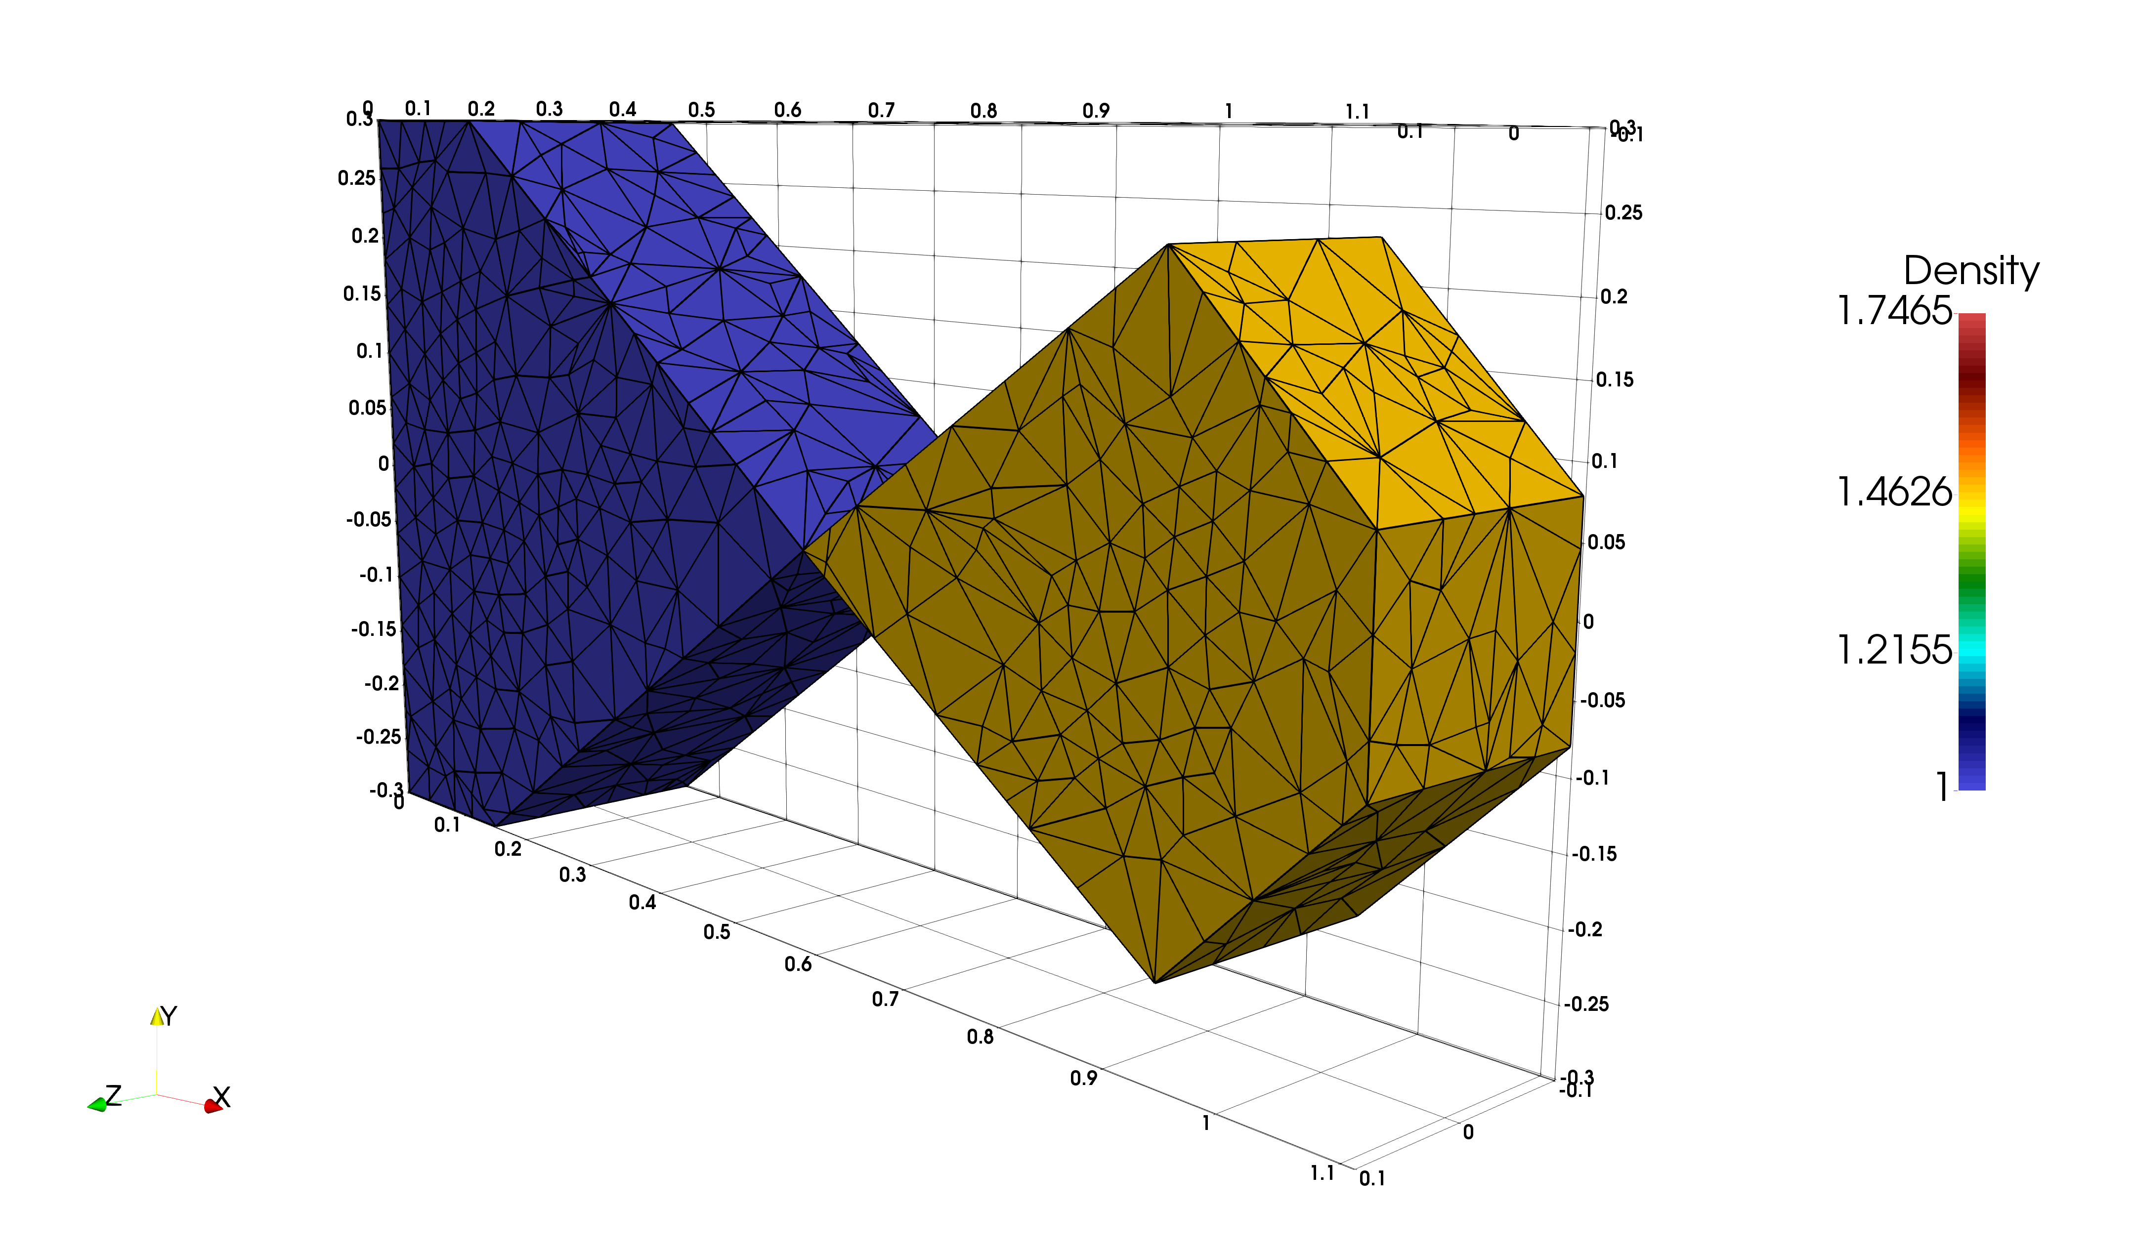
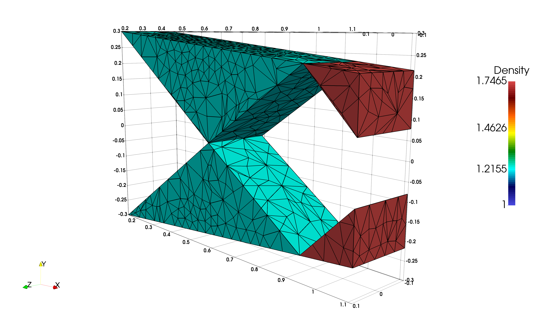
MDG-ICE Discretization Scheme
  Moving Discontinuous Galerkin with Interface Condition Enforcement
    Intersecting Oblique Shocks
    MDG-ICE handles non-trivial interface topology:
      Using standard edge collapse / refine grid operations
        Also works for higher-dimensional simplexes

Slide 8


Smooth Bump Verification Case
  Smooth Bump
    Isoparametric q2 quadrilateral elements
      Flux projected to q4
    DG
      Implicit solver: Newton/Backward-Euler
      Expected order of accuracy observed (slope = 3)
      Slopes:
        5.81, 3.25, 3.27
    DG with Shock Capturing
      Explicit solver: RK2
      Slopes:
        1.95, 0.99, 1.36
Pressure
Entropy

Slide 9



Bow Shock Test Case
  Mach 4 Bow Shock
    Isoparametric q2 quadrilateral elements
      Flux projected to q4
    DG with Shock Capturing
      Explicit solver: RK2
      Residual based shock capturing
    MDG-ICE
      No shock capturing
Pressure
Grid
Mach

Slide 10
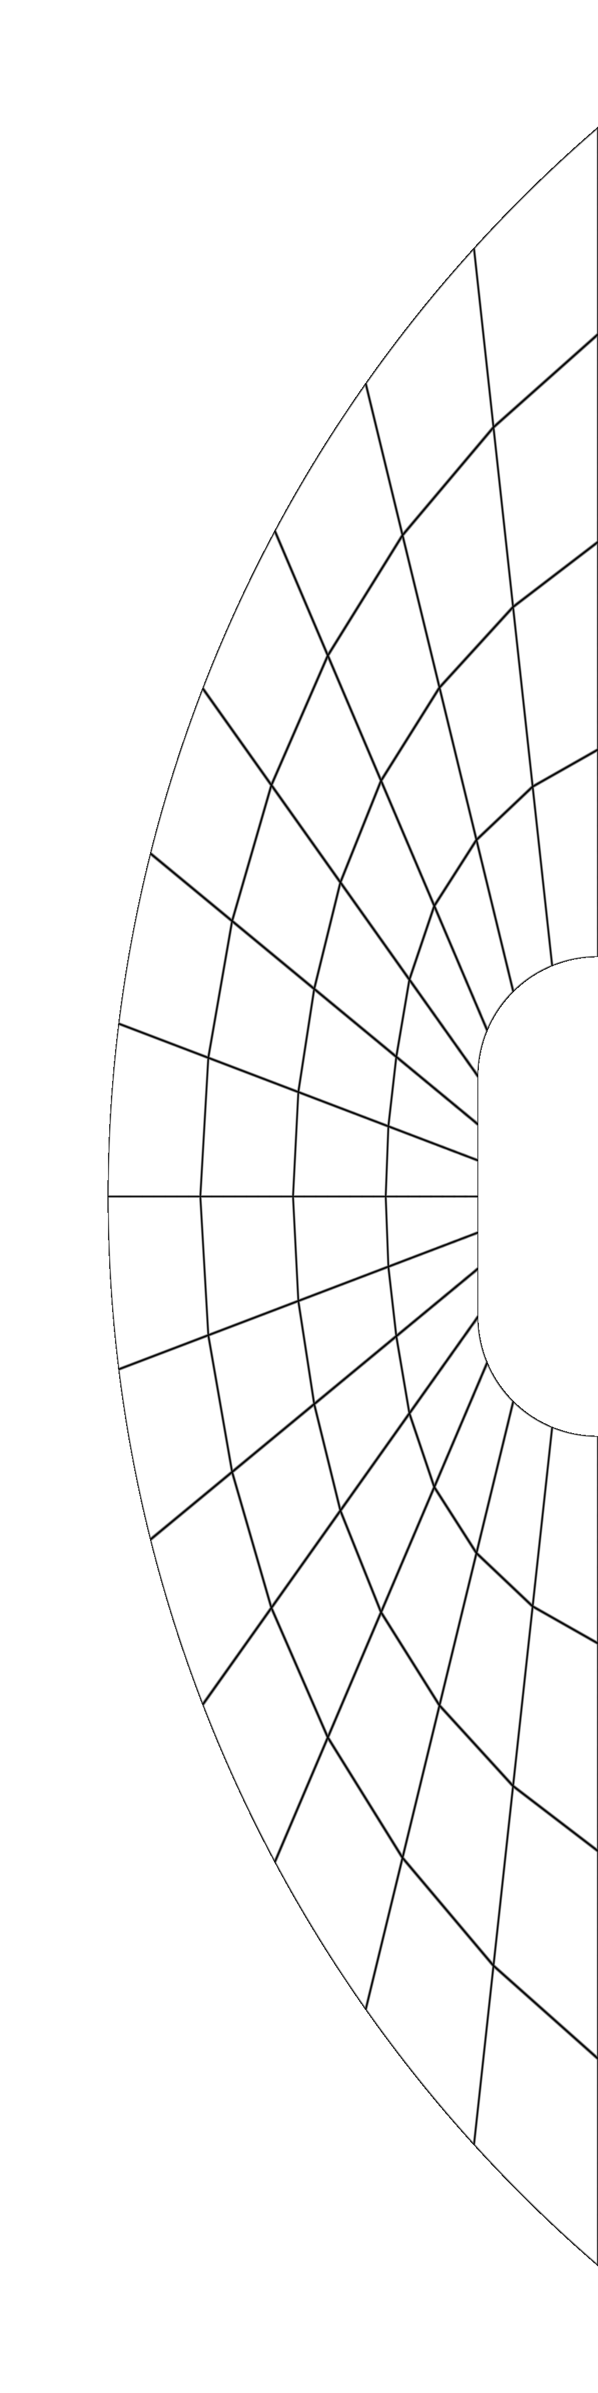
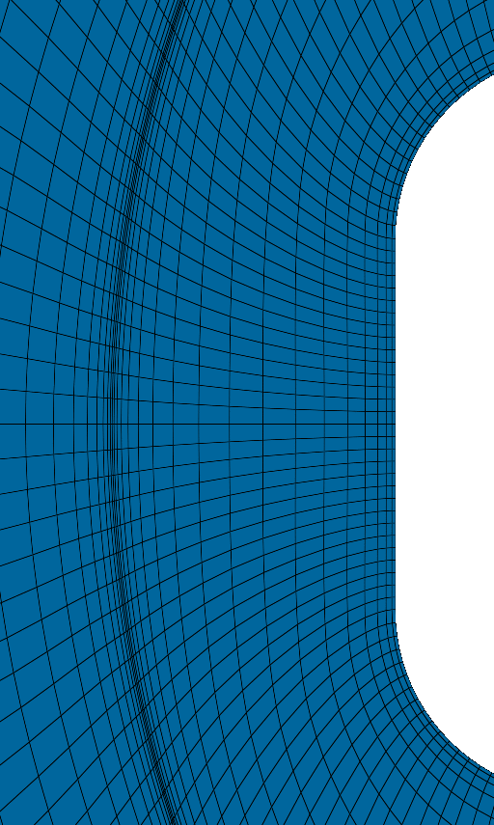
Bow Shock: Geometry
Ran on uniform structured grids
    Shock location appeared to be moving across different levels of the provided grids
Blunt body geometry is exactly as specified
Inflow surface is modified slightly:
    Circular arc:
        Origin 3.85
        Radius 5.9
        Top/bottom at:
        (x,y)=(0, ±4.4704)
MDG-ICE requires geometric boundary conditions:
    So that the geometry can move along the boundary
The shock refinement location appears to move on the provided grids:

Slide 11
Bow Shock: Stagnation Enthalpy
  DG(q=2) isoparametric quadrilateral elements with shock capturing
    Slopes: 0.86, 1.05, 0.39, 0.40
  MDG-ICE(q=2) isoparametric quadrilateral elements
    Slopes: 2.34 1.37
Expected slope = 3

Slide 12
Bow Shock: Pressure at the Stagnation Point
  DG(q=2) isoparametric quadrilateral elements with shock capturing
    Instabilities arise on finest grid, which degrades accuracy
  MDG-ICE(q=2) isoparametric quadrilateral elements
    Initially very accurate, but non-monotonic convergence (far from asymptotic regime?)

Slide 13
Bow Shock: DG Convergence History
  DG(q=2) isoparametric quadrilateral elements with shock capturing
    Explicit time-stepping
    Excruciatingly slow convergence for steady flow.
    Converged until output quantities stopped changing beyond ~4 decimal places

Slide 14
Bow Shock: DG Work Units
  DG(q=2) isoparametric quadrilateral elements with shock capturing
    Explicit time-stepping
    Excruciatingly slow convergence for steady flow.
    Converged until output quantities stopped changing beyond ~4 decimal places
  Work Units
      TauBench Score: 6.223
      Run on GPU:
        Normalized also by GPU vs. 1-Core CPU speedup: 62.627x
      56 cells: 711.7
      224 cells: 1566.8
      896 cells: 3404.5
      3584 cells: 9552.9
      14436 cells: 65611.0

Slide 15
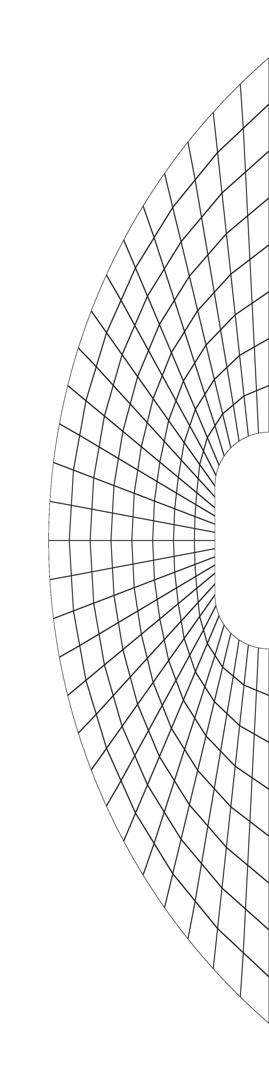
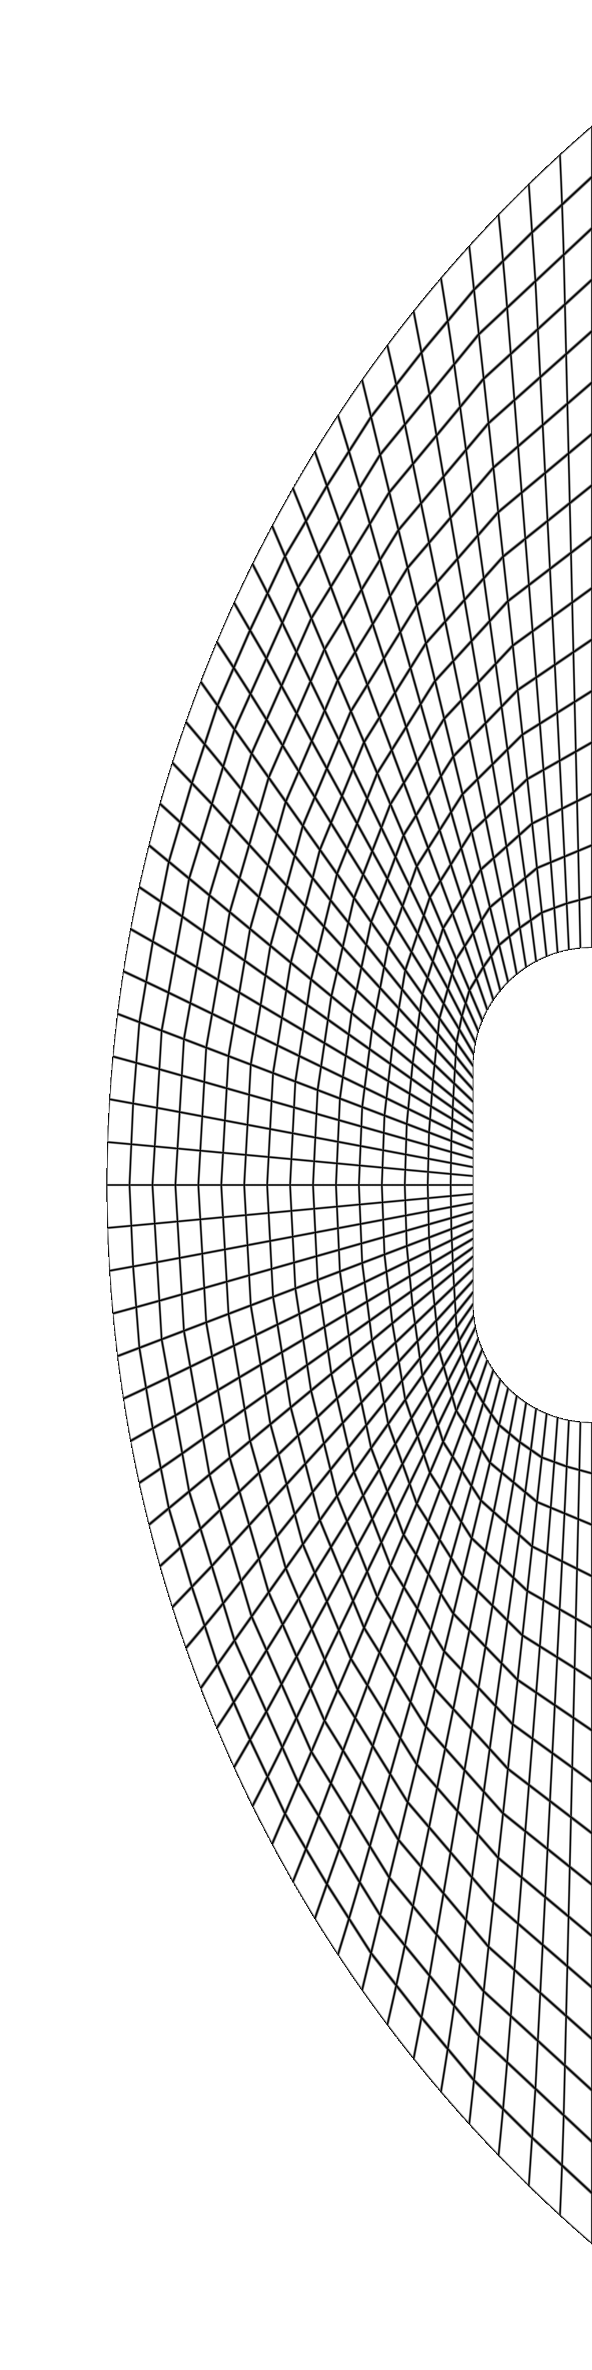
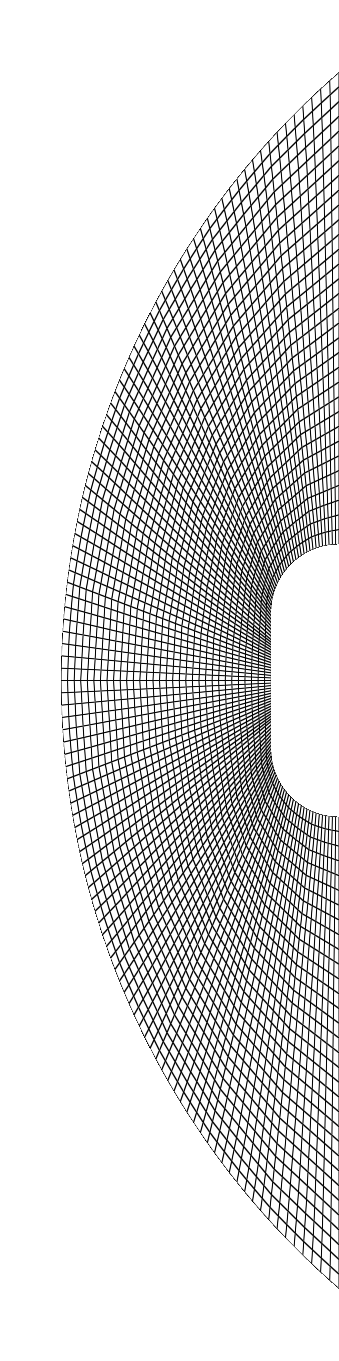
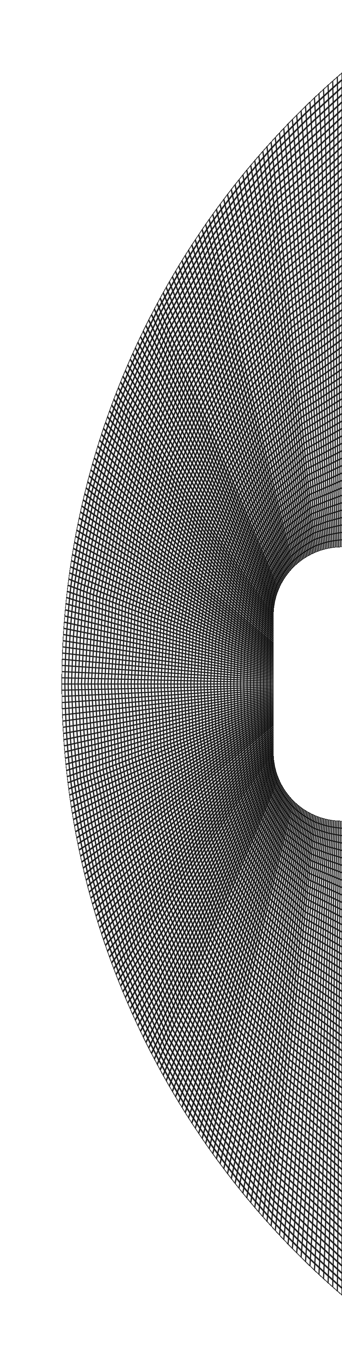
Bow Shock: Grids
DG(q=2) isoparametric quadrilateral elements with shock capturing
Uniformly refined from initial grid
  Projected geometry to analytic surfaces
56 cells 224 cells 896 cells 3584 cells 14336 cells

Slide 16
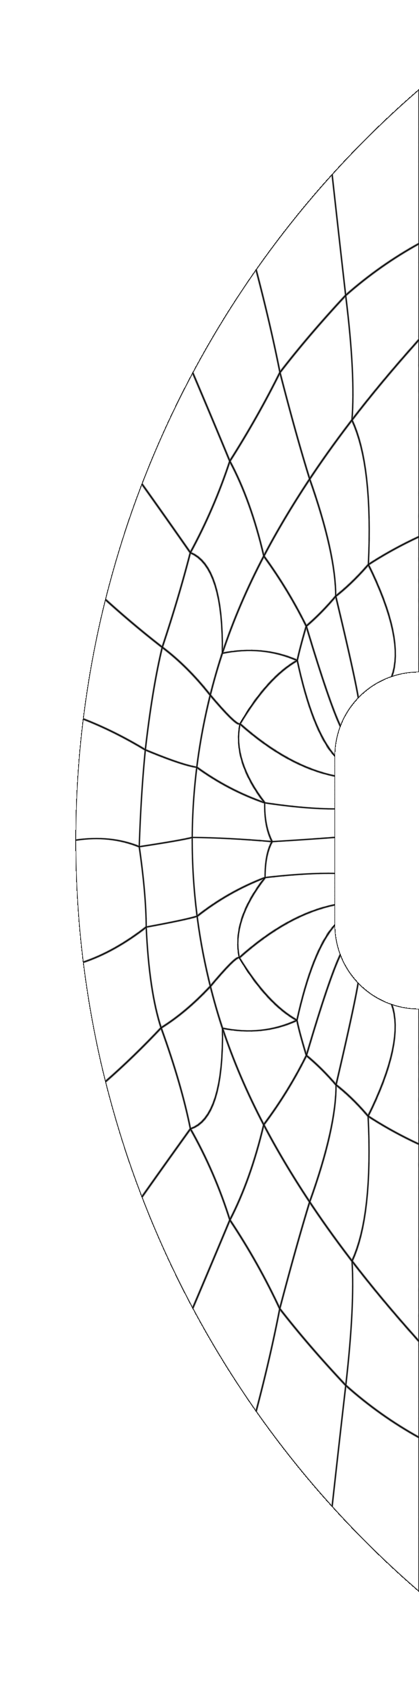
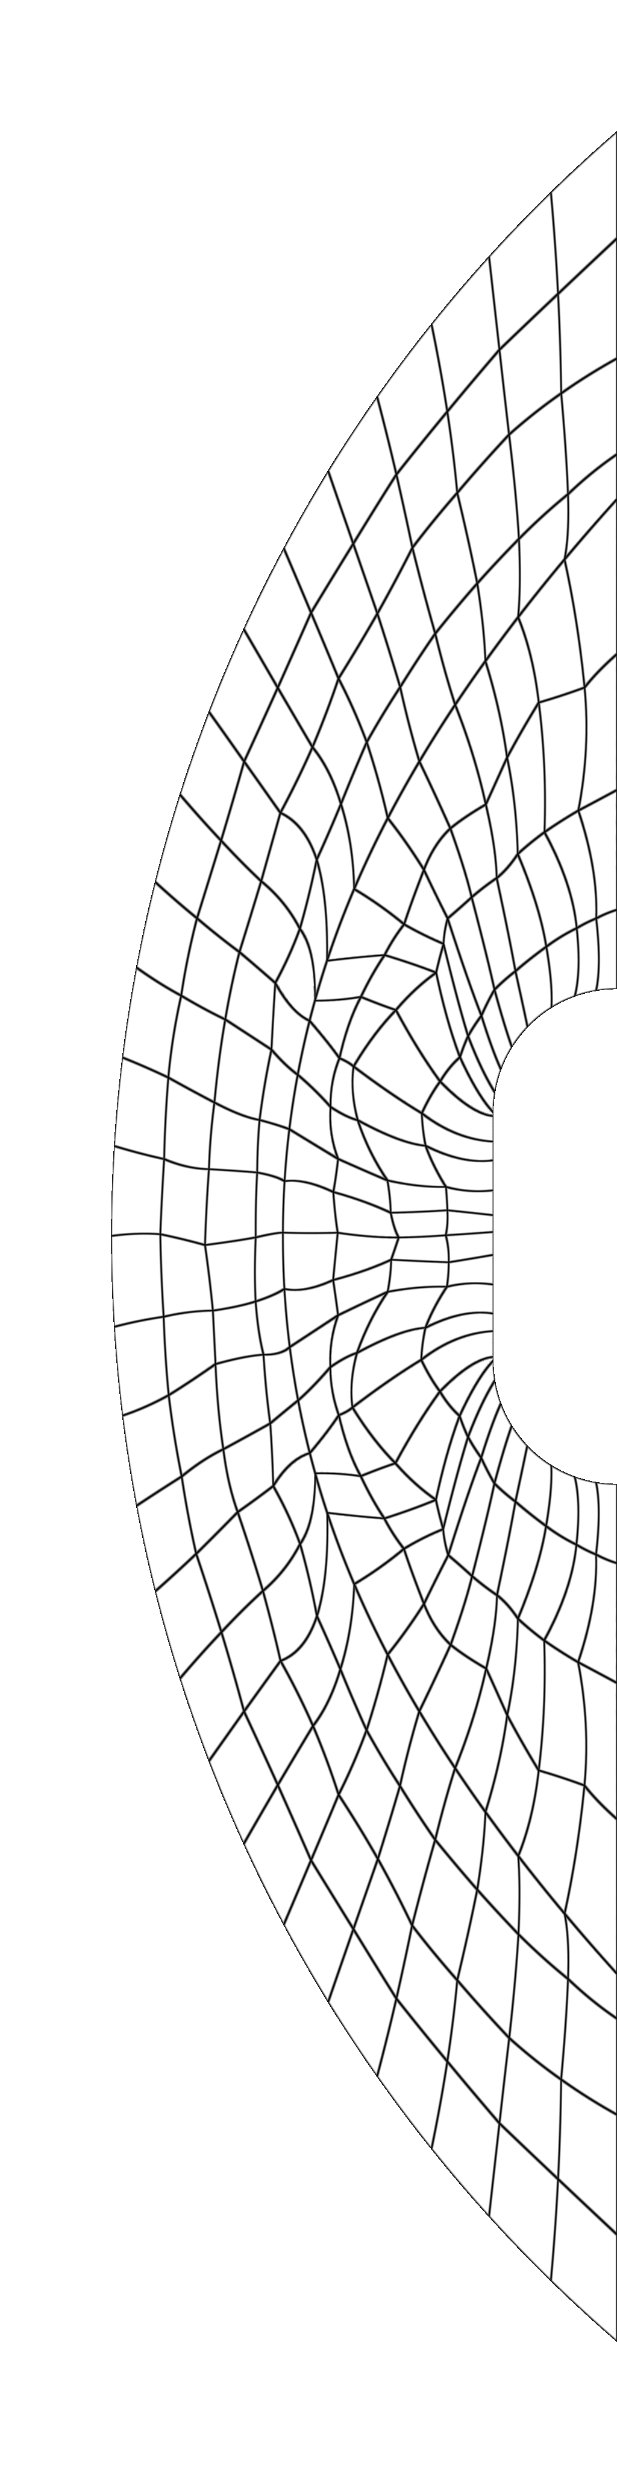
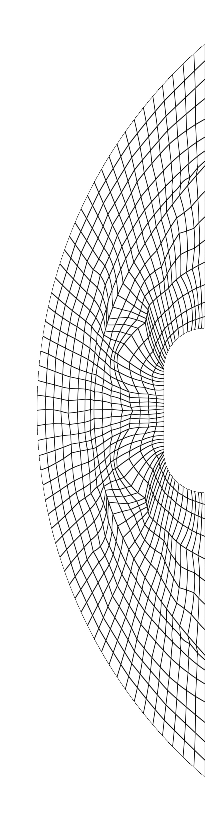
Bow Shock: Grids
MDG-ICE(q=2) isoparametric quadrilateral elements
  First solved for the initial fitted grid using 56 cells
  Finer grid solutions were obtained by refining the coarse grid solution and restarting, so that the grid continues to move
Points move along the boundaries, constrained by geometric boundary conditions.
  At surface intersections, the points are fixed
56 cells 224 cells 896 cells

Slide 17
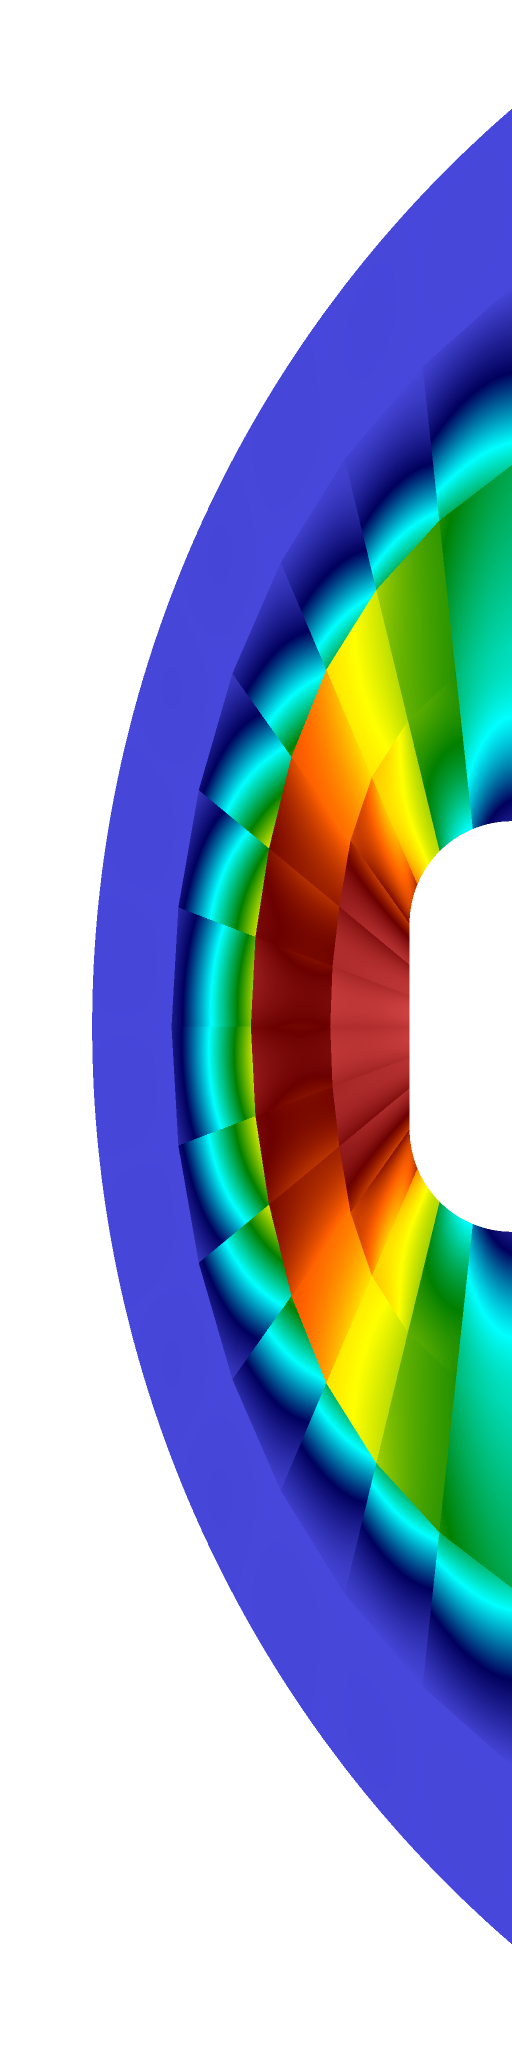
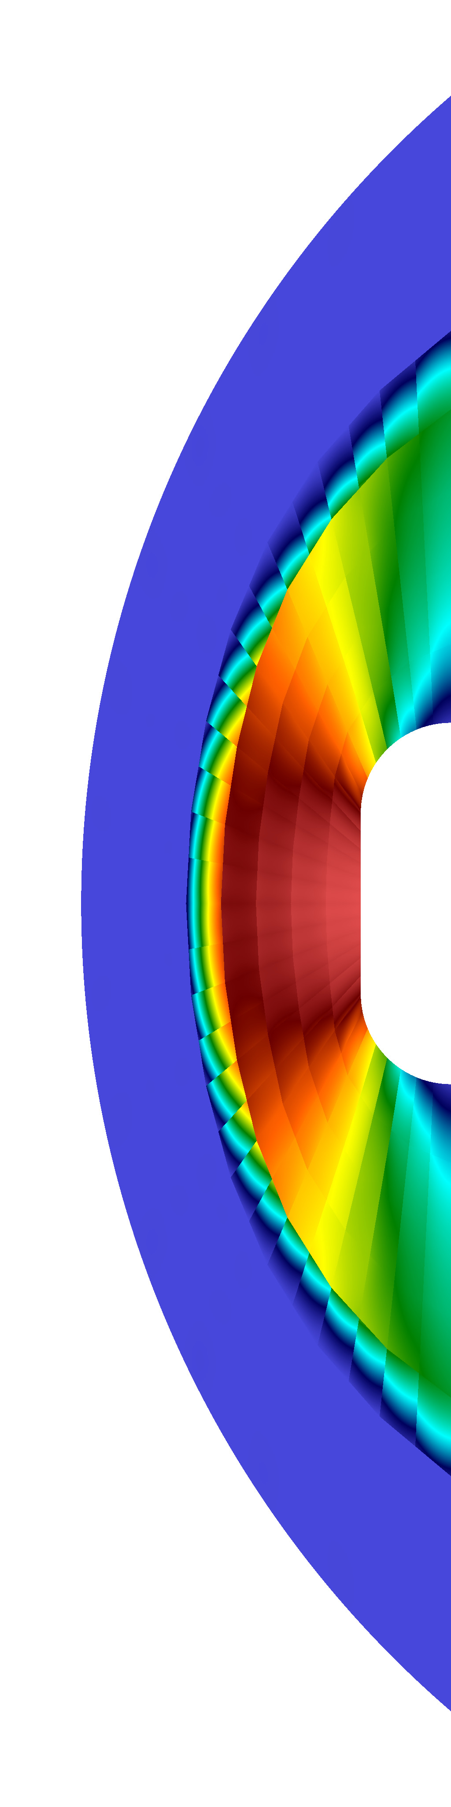
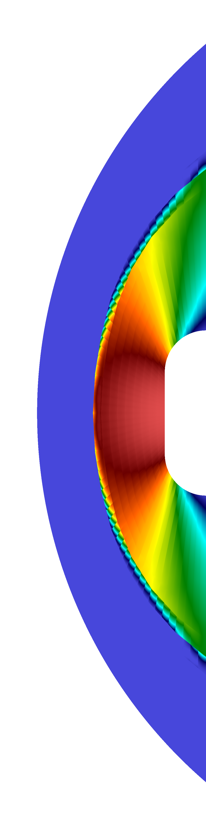

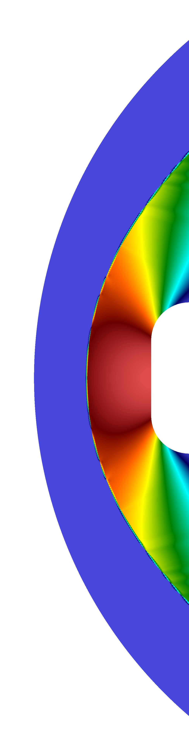
Bow Shock: Pressure
DG(q=2) isoparametric quadrilateral elements with shock capturing
  Plotted range (0,4)
56 cells 224 cells 896 cells 3584 cells 14336 cells

Slide 18
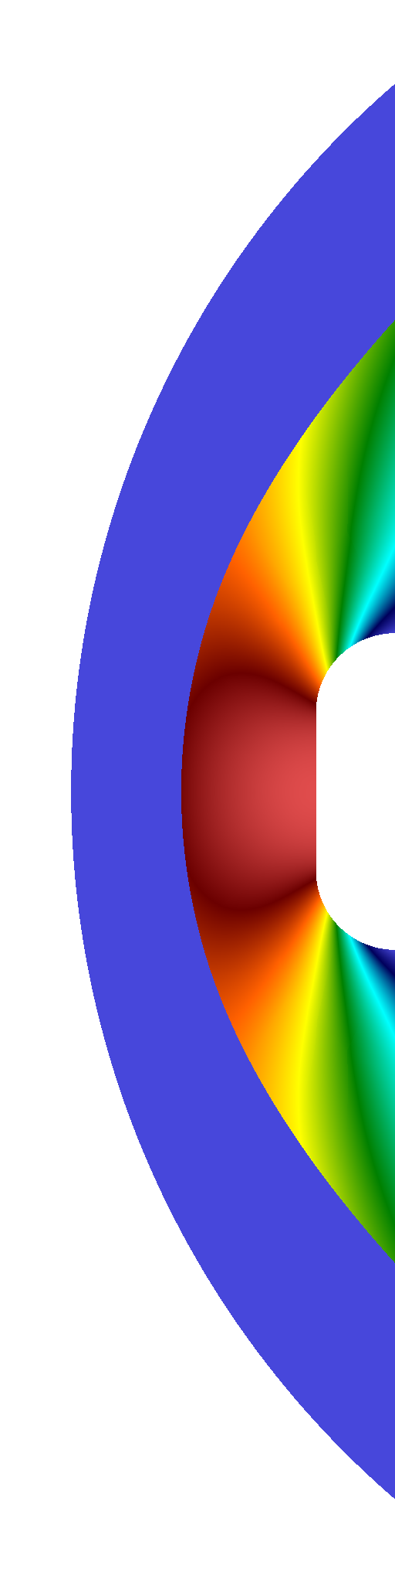
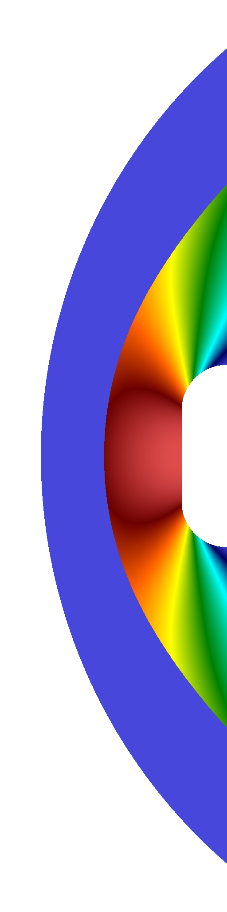
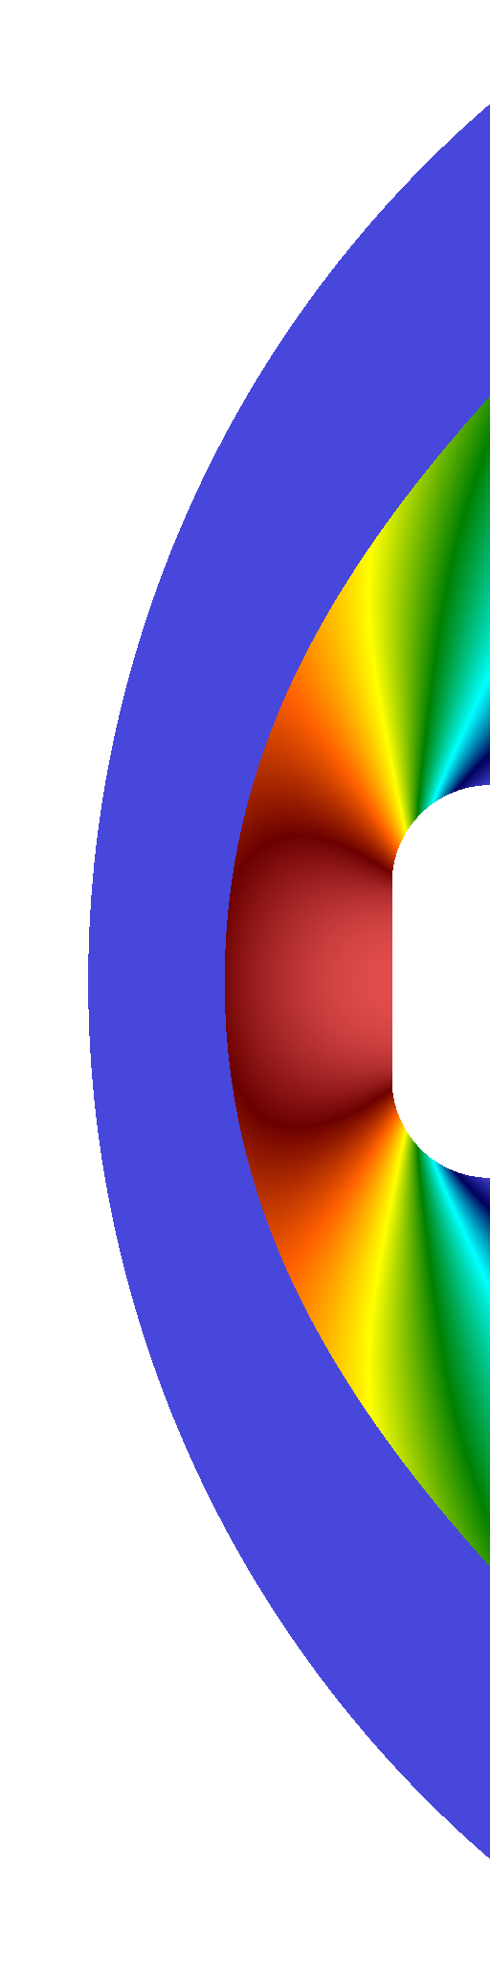
Bow Shock: Pressure
MDG-ICE(q=2) isoparametric quadrilateral elements
  Plotted range (1,21.068)
56 cells 224 cells 896 cells

Slide 19
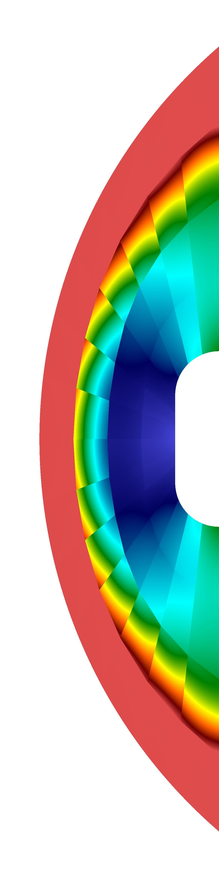
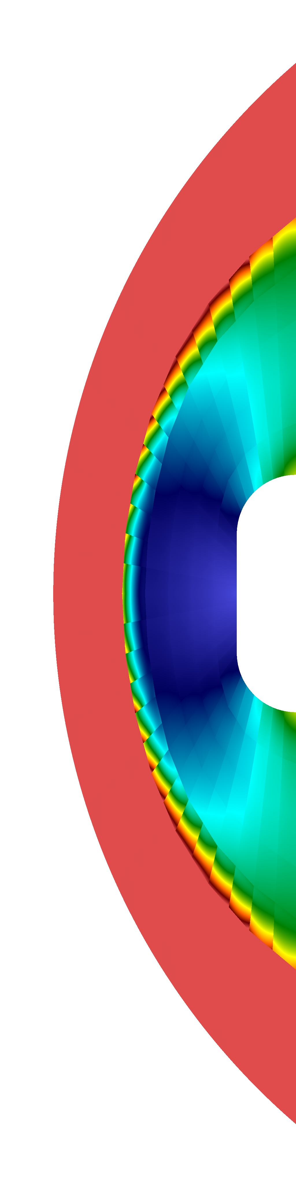

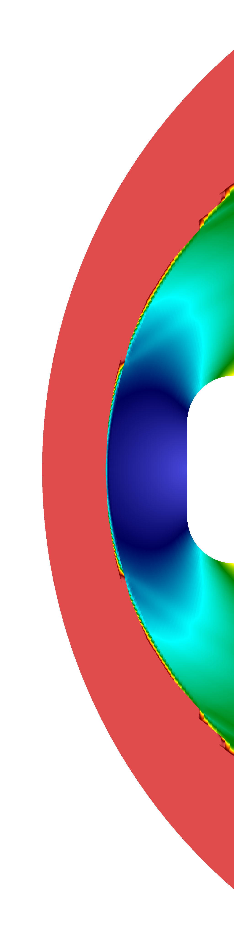

Bow Shock: Mach
DG(q=2) isoparametric quadrilateral elements with shock capturing
  Plotted range (0,4)
56 cells 224 cells 896 cells 3584 cells 14336 cells

Slide 20



Bow Shock: Mach
MDG-ICE(q=2) isoparametric quadrilateral elements
  Plotted range (0,4)
56 cells 224 cells 896 cells

Slide 21
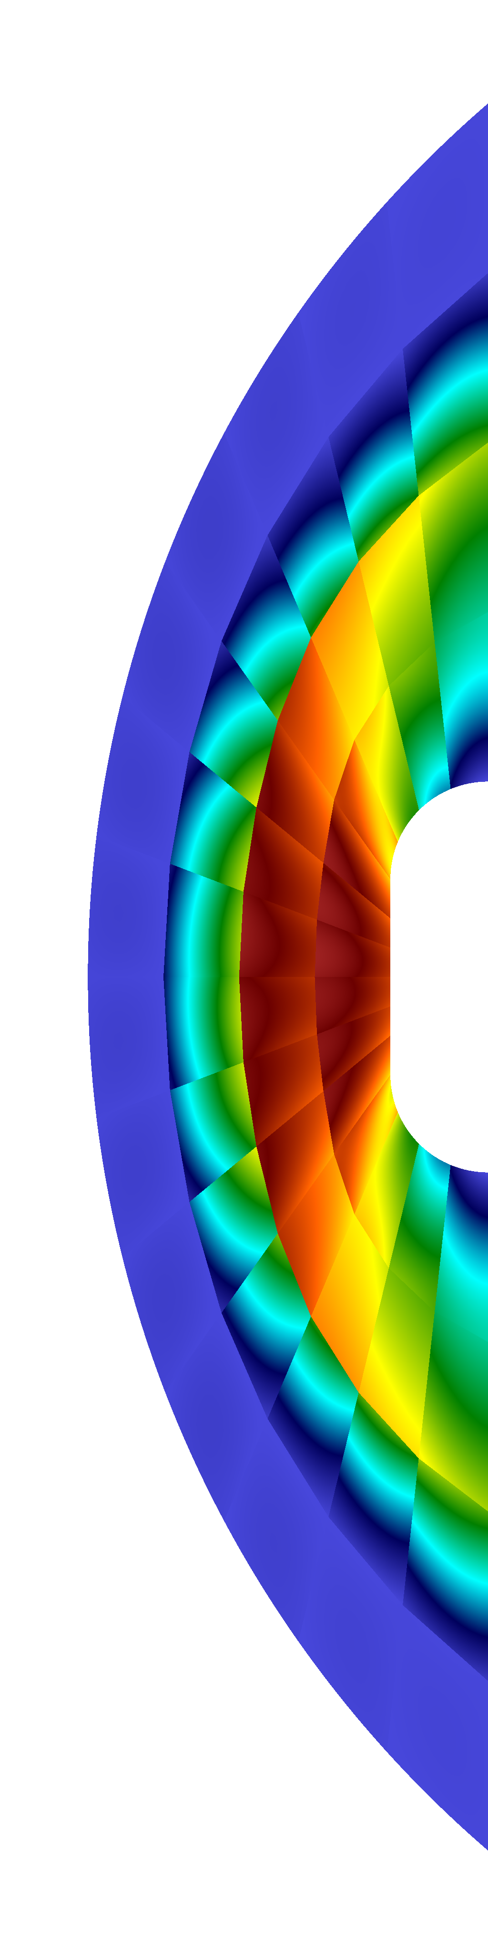
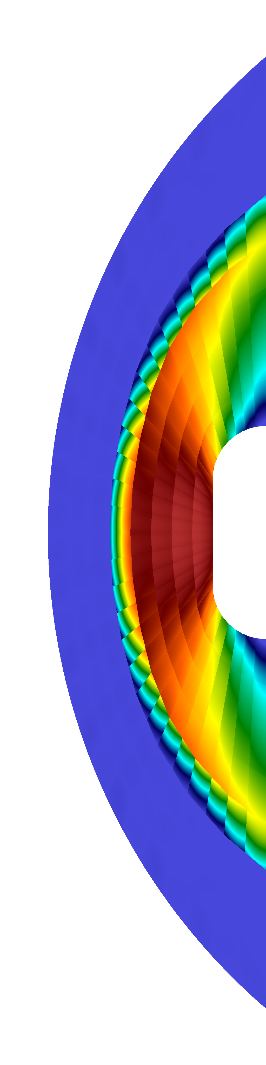
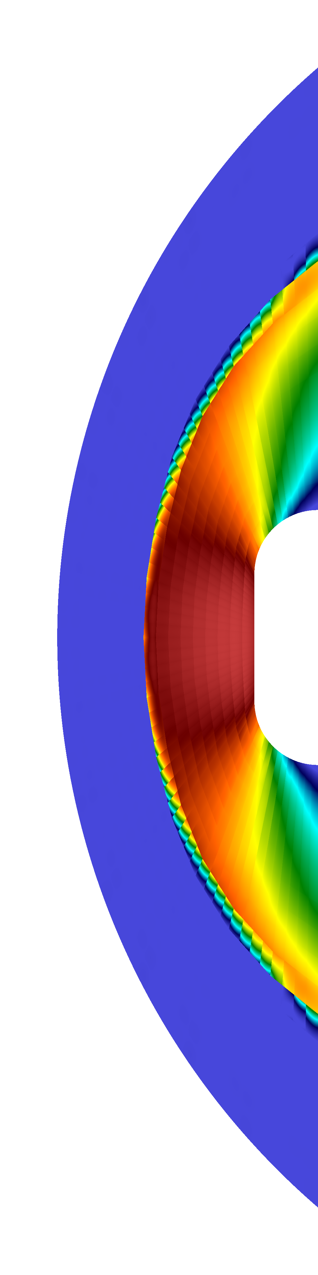
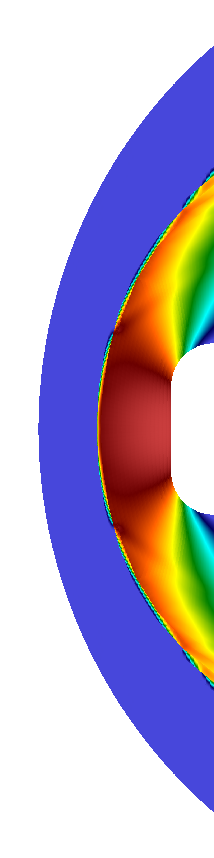
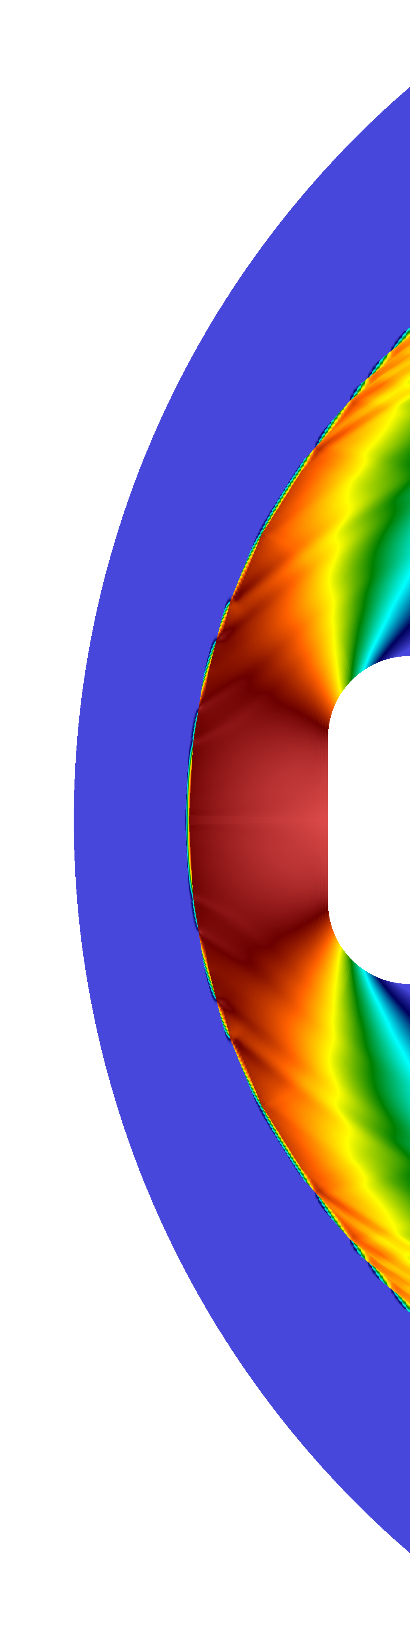
Bow Shock: Density
DG(q=2) isoparametric quadrilateral elements with shock capturing
  Plotted range (1,5.1)
56 cells 224 cells 896 cells 3584 cells 14336 cells

Slide 22
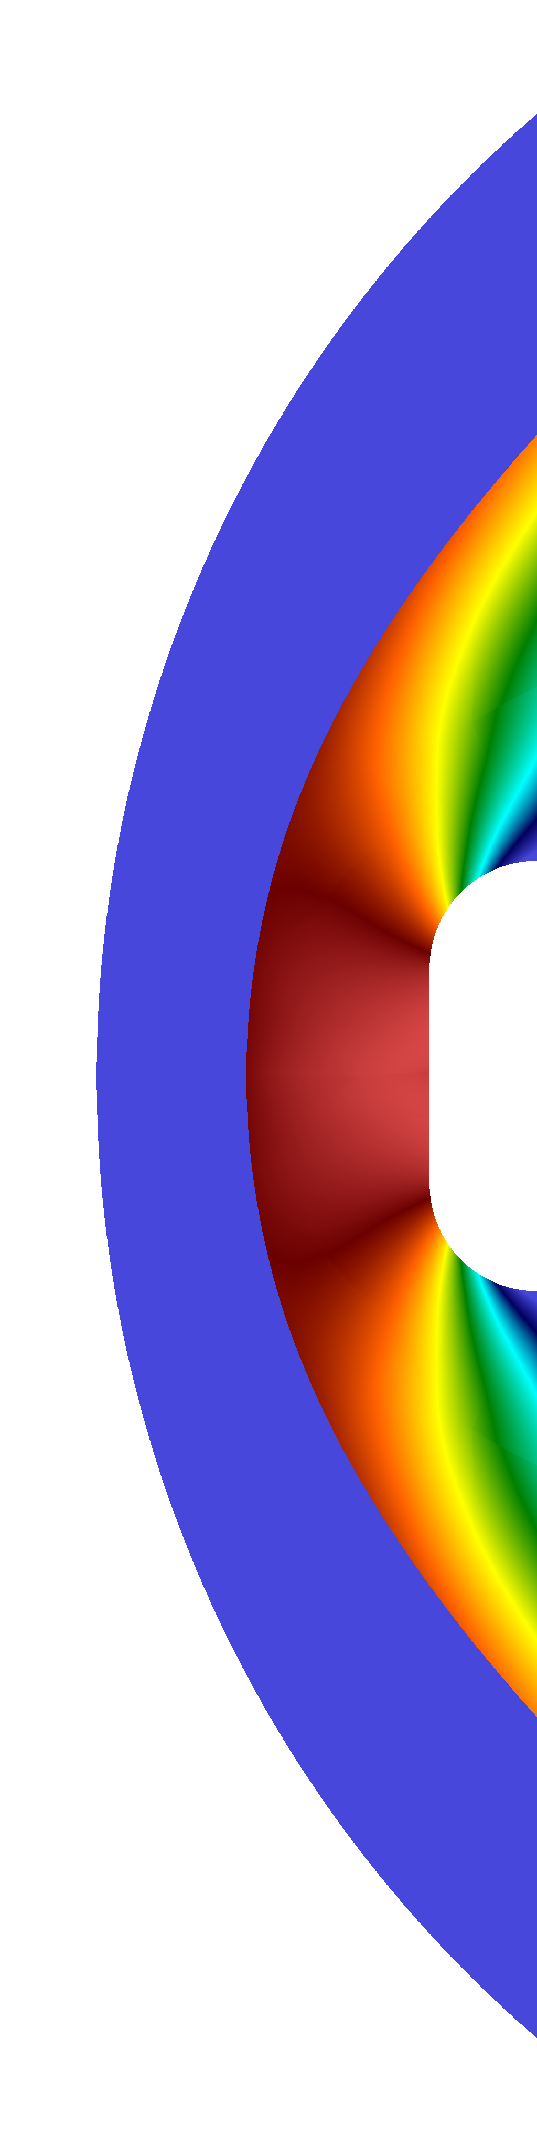
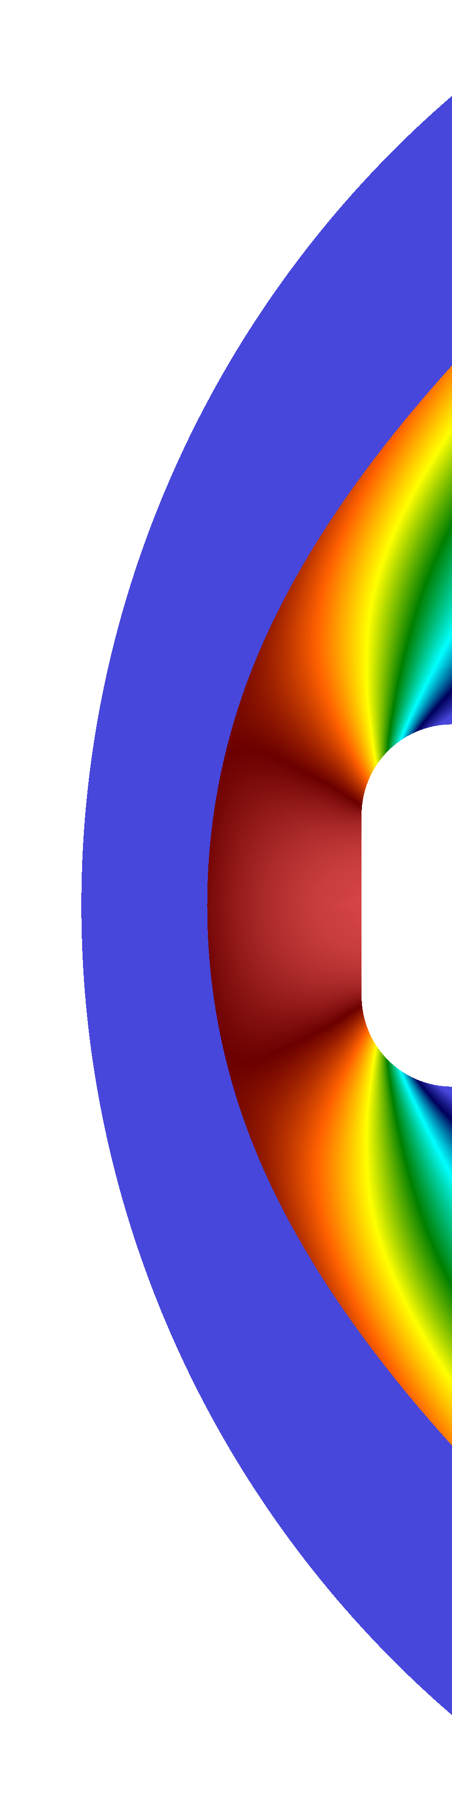
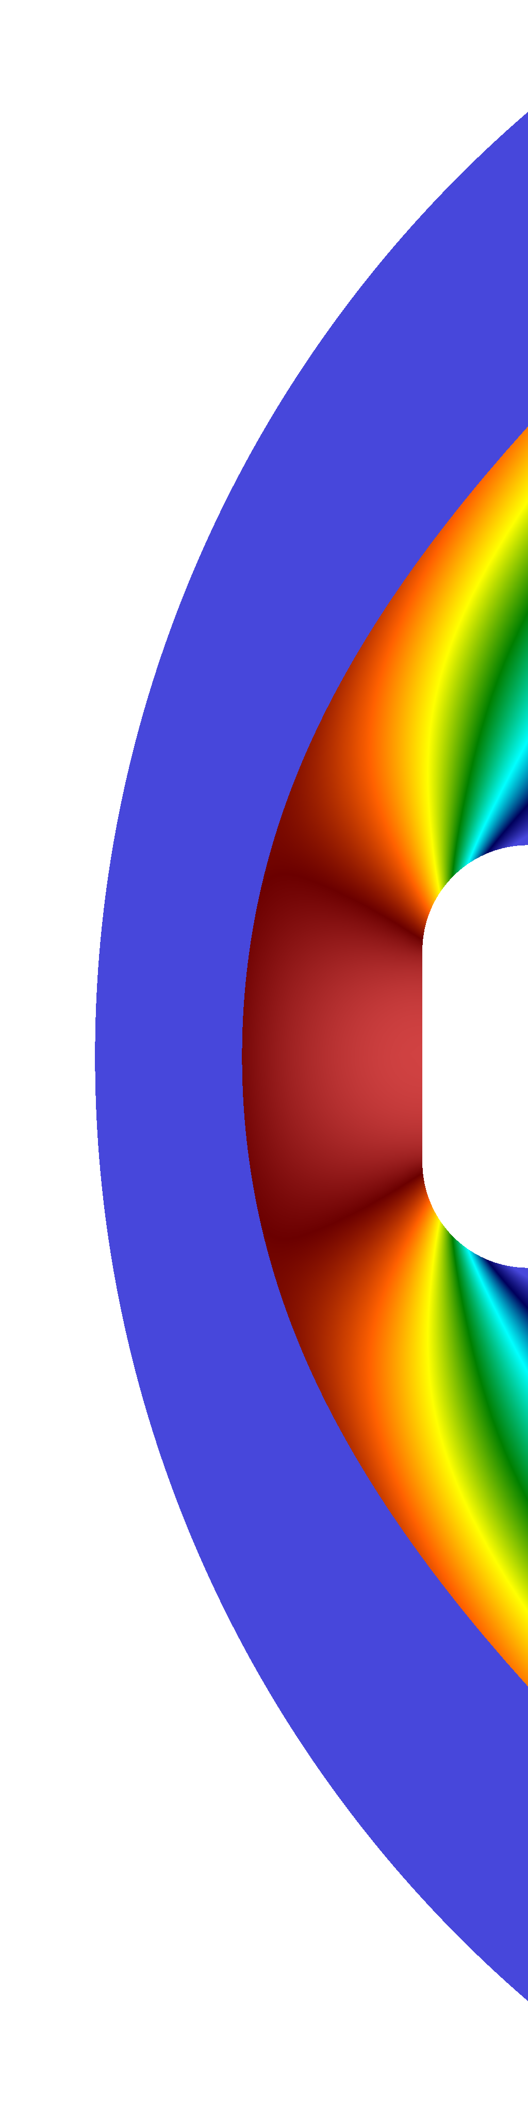
Bow Shock: Density
MDG-ICE(q=2) isoparametric quadrilateral elements
  Plotted range (1,5.1)
56 cells 224 cells 896 cells

Slide 23
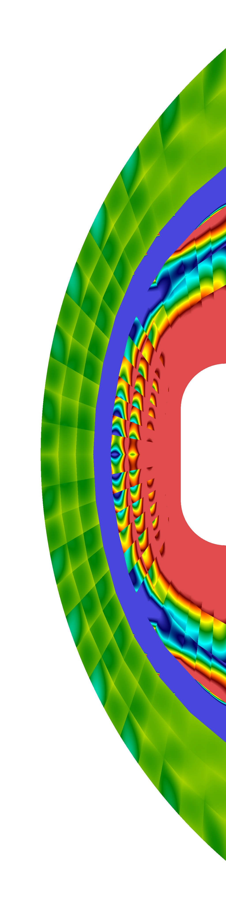
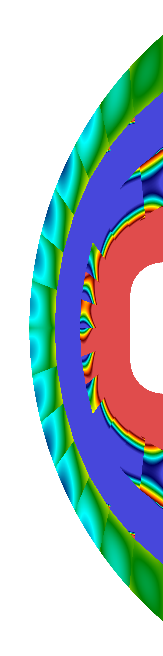
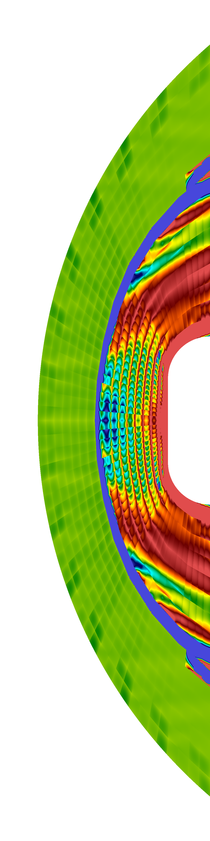
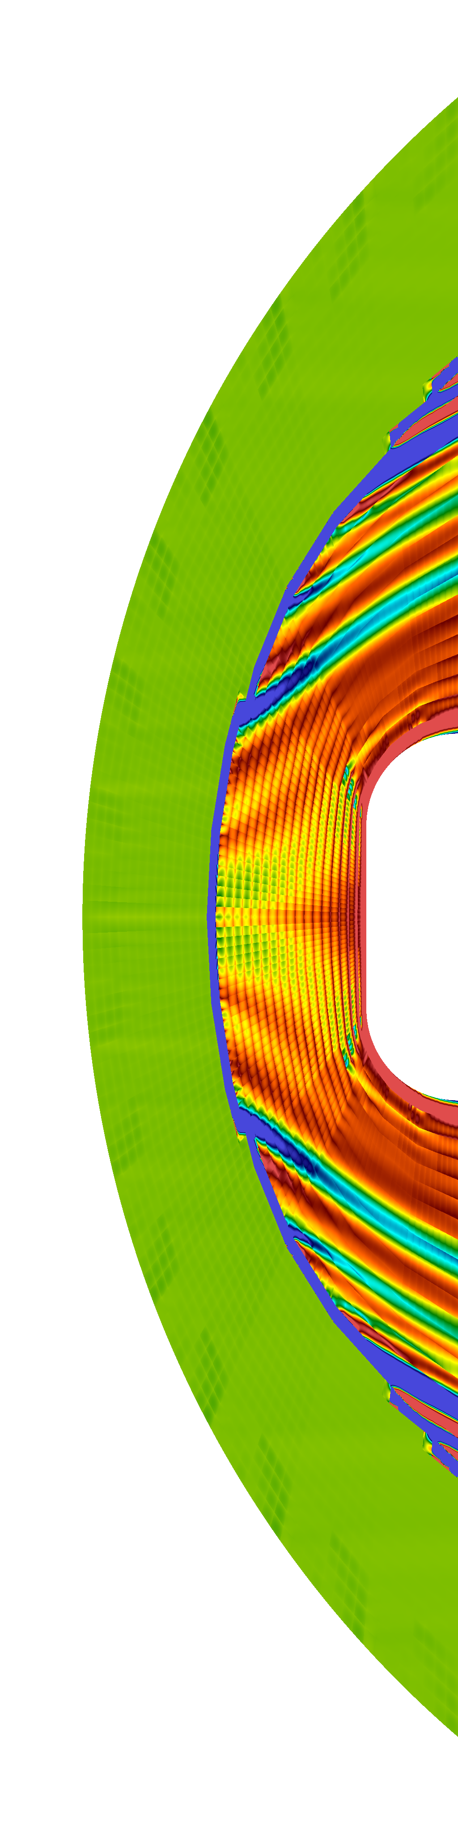

Bow Shock: Stagnation Enthalpy
DG(q=2) isoparametric quadrilateral elements with shock capturing
  Stagnation Enthalpy = 14.7
  Plotted range 14.6,14.8
56 cells 224 cells 896 cells 3584 cells 14336 cells

Slide 24
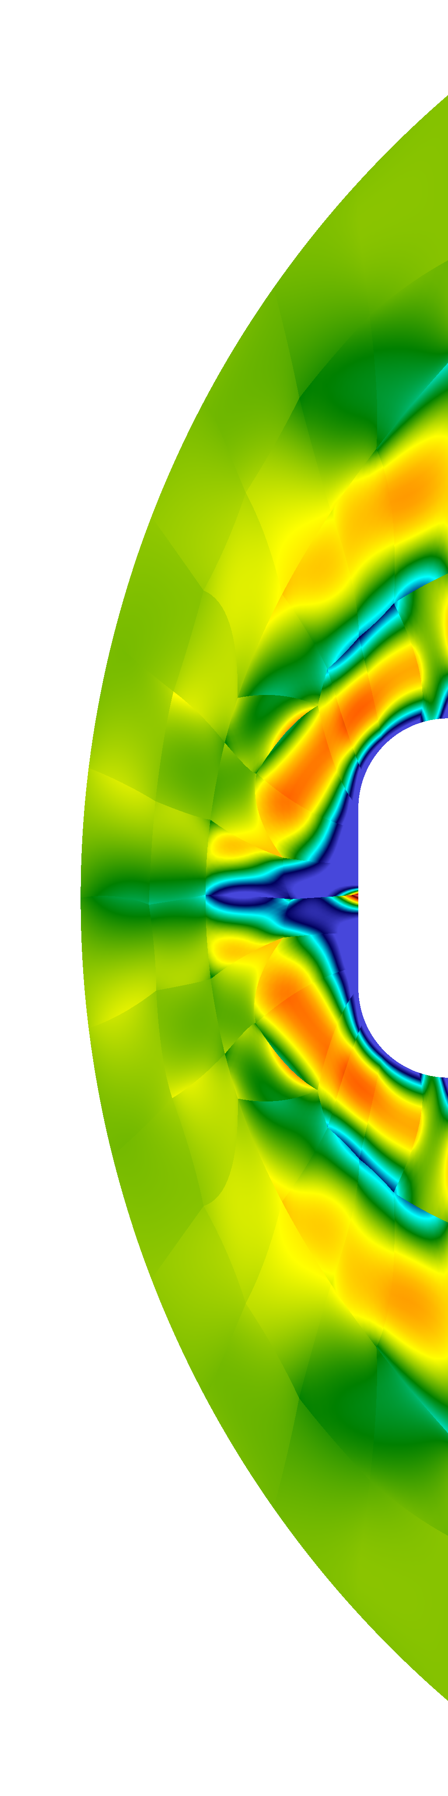


Bow Shock: Stagnation Enthalpy
MDG-ICE(q=2) isoparametric quadrilateral elements
  Stagnation Enthalpy = 14.7
  Plotted range 14.6,14.8
56 cells 224 cells 896 cells

Slide 25
Conclusions
    Were the verification cases helpful and which ones were used?
      The smooth bump test case helped verify the high-order accuracy of the DG method with curved geometry
    What improvements are needed to the test case?
      Nested structured grids might give a better indication of the order of convergence
      Fully unstructured grids would further stress:
        The accuracy of shock capturing schemes
        The robustness of shock fitting schemes.
    Did the test case prompt you to improve your method/solver?
      Yes, we implemented a higher-order flux projection.
    What worked well with your method/solver?
      MDG-ICE fits the curved bow shock with high accuracy on a coarse grid
    What improvements are needed to your method/solver?
      A fast implicit solver: linear solver scalability and efficiency
      Improving the nonlinear Levenberg-Marquardt regularization strategy to optimally balance robustness and efficiency

Slide 26
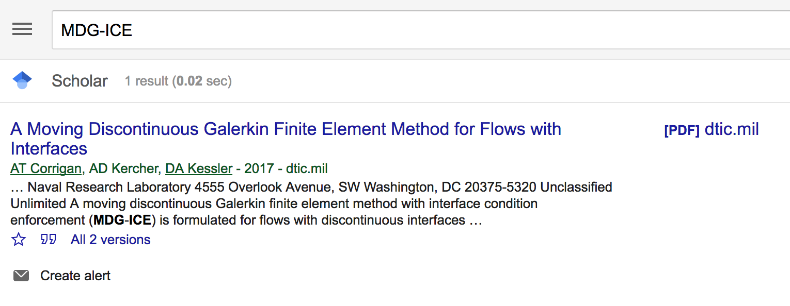
References
    NRL Memo Report / Submitted Manuscript:
      A Moving Discontinuous Galerkin Finite Element Method for Flows with Interfaces
        Google Scholar: MDG-ICE
    AIAA SciTech 2018 Papers
      AIAA-2018-0136. Flow Characteristics of a Recirculating Flameless Combustor Configuration
      AIAA-2018-1247. Jet Noise Simulation using a Higher-Order Discontinuous Galerkin Method
      AIAA-2018-1252. Noise Characteristics of a Supersonic High Aspect Ratio Rectangular Nozzle for Ideally Expanded Jet Flow
      AIAA-2018-1485. A Hybrid DSMC-discontinuous Galerkin finite element method for rarefied gas flows
www.dtic.mil/docs/citations/AD1042881

