Slide 1
CI2 – Inviscid Strong Vortex-Shock Wave Interaction
Chongam Kim
(with Hojun You, Seonghun Cho)
Department of Mechanical and Aerospace Engineering
Seoul National University, Korea
Jan. 6-7, 2018

Slide 2
Introduction

Slide 3
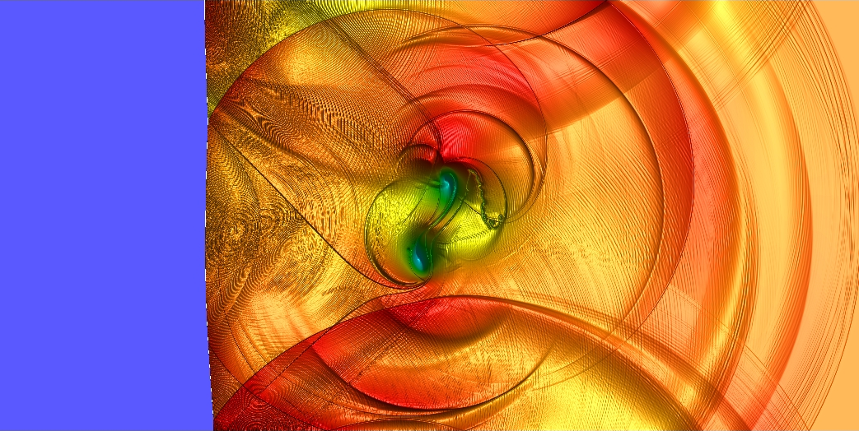
Problem Description
Test objective
  Capability of capturing unsteady compressible flow physics qualitatively
    Post-shock vortical structure due to compression effects
    Propagation of discontinuous waves and cylindrical acoustic waves
  Attempts to evaluate unsteady flow solution quantitatively
    Quantification of monotonicity across shock
    Quantification of discrete shock-driven numerical oscillations
    Evaluation of error and order-of-accuracy in post-shock region
CI2 – Density Contour of Reference Solution

Slide 4

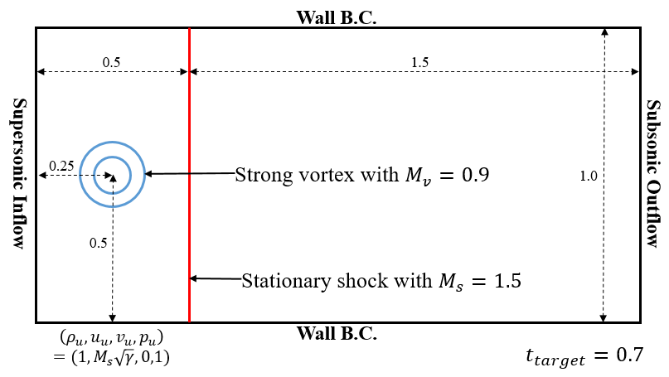
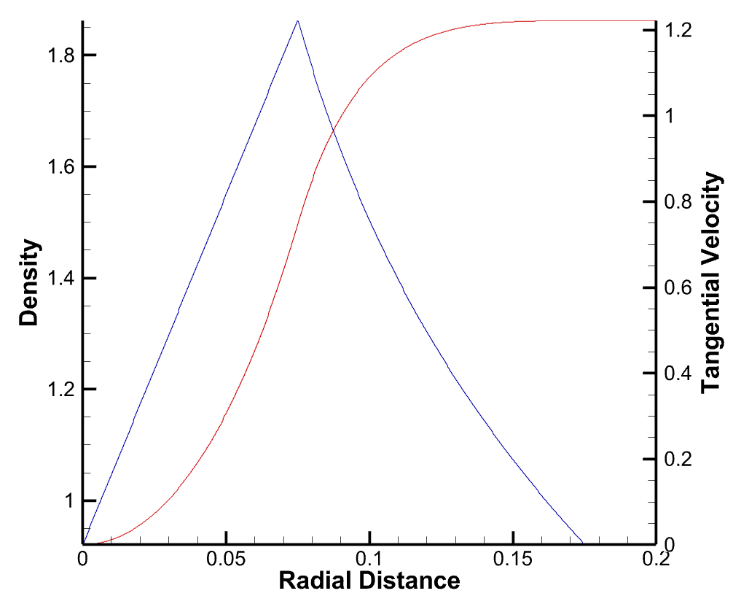



Problem Description
Initial condition
  Non-dimensional 2-D Euler equations with EOS for ideal gas
  Initially, the flow field contains a stationary shock and a strong vortex located in upstream.
  Composite vortex with C⁰-continuous angular velocity and C¹-continuous density profiles
  $M_{v}=v_{m}/\sqrt{γ}$ as a measure of the vortex strength
$$\frac{v_{θ}}{v_{m}}=\left\{\begin{aligned}\frac{r}{a} if r≤a, \\ \frac{a}{a^{2}−b^{2}}\left(r−\frac{b^{2}}{r}\right) if a<r≤b, \\ 0 if r>b.\end{aligned}\right.$$
※ $\left(a,b\right)=(0.075, 0.175)$
Composite Vortex Model

Slide 5
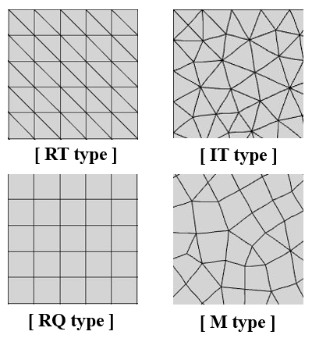
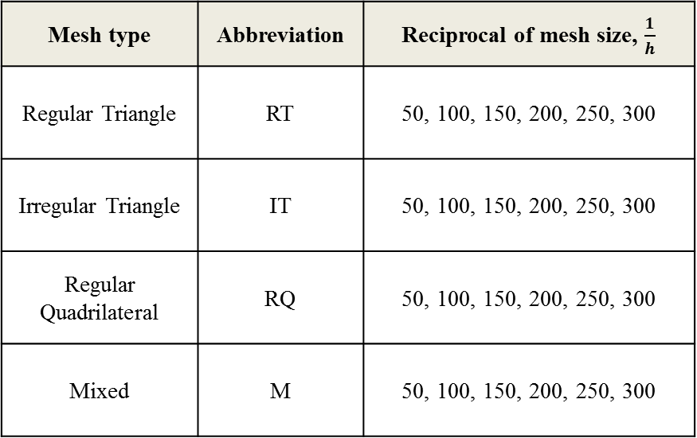
Problem Description
Grid definition
  Rule of mesh naming: Abbreviation of mesh type-Reciprocal of mesh size
    Ex) RT50, RQ100, etc.
Mesh type | Abbreviation | Reciprocal of mesh size, $\frac{1}{h}$
Regular Triangle | RT | 50, 100, 150, 200, 250, 300
Irregular Triangle | IT | 50, 100, 150, 200, 250, 300
Regular Quadrilateral | RQ | 50, 100, 150, 200, 250, 300
Mixed | M | 50, 100, 150, 200, 250, 300

Slide 6
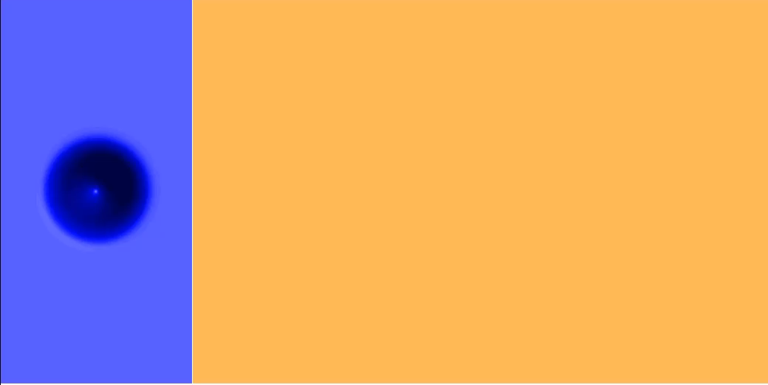
Problem Description
Flow field description
Shock distortion

Slide 7
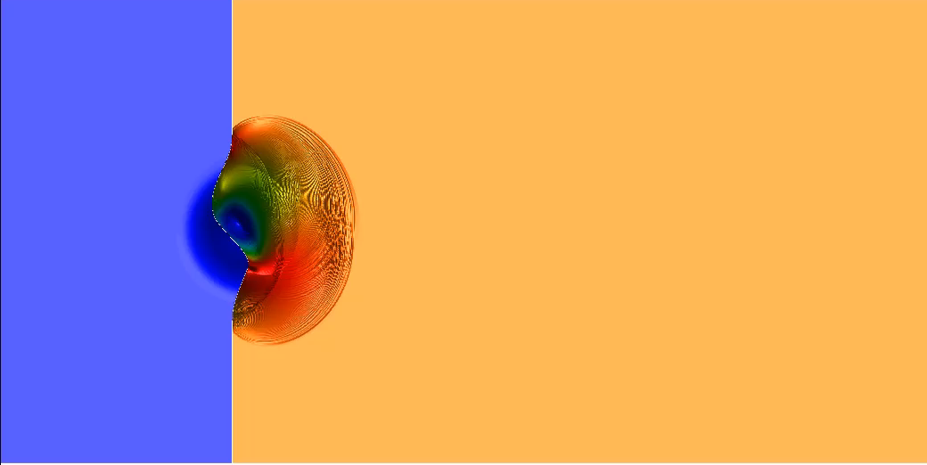
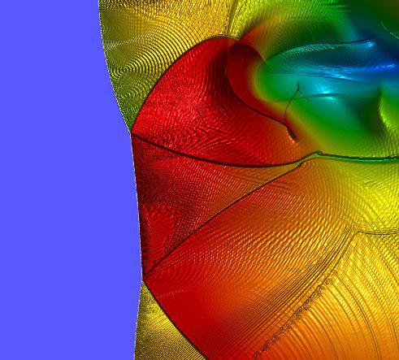
Problem Description
Flow field description
Reflected shock
Slip line
Mach stem

Slide 8
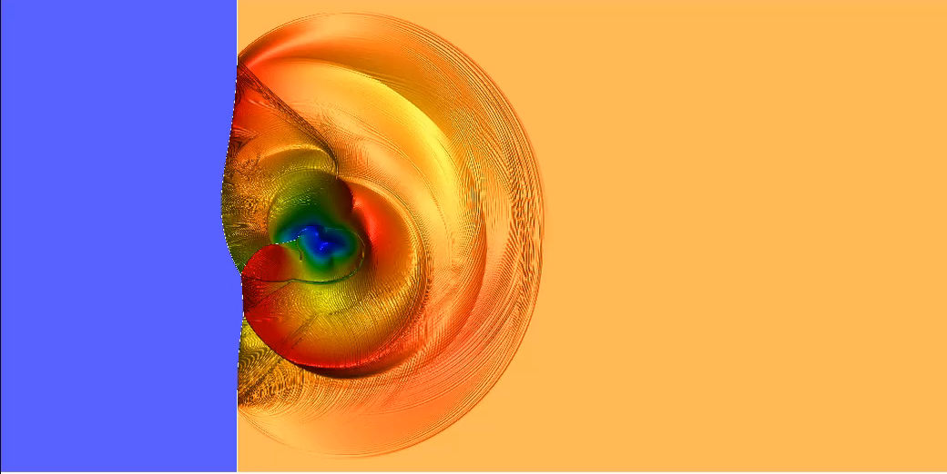
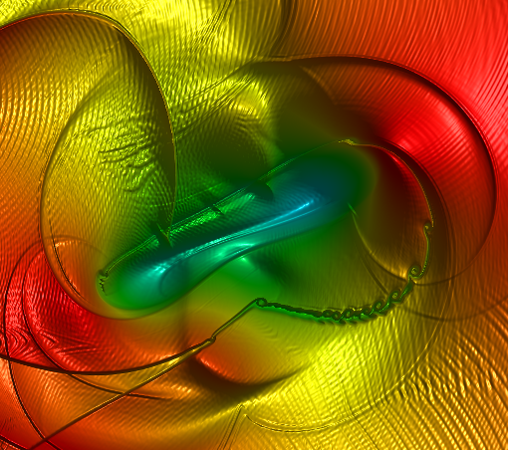
Problem Description
Flow field description
Kelvin-Helmholtz instability

Slide 9
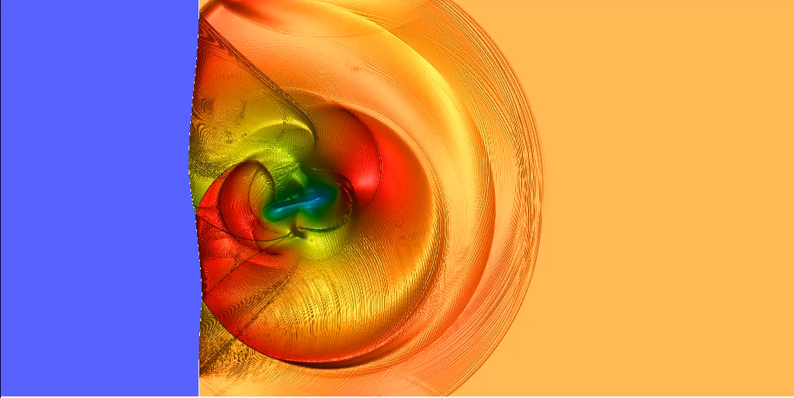
Problem Description
Flow field description
First acoustic wave
Third acoustic wave
Second acoustic wave

Slide 10
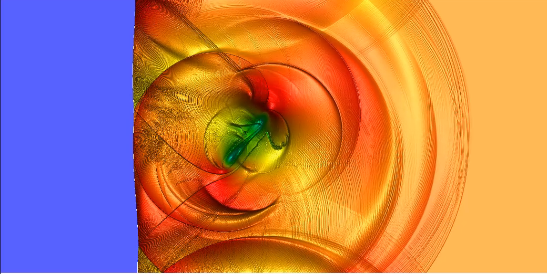
Problem Description
Flow field description
Numerical artifacts
Vortex core splitting

Slide 11
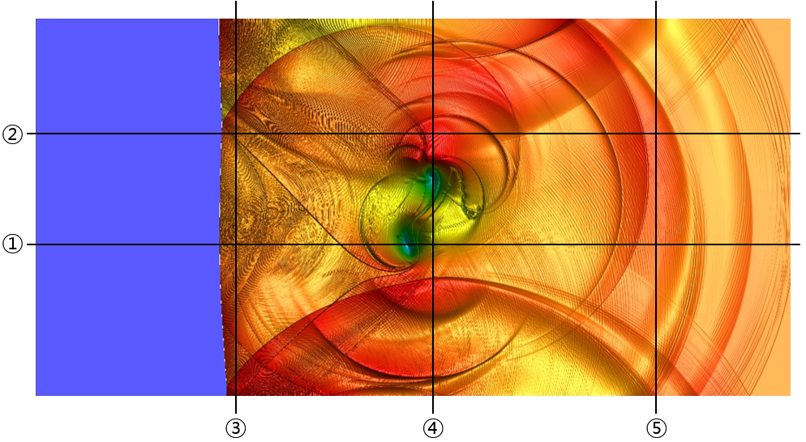






Problem Description
Reference lines for data submission
$$y=0.7+ε$$
$$y=0.4+ε$$
$$x=0.52+ε$$
$$x=1.05+ε$$
$$x=1.65+ε$$
Num. | ① | ② | ③ | ④ | ⑤
Physical meaning | Stationary shock & vortex center | Stationary shock | Right after stationary shock | Vortex center | Far downstream
※ $ε=1×{10}^{−4}$ is to avoid the cell interfaces.

Slide 12
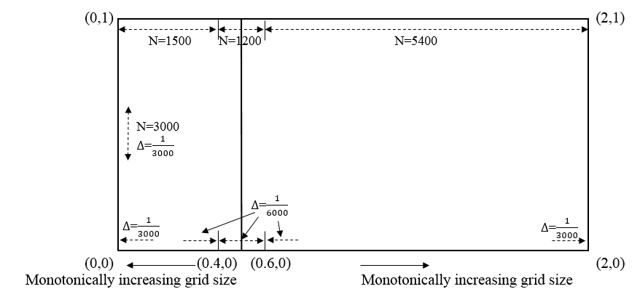

Reference Solution
Setting the reference solution
  Reference solution is computed by FVM on extremely fine meshes.
    Ref1000: Number of cells = 2,700,000 / $h_{min}=1/2000$
    Ref2000: Number of cells = 10,800,000 / $h_{min}=1/4000$
    Ref3000: Number of cells = 24,300,000 / $h_{min}=1/6000$
    $⇒$ The result with Ref3000 mesh is adopted as the reference solution.
    FVM solver with Roe flux / 3rd-order TVD-RK for spatial- / temporal-discretization,
    and MLP5 limiter for shock-capturing
Ref3000 Mesh

Slide 13
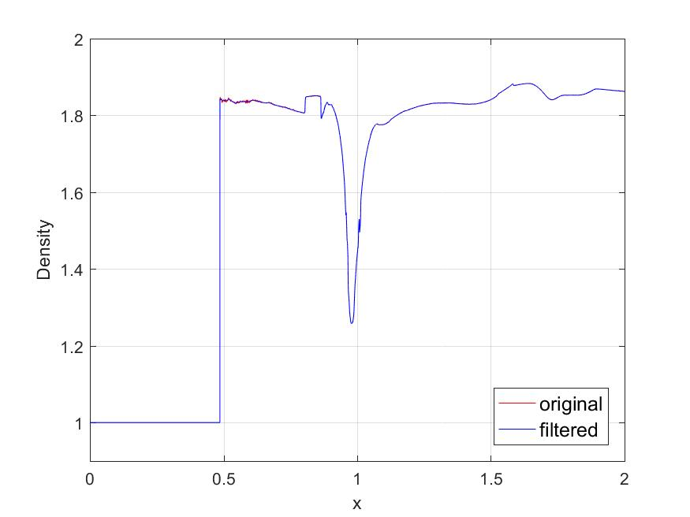
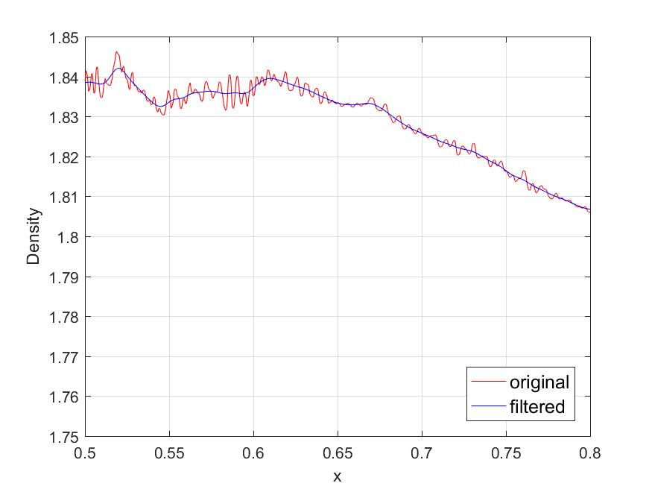

Reference Solution
Removal of non-physical oscillations with filtering technique
  Low-pass filter is applied to some reference lines.
    Gaussian filtering is applied to Line 1~3 where non-physical oscillations/noises occur noticeably.
      Filtering is locally applied by considering the amplitude of local non-physical oscillations.
      Cut-off frequency where the response value becomes $\exp\left(−0.5\right)≈0.607$ is locally determined as 3~5 times of noticeable oscillatory frequency from FFT results.
      Saturation phenomenon is not observed during grid refinement test using the filtered reference solution.
    Conservation laws are still satisfied when the low-pass filter is applied.
Density Distribution along Line 1

Slide 14




Verification Test (VI1 – Inviscid Convected Vortex)
Inviscid isentropic Taylor vortex is transported by uniform flow for 50 periods.
Two types of freestream conditions
  Slow: Mach number = 0.05
  Fast: Mach number = 0.5
Results
  L2-norm error vs. Length scale
  L2-norm error vs. Time unit
Four types of meshes
  Regular triangle
  Regular quadrilateral
  Randomly perturbed regular triangle
  Randomly perturbed regular quadrilateral

Slide 15
Participants
University of Kansas
  FR/CPR method[1] with P2 and P3 approximations
  Explicit TVD-RK3
  SMOOTH limiter[2]
  Roe solver
University of Michigan
  DG method with P1 and P3 approximations
  Explicit RK4 for CI2 and VI1-P1 / Explicit 8th-order 13-stage RK for VI1-P3
  PDE-based artificial dissipation method[3] (with BR2 method)
  SLAU2 Riemann solver[4] on RQ-P1 / Roe solver for the others
  ICB-N method[5] for recovery on RQ
Seoul National University
  DG method with P1, P2 and P3 approximations
  Explicit TVD-RK3 for P1 and P2 / Explicit 4th-order 5-stage SSP-RK for P3
  hMLP[6] and hMLP_BD limiter[7] (tagged as SNU1 and SNU2 in the following figures)
  Local Lax-Friedrich flux for VI1 / Roe solver for CI2

Slide 16
Participants
University of Kansas
  VI1
    Total 20 (Slow vortex) cases
      No limiter and SMOOTH limiter
      P2 and P3 approximations on RQ meshes with 1/h = 16, 32, 64, 128, 256
University of Michigan
  VI1
    Total 28 (Slow vortex) + 32 (Fast vortex) cases
      PDE-based artificial dissipation
      P1 and P3 approximations on RQ, RT, rpRQ and rpRT meshes with 1/h = 16, 32, 64, 128, 256
Seoul National University
  VI1
    Total 76 (Slow vortex) + 81 (Fast vortex) cases
      No limiter, hMLP and hMLP_BD limiters
      P1, P2 and P3 approximations on RQ and RT meshes with 1/h = 16, 32, 64, 128, 256
  CI2
    Total 12 cases
      SMOOTH limiter
      P2 and P3 approximations on RQ meshes with 1/h = 50, 100, 150, 200, 250, 300
  CI2
    Total 18 cases
      PDE-based artificial dissipation
      P1 and P3 approximations on IT and RQ meshes with 1/h = 50, 100, 150, 200, 250, 300
  CI2
    Total 96 cases
      hMLP and hMLP_BD limiters
      P2 and P3 approximations on RT, IT, RQ and M meshes with 1/h = 50, 100, 150, 200, 250, 300

Slide 17
References
[1] Z. J. Wang and H. Gao. "A unifying lifting collocation penalty formulation including the discontinuous Galerkin, spectral volume/difference methods for conservation laws on mixed grids." Journal of Computational Physics 228.21 (2009): 8161-8186.
[2] Y. Li and Z. J. Wang. "A convergent and accuracy preserving limiter for the FR/CPR method." 55th AIAA Aerospace Sciences Meeting. 2017.
[3] J. Reisner, J. Serencsa and S. Shkoller. "A space–time smooth artificial viscosity method for nonlinear conservation laws." Journal of Computational Physics 235 (2013): 912-933.
[4] K. Kitamura and E. Shima. "Towards shock-stable and accurate hypersonic heating computations: A new pressure flux for AUSM-family schemes." Journal of Computational Physics 245 (2013): 62-83.
[5] P. Johnson, To be presented at 2018 SciTech meeting.
[6] J. S. Park and C. Kim. "Higher-order multi-dimensional limiting strategy for discontinuous Galerkin methods in compressible inviscid and viscous flows." Computers & Fluids 96 (2014): 377-396.
[7] H. You and C. Kim. "Higher-Order Multi-Dimensional Limiting Strategy for Subcell Resolution." 23rd AIAA Computational Fluid Dynamics Conference. 2017.

Slide 18
Summary

Slide 19
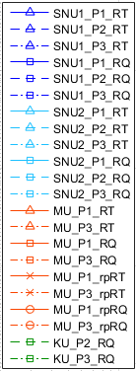

Verification Test (VI1 – Inviscid Convected Vortex)
Slow Vortex ($M=0.05$)

Slide 20

Verification Test (VI1 – Inviscid Convected Vortex)
Fast Vortex ($M=0.5$)

Slide 21
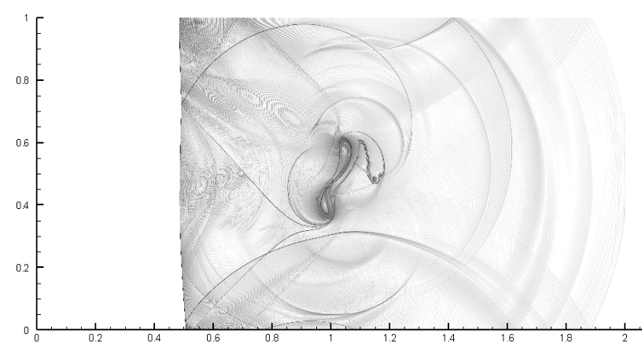
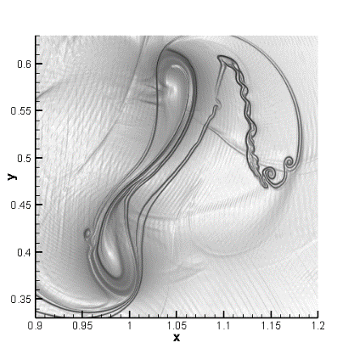
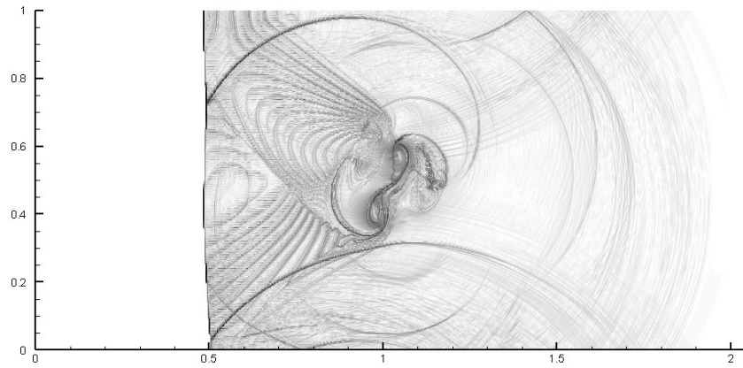
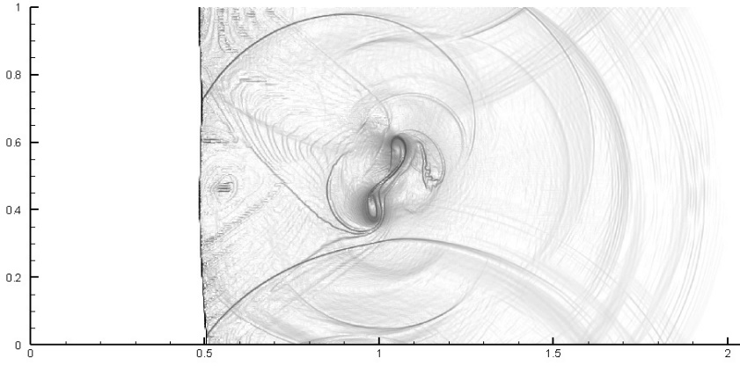
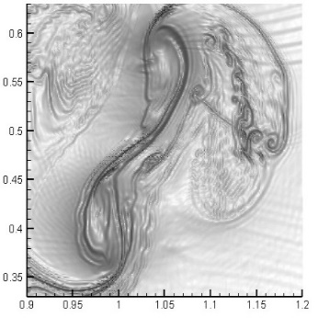
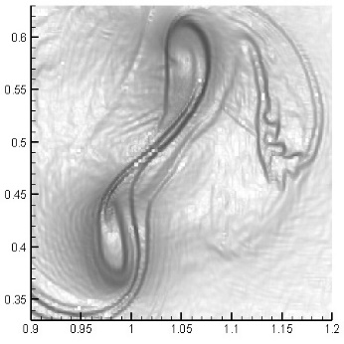
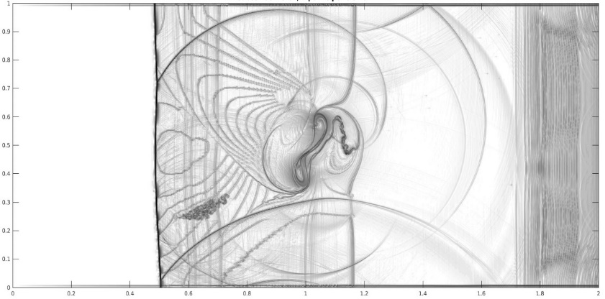
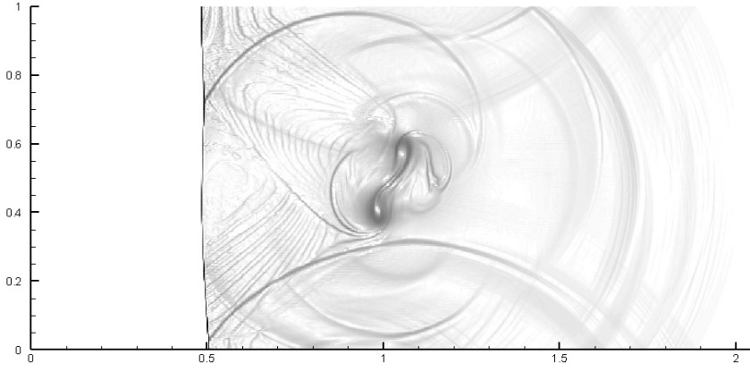
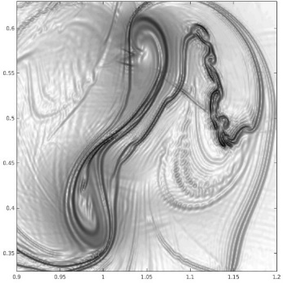

Results (Schlieren View)
Effects of numerical schemes
  Well-resolved flow structures with much less DOFs
    Vortex core splitting
    Complex shock structure
    Kelvin-Helmholtz instability along slip layer
  Undesirable numerical artifacts
    Shock-driven oscillations
    Small scale wiggles
    Spurious wave structures
Reference
KU_P3_RQ300
SNU1_P3_RQ300
MU_P3_RQ300
SNU2_P3_RQ300

Slide 22
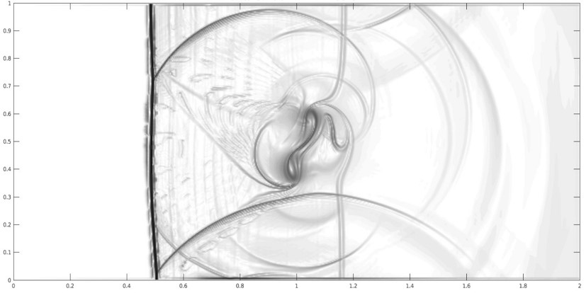
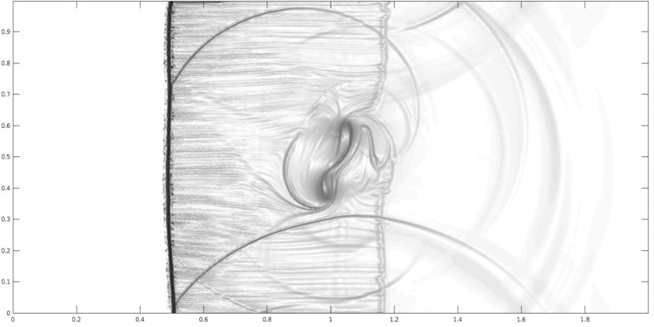
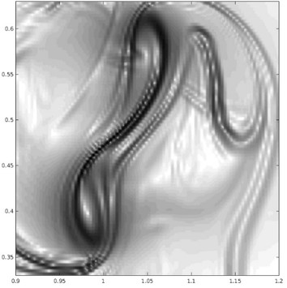
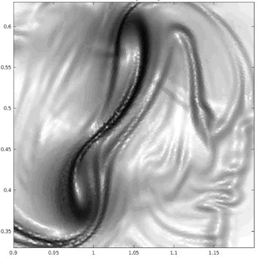
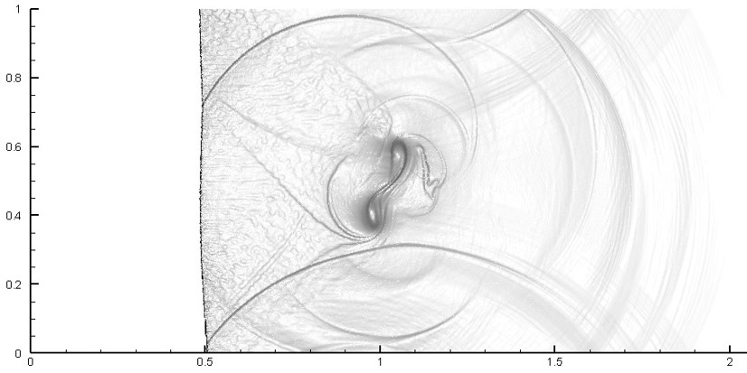
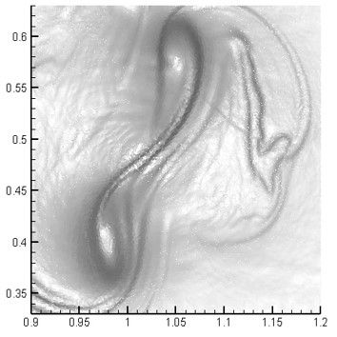
Results (Schlieren View)
Effects of mesh types
Reference
  Large scale flow structure is still captured.
    Higher resolution with IT meshes results from the
    increase of DOF.
  Mesh type dependence of numerical artifacts
    Shock-driven oscillation patterns
MU_P1_RQ300
MU_P1_IT300
SNU2_P3_RQ300
SNU2_P3_IT300

Slide 23
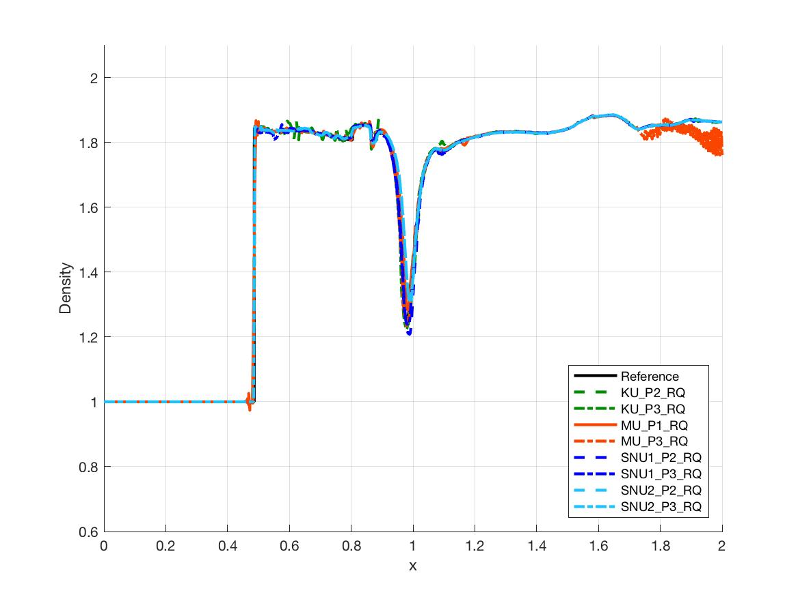
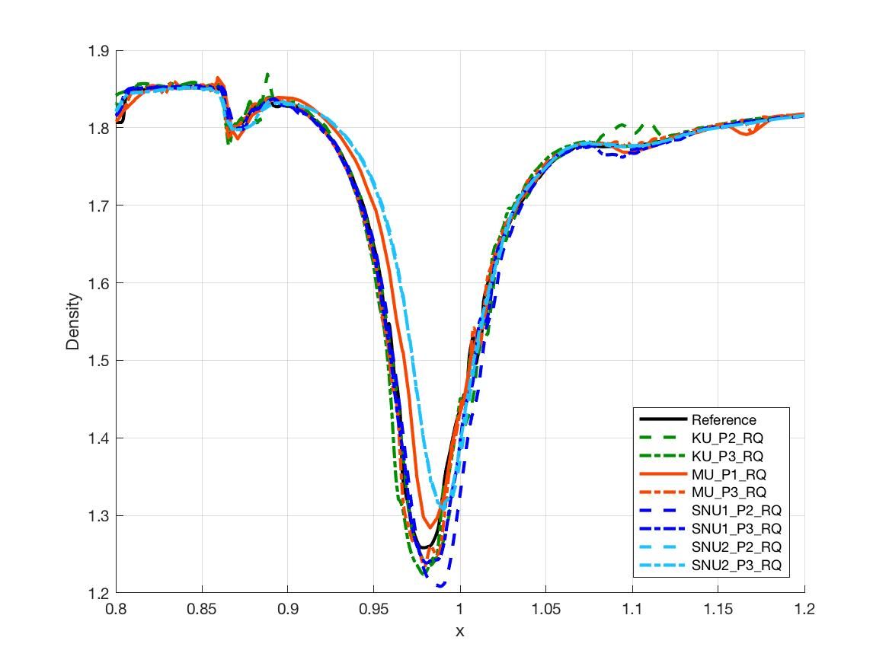
Results (Line 1)
Well-resolved large scale flow structure along Line 1
  Shock and vortex core are captured.
  Numerical artifacts around the shock and outflow region are clearly shown.
Solution behavior around vortex core
  Location and depth of the vortex core are different with various schemes.
  Some schemes show numerical artifacts that are different from the reference solution.
Line 1 (RQ250)
Line 1 (Vortex Core Close-up)

Slide 24
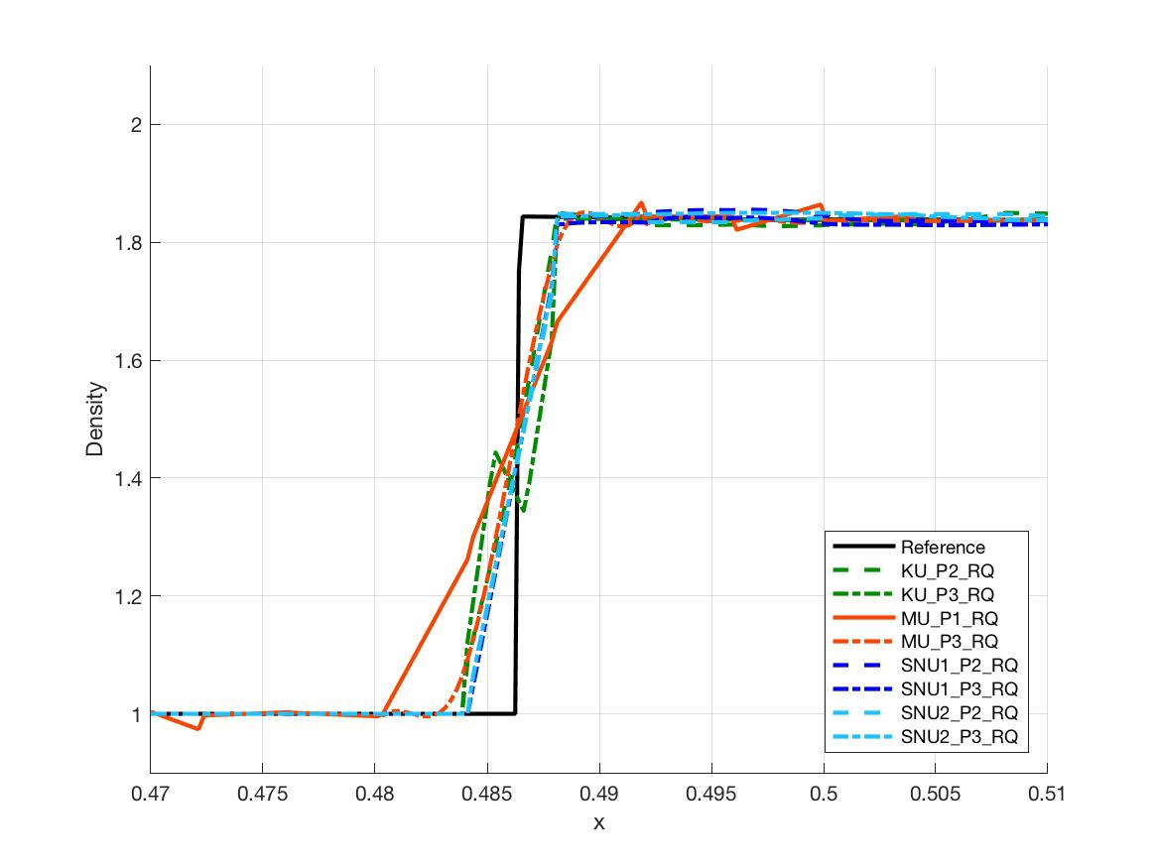

Results (Line 1)
Solution behavior around the stationary shock
  Shock thickness is different with various schemes.
  Monotonicity of the shock may not be satisfied.
Evaluation of shock monotonicity
  Total variation and maximum undershoot normalized by the shock strength on the region containing the shock, $0.47<x<0.5$.
  Non-monotonic shock profile shows either large total variation or large maximum undershoot.
Line 1 (Shock Close-up)
Comparison of Monotonicity across Shock (P3 on RQ meshes)
 |  | KU | MU | SNU1 | SNU2
RQ150 | Total Variation* | 1.069 | 1.452 | 1.099 | 0.9942
 | Max Undershoot* | 2.069E-2 | 1.189E-2 | 7.077E-3 | 3.460E-7
RQ250 | Total Variation* | 1.212 | 1.177 | 0.9995 | 1.000
 | Max Undershoot* | 1.370E-8 | 4.939E-3 | 4.082E-11 | 1.254E-7
*: Normalized by the shock strength ($Δρ≈8.620×{10}^{−1}$)

Slide 25
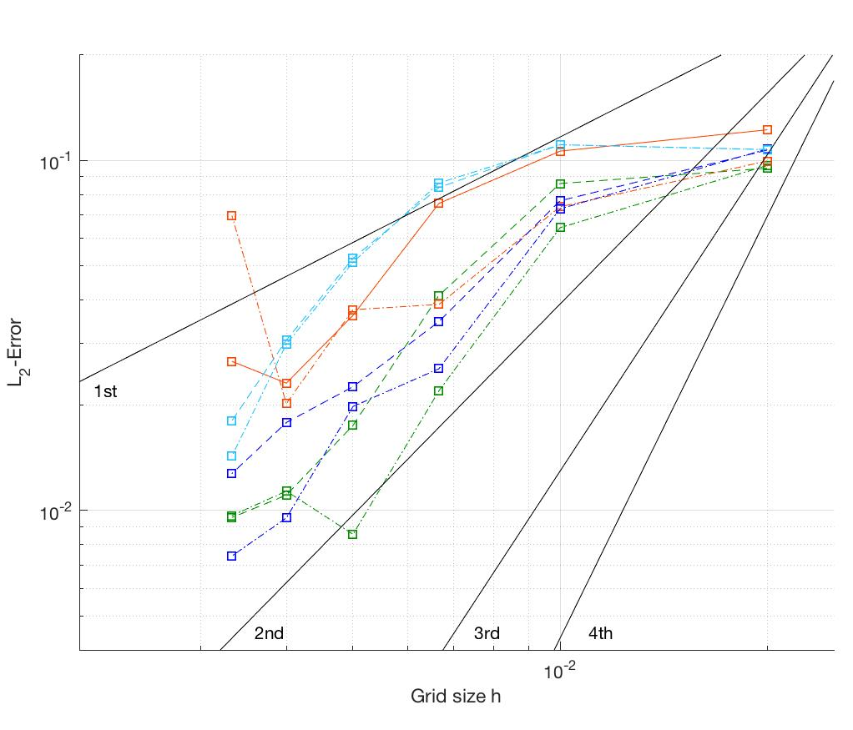
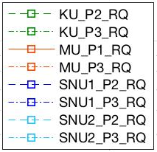
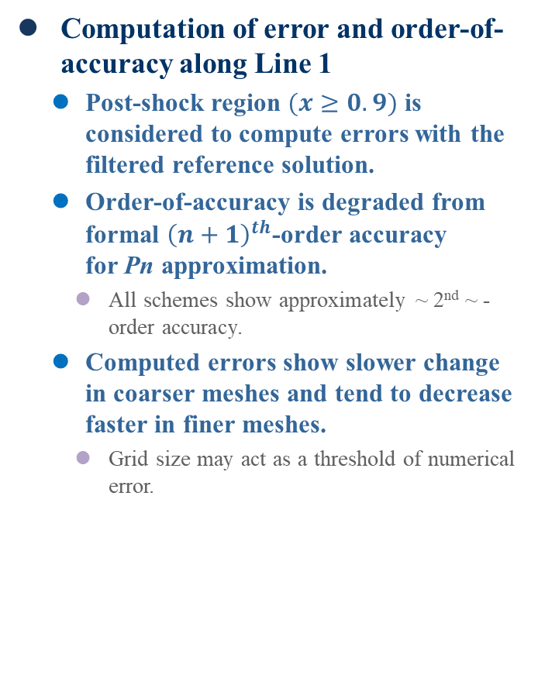
Results (Line 1)
Computation of error and order-of-accuracy along Line 1
  Post-shock region $(x≥0.9)$ is considered to compute errors with the filtered reference solution.
  Order-of-accuracy is degraded from formal ${\left(n+1\right)}^{th}$-order accuracy
  for Pn approximation.
    All schemes show approximately ~ 2nd ~ -order accuracy.
  Computed errors show slower change in coarser meshes and tend to decrease faster in finer meshes.
    Grid size may act as a threshold of numerical error.
Grid Refinement Tests along Line 1 in Post-shock Region

Slide 26
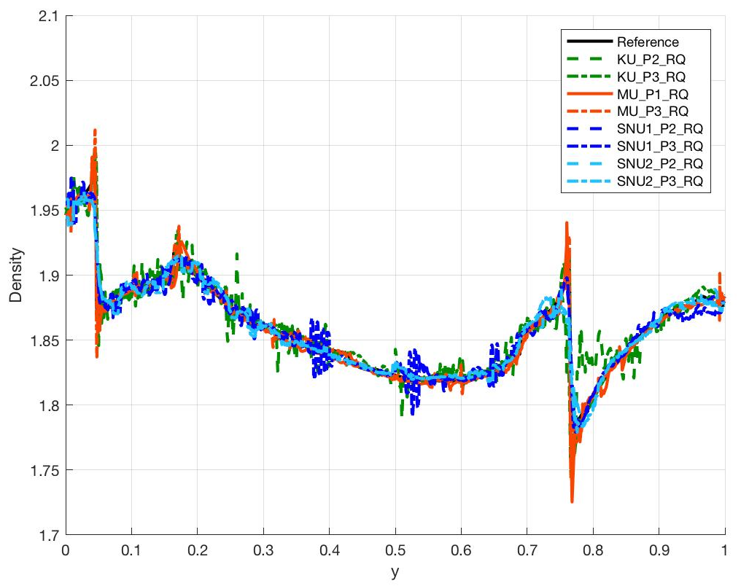
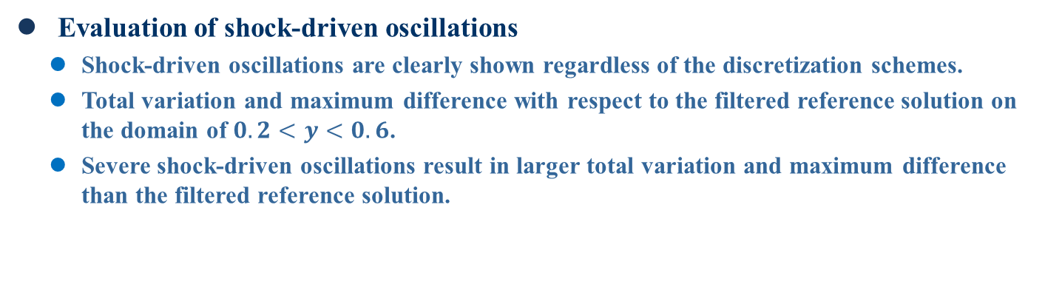
Results (Line 3)
Evaluation of shock-driven oscillations
  Shock-driven oscillations are clearly shown regardless of the discretization schemes.
  Total variation and maximum difference with respect to the filtered reference solution on the domain of $0.2<y<0.6$.
  Severe shock-driven oscillations result in larger total variation and maximum difference than the filtered reference solution.
Line 3 (RQ250)
Comparison of Oscillations (P3 on RQ250 meshes)
 | KU | MU | SNU1 | SNU2
Total Variation* | 5.939E-1 | 3.765E-1 | 9.598E-1 | 2.281E-1
Max Difference | 1.289E-2 | 1.228E-2 | 2.938E-2 | 1.074E-2
*: Reference total variation = 8.270E-2

Slide 27
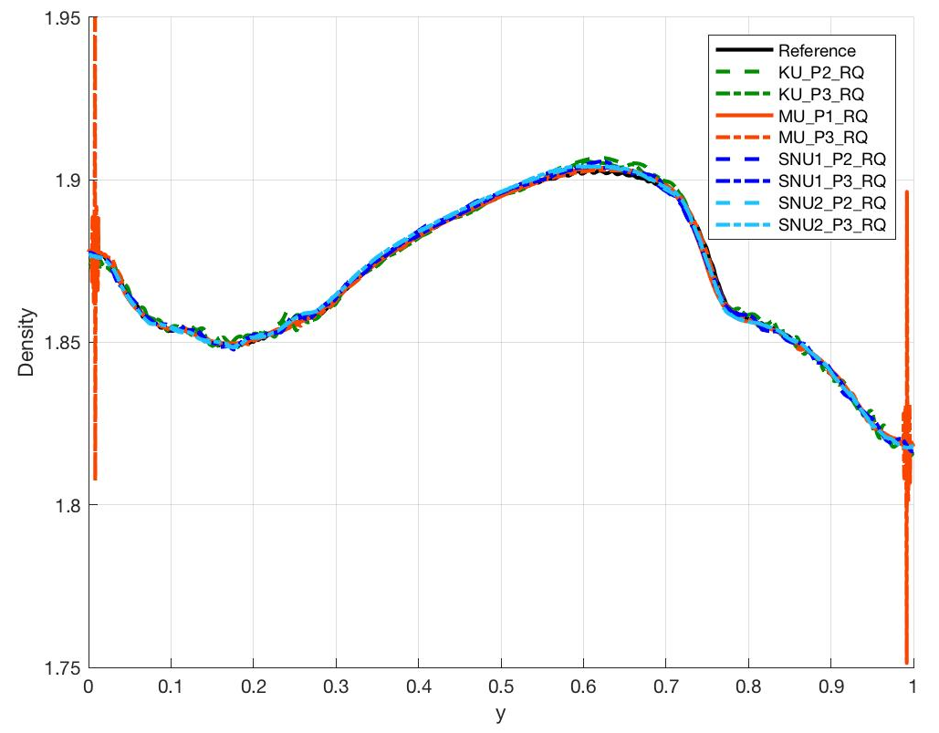
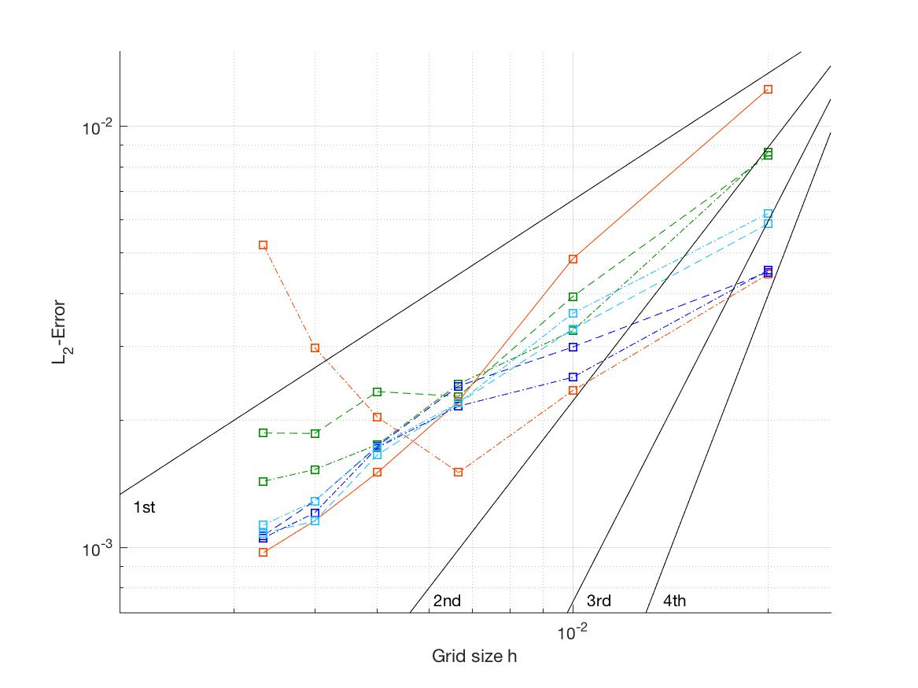
Results (Line 5)
Solution behavior on the downstream region
  Shock-driven oscillations far downstream are rather damped out.
  Similar to Line 1, computed order-of-accuracy is degraded to ~ 2nd ~ -order accuracy for most of the schemes.
  Computed error does not show threshold-like behavior on coarse mesh.
Line 5 (RQ250)
Grid Refinement Tests along Line 5

Slide 28
Order-of-Accuracy Degradation
Factors affecting order-of-accuracy degradation
Additional test problems
  Composite vortex is considered for all tests.
Non-smooth region $⊃$ Shock $⊃$ Shock inside cells $⊃$ Non-aligned shock
Test Problem | Non-smooth region | Shock | Shock inside cells | Non-aligned shock
Vortex Transport (Baseline) | O | X | X | X
Vortex behind Stationary Shock | O | O | X | X
Vortex behind Stationary Shock inside a Cell | O | O | O | X
Vortex behind Non-aligned Stationary Shock | O | O | O | O

Slide 29
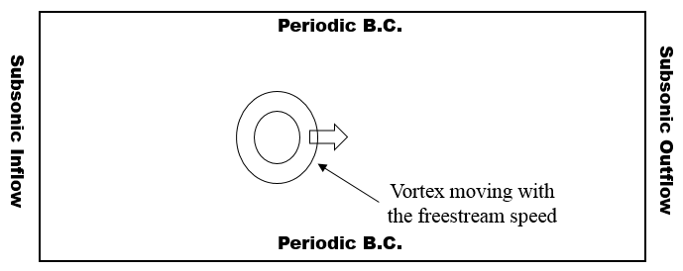
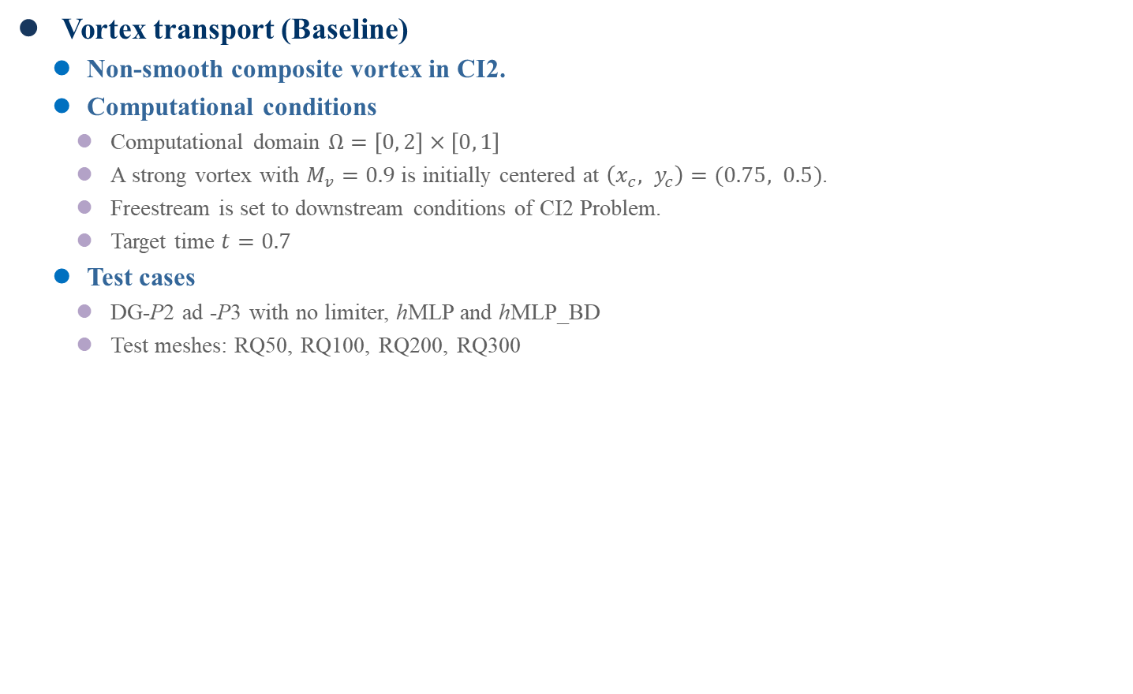
Order-of-Accuracy Degradation
Vortex transport (Baseline)
  Non-smooth composite vortex in CI2.
  Computational conditions
    Computational domain $Ω=\left[0, 2\right]×\left[0, 1\right]$
    A strong vortex with $M_{v}=0.9$ is initially centered at $\left(x_{c}, y_{c}\right)=(0.75, 0.5)$.
    Freestream is set to downstream conditions of CI2 Problem.
    Target time $t=0.7$
  Test cases
    DG-P2 ad -P3 with no limiter, hMLP and hMLP_BD
    Test meshes: RQ50, RQ100, RQ200, RQ300
Schematic View of Vortex Transport Problem

Slide 30
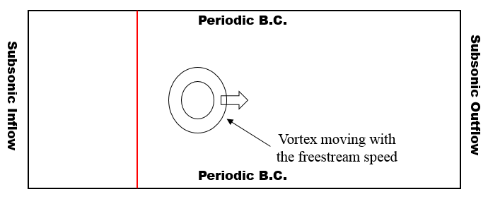




Order-of-Accuracy Degradation
Vortex behind stationary shock
  Stationary shock is exactly aligned with a cell interface.
  Baseline + Stationary shock ($M_{s}=1.5$) at $x=0.5$
Vortex behind stationary shock inside a cell
  Stationary shock is located inside a cell.
  Baseline + Stationary shock ($M_{s}=1.5$) at $x=0.5+ε$ where $ε=h/2$
Vortex behind non-aligned stationary shock
  Stationary shock is located along the regularly perturbed meshes.
  Baseline + Stationary shock ($M_{s}=1.5$) at $x=0.5$ + Regularly perturbed
  mesh at stationary shock location
: Grid interface
: Stationary shock
Schematic View of Vortex-Shock Problems
Aligned Shock
Shock inside a Cell
Regularly
Perturbed Mesh

Slide 31
Order-of-Accuracy Degradation
Effects of each factor
    ( ) : Order-of-accuracy degradation with respect to the baseline test
  In the baseline test, formal order-of-accuracy is not preserved even when the limiter is not used. Projection error seems to be the main cause of the degradation.
  If the shock is located at the interface of meshes, it does not affect the order-of-accuracy.
  If the shock is located inside a cell or not aligned with meshes, non-physical oscillations generated by the shock negatively affect the order-of-accuracy.
Test Problem | DG-P2 hMLP | DG-P2 hMLP_BD | DG-P2 no limiter | DG-P3 hMLP | DG-P3 hMLP_BD | DG-P3 no limiter
Vortex Transport (Baseline) | 1.954 | 1.785 | 1.950 | 1.883 | 1.785 | 2.155
Vortex behind Stationary Shock | 1.980 (+0.026) | 1.793 (+0.008) | - | 1.821 (-0.062) | 1.790 (+0.005) | -
Vortex behind Stationary Shock inside a Cell | 1.798 (-0.156) | 1.398 (-0.387) | - | 1.864 (-0.019) | 1.167 (-0.618) | -
Vortex behind Non-aligned Stationary Shock | 0.966 (-0.988) | 1.527 (-0.258) | - | 0.804 (-1.079) | 1.576 (-0.209) | -

Slide 32





Order-of-Accuracy Degradation
Projection error
  Projection error occurs when the exact initial profile is projected onto Pn-polynomial space.
  Grid refinement test is conducted to measure projection error of baseline vortex problem.
  Due to projection error, the formal order-of-accuracy could not be achieved.
  Computed order-of-accuracy
    x-Momentum (C⁰-continuous profile): DG-P2: 1.568, DG-P3: 1.520
    Density (C¹-continuous profile): DG-P2: 2.390, DG-P3: 2.549
Grid Refinement Test of Projection Error
x-Momentum Profile along a Vertical Line
Passing Vortex Core at Initial Condition

Slide 33
Open Discussion

Slide 34
Observations
High-order methods can resolve complex flow structures of shock-vortex interaction with less DOFs than finite volume methods, but yield some unwanted numerical artifacts across shock and post-shock region.
In highly non-linear problem with non-smooth profile, we have degradation in order-of-accuracy.
  All schemes shows approximately show ~ 2nd ~ -order accuracy.
Several factors affecting the formal order-of-accuracy in high-order methods.
  Projection error of a non-smooth initial profile
  Non-physical oscillations (numerical flux, limiting strategy/amount of diffusion, shock-alignment & mesh distribution, etc)
Further studies are necessary to improve accuracy, efficiency and robustness of high-order methods for unsteady compressible flows.

Slide 35
Appendix

Slide 36


Appendix. Reference Solution
Reliability of reference solution
  In order to observe the behavior of order test results with respect to the reference solution, 1-D smooth problem is examined.
  Problem description
    Non-dimensional 1-D Euler equations with EOS for ideal gas
    Initial condition: $\left[ρ, u, p\right]=[1+0.2sin\left(2πx\right),1,1]$
    Computational domain: $Ω= \left[0,1\right]$
    Target time: $t=1$
    Grid sizes for DG method: $h=\frac{1}{15},\frac{1}{30},\frac{1}{60},\frac{1}{90}$
Density Profile

Slide 37




Appendix. Reference Solution
Reliability of reference solution (Cont’)
  Error of the DG solution is measured with the reference solution, which is computed by FVM with fine meshes.
  Judging from the observation in the 1-D smooth problem, if the reference solution is obtained on sufficiently fine meshes, the order-of-accuracy is correctly behaved, otherwise the error is saturated at some point.
(a) FVM results from $h=\frac{1}{1,000,000}$
(b) FVM results from $h=\frac{1}{10,000}$
L2 Error Measured with the Reference Solution

Slide 38



Appendix. Results (Line 2 & 4)
Line 2: Similar shock structure shown in Line 1
  Solution behavior around the shock is similar to Line 1.
  Non-monotonicity of shock is shown more clearly in Line 2.
Line 4: Similar vortical structure shown in Line 1
  Solution behavior around vortex core is similar to Line 1.
  Difference in location and depth of the vortex core is more apparent in Line 4.
Line 2 (RQ250)
Line 2 (Shock Close-up)
Line 4 (RQ250)

