Slide 1
RADGUM:
The Recovery-Assisted DG code of the
University of Michigan
(WS1 case only)
January 6th, 2017
5th International Workshop on High-Order CFD Methods
Kissimmee, Florida
Philip E. Johnson & Eric Johnsen
Scientific Computing and Flow Physics Laboratory
Mechanical Engineering Department
University of Michigan, Ann Arbor

Slide 2
Code Overview
Basic Features:
Spatial Discretization: Discontinuous Galerkin, nodal basis
Time Integration: Explicit Runge-Kutta (4th order and 8th order available)
Riemann solver: Roe, SLAU2†
Quadrature: One quadrature point per basis function
Non-Standard Features:
ICB reconstruction: compact technique, adjusts Riemann solver arguments
Compact Gradient Recovery (CGR): Mixes Recovery with traditional mixed formulation for viscous terms
Shock Capturing: PDE-based artificial dissipation inspired by C-method†† of Reisner et al.
Discontinuity Sensor: Detects shock/contact discontinuities, tags “troubled” elements
†Kitamura & Shima, JCP 2013
††Reisner et al., JCP 2013
1

Slide 3
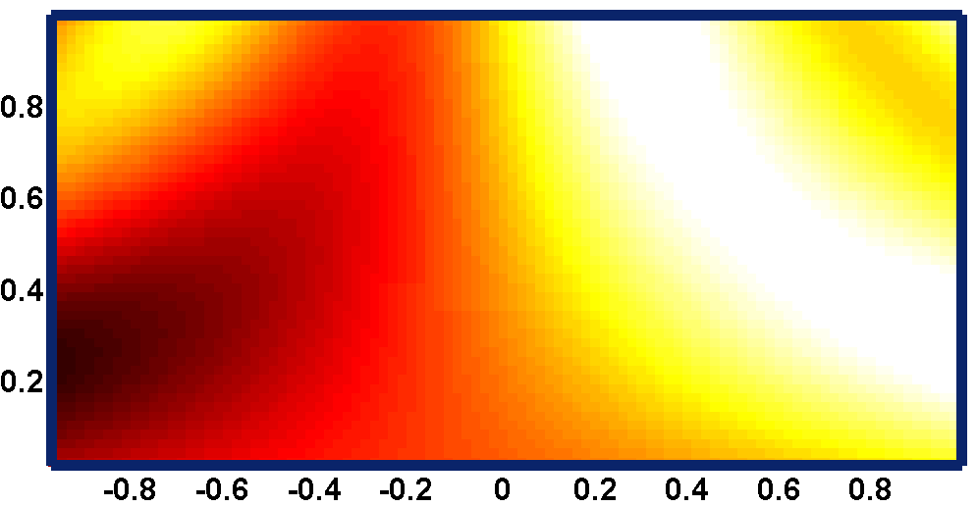
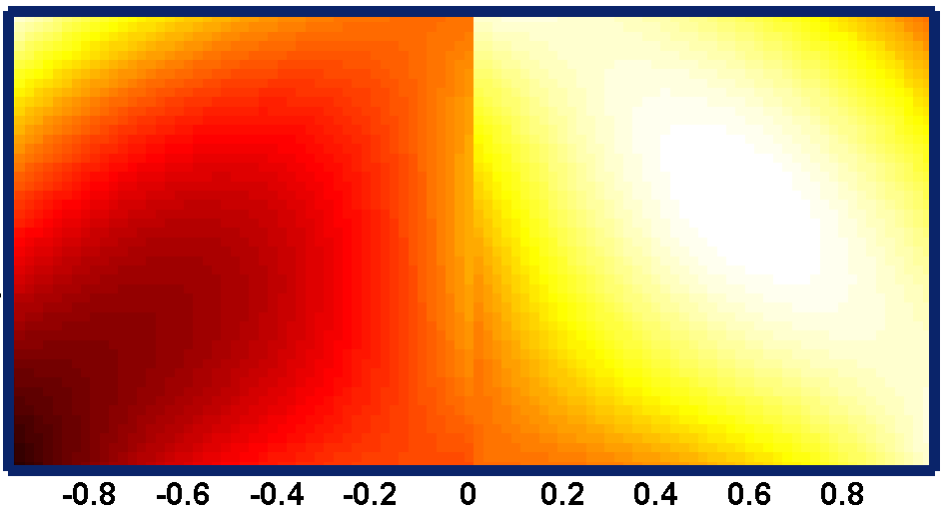
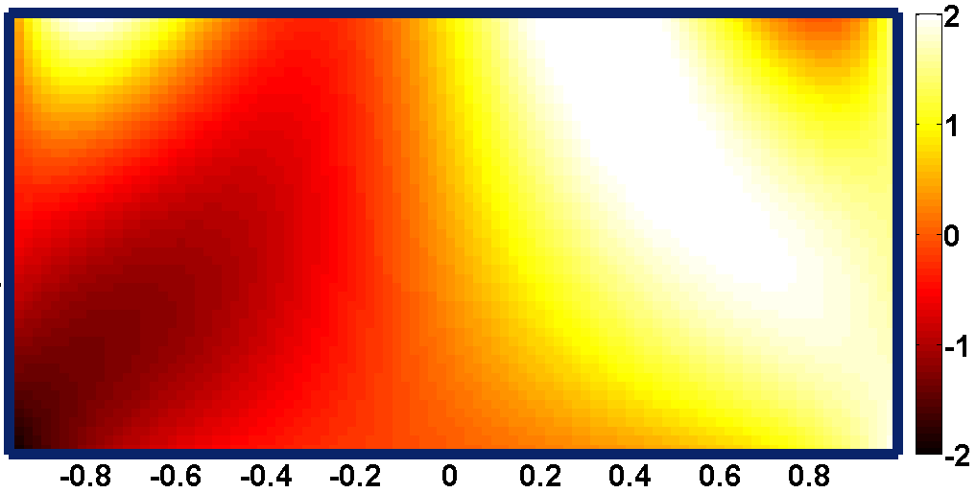
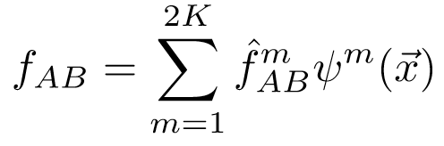
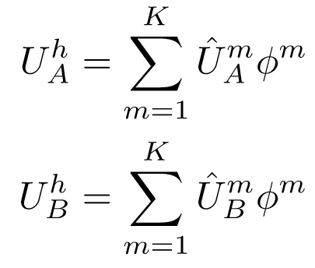
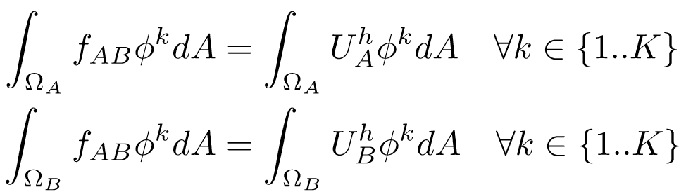
Recovery Concept†
Exact Distribution U
DG solution: $U_{h}^{A}$ , $U_{h}^{B}$
Recovered solution: $f_{AB}$
Ω_{A}
Ω_{B}
Ω_{A}
Ω_{B}
Ω_{A}
Ω_{B}
$$U=x+y+\sin\left(2πxy\right)$$
†Van Leer & Nomura, AIAA Conf. 2005
2
Schematic from [Johnson & Johnsen, APS DFD 2015]

Slide 4
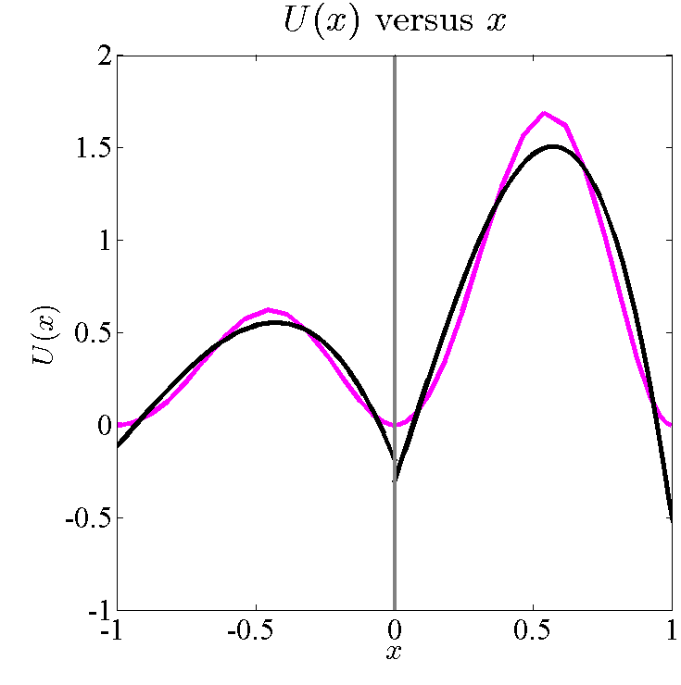
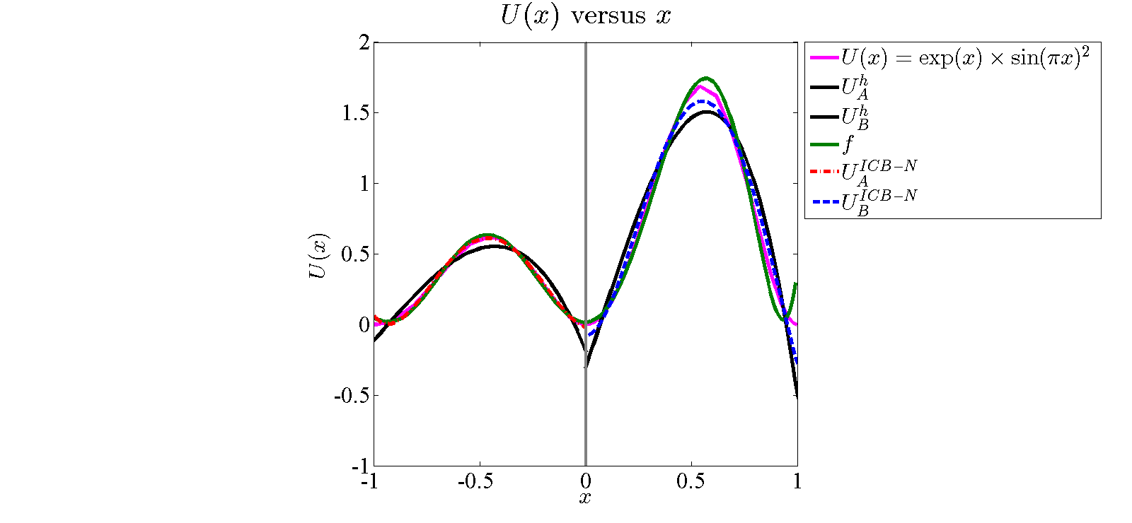



Recovery Demonstration: $p=3$
$$Ω_{A}$$
$$Ω_{B}$$
3

Slide 5
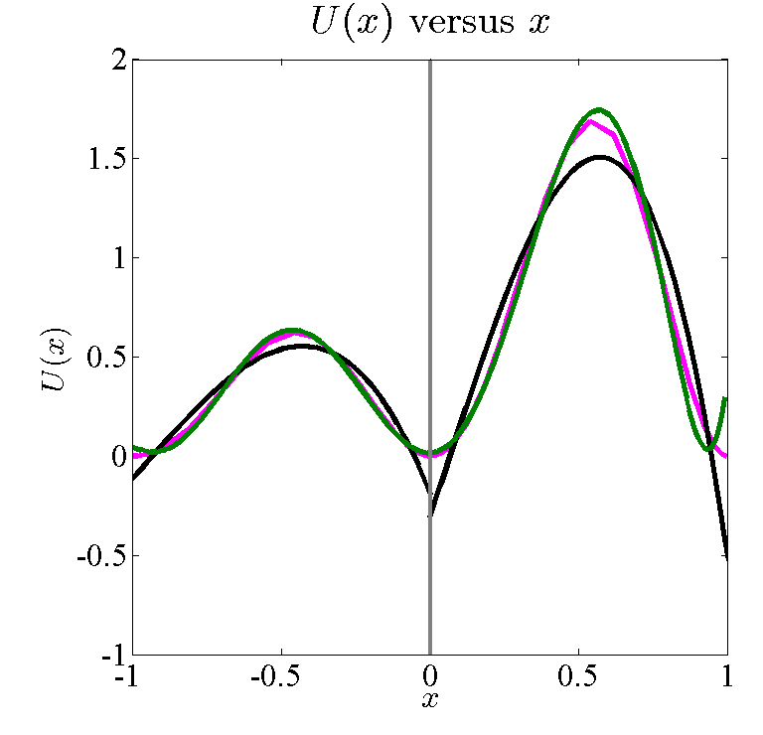
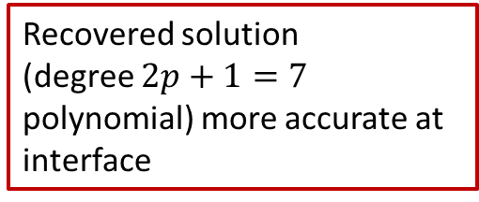
Recovery Demonstration: $p=3$
Recovered solution
(degree $2p+1=7$ polynomial) more accurate at interface
$$Ω_{A}$$
$$Ω_{B}$$
3

Slide 6
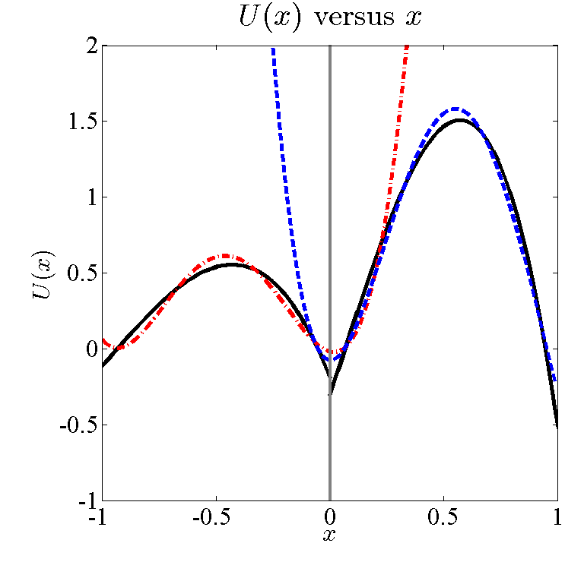
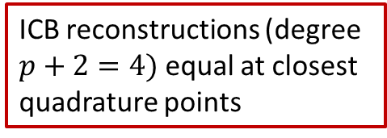
Recovery Demonstration: $p=3$
ICB reconstructions (degree $p+2=4)$ equal at closest quadrature points
$$Ω_{A}$$
$$Ω_{B}$$
3

Slide 7



Our Approach vs. Conventional DG
For diffusive fluxes: CGR maintains compact stencil†, offers advantages over BR2
  Larger allowable explicit timestep size
  Improved wavenumber resolution
For advection problems:
DG weak form: Must calculate flux along interfaces
  Conventional approach (upwind DG): plug in left/right values of DG solution
Conventional approach:
Our approach: ICB reconstruction scheme††
  Replace left/right solution values with ICB reconstruction:
† Johnson & Johnsen, AIAA Aviation 2017
4
†† Khieu & Johnsen, AIAA Aviation 2014
Notes:
Advection weak form goes under DG weak form. Need symbols for UCB solution and standard DG solution as inputs to the Riemann solver.

Slide 8
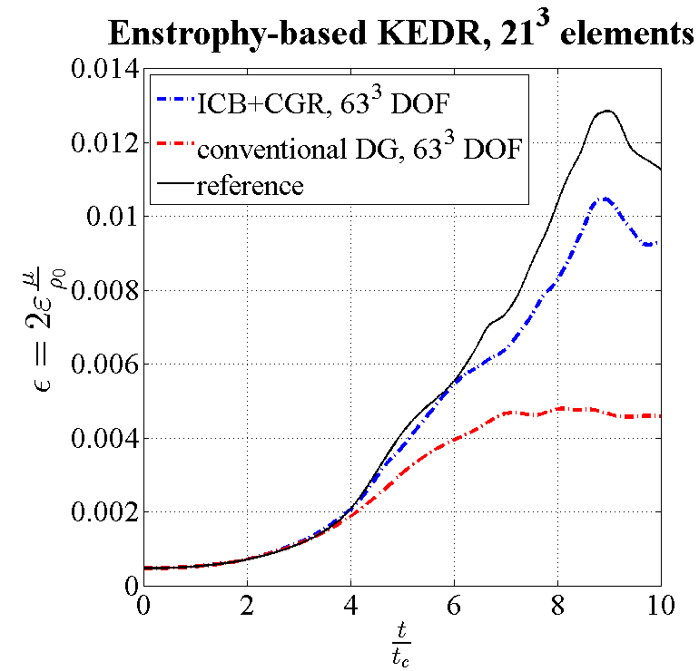
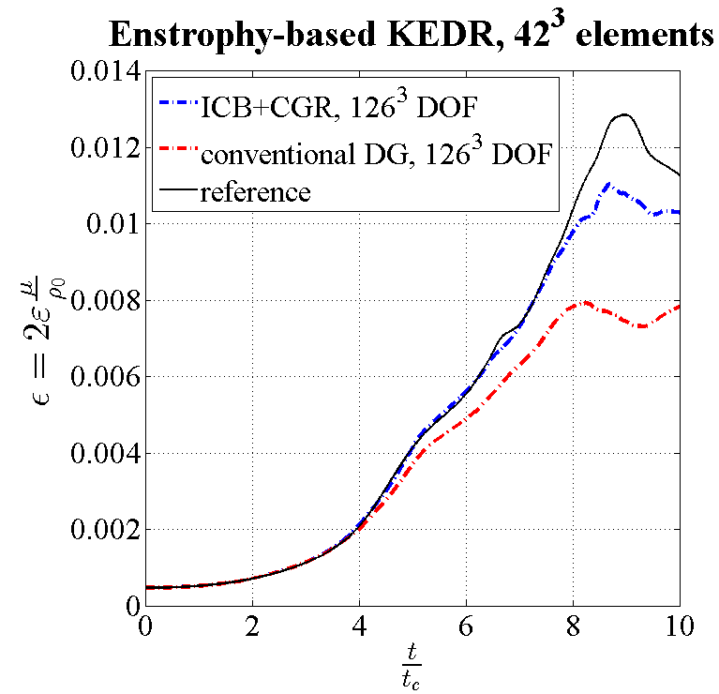
Taylor-Green Test (WS1)
  Code setup: p2 elements, uniform hex mesh (27 DOF/element), RK4 time integration
    Reference result taken from HiOCFD3 workshop
    Our approach allows larger stable time step
ICB+CGR: 2.5 CPU-hours
Conventional: 9.2 CPU-Hours
ICB+CGR: 75 CPU-hours
Conventional: 304 CPU-Hours
5

Slide 9
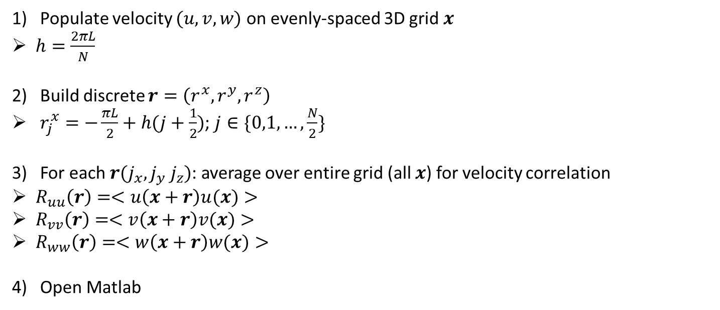
Energy Spectrum Computation
Populate velocity $(u,v,w)$ on evenly-spaced 3D grid $x$
$h=\frac{2πL}{N}$
Build discrete $r=\left(r^{x},r^{y},r^{z}\right)$
$r_{j}^{x}=−\frac{πL}{2}+h(j+\frac{1}{2})$; $j∈\{0,1,…,\frac{N}{2}\}$
For each $r(j_{x}, j_{y} j_{z})$: average over entire grid (all $x$) for velocity correlation
$R_{uu}\left(r\right)=<u\left(x+r\right)u(x)>$
$R_{vv}\left(r\right)=<v\left(x+r\right)v(x)>$
$R_{ww}\left(r\right)=<w\left(x+r\right)w(x)>$
Open Matlab
6

Slide 10

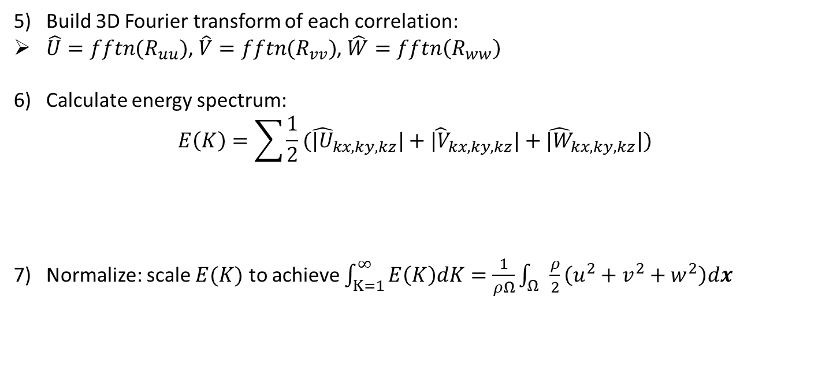
Energy Spectrum Computation
Build 3D Fourier transform of each correlation:
$\hat{U}=fftn(R_{uu})$, $\hat{V}=fftn(R_{vv})$, $\hat{W}=fftn\left(R_{ww}\right)$
Calculate energy spectrum:
$$E\left(K\right)=\sum{\frac{1}{2}({\hat{|U}}_{kx,ky,kz}|+{\hat{|V}}_{kx,ky,kz}|+{\hat{|W}}_{kx,ky,kz}|) }$$
Normalize: scale $E(K)$ to achieve $\int_{K=1}^{∞}{E\left(K\right)dK}=\frac{1}{ρΩ}\int_{Ω}{\frac{ρ}{2}\left(u^{2}+v^{2}+w^{2}\right)dx}$
$$\sqrt{kx^{2}+ky^{2}+kz^{2}}=K$$
7

Slide 11
Conclusions
Were the verification cases helpful and which ones were used?
  TGV: First 3D simulation, demonstrates value of ICB+CGR for nonlinear problem
  What improvements are needed to the test case?
    TGV: Standardize energy spectrum calculation and make reference data more easily accessible
    Did the test case prompt you to improve your methods/solver
      Yes: added 3D capability
What worked well with your method/solver?
  Feature resolution on Cartesian meshes (ICB very helpful)
  What improvements are necessary to your method/solver?
    ICB/CGR robustness on non-Cartesian elements
8

Slide 12
SciTech Talk
Title: A Compact Discontinuous Galerkin Method for Advection-Diffusion Problems
Session: FD-33, High-Order CFD Methods 1
Setting: Sun 2, January 10, 9:30 AM
Acknowledgements
Computing resources were provided by the NSF via grant 1531752 MRI: Acquisition of Conflux, A Novel Platform for Data-Driven Computational Physics (Tech. Monitor: Ed Walker).
9

Slide 13
References
Kitamura, K. & Shima, E., “Towards shock-stable and accurate hypersonic heating computations: A new pressure flux for AUSM-family schemes,” Journal of Computational Physics, Vol. 245, 2013.
Reisner, J., Serensca, J., Shkoller, S., “A space-time smooth artificial viscosity method for nonlinear conservation laws,” Journal of Computational Physics, Vol. 235, 2013.
Johnson, P.E. & Johnsen, E., “A New Family of Discontinuous Galerkin Schemes for Diffusion Problems,” 23rd AIAA Computational Fluid Dynamics Conference, 2017.
Khieu, L.H. & Johnsen, E., “Analysis of Improved Advection Schemes for Discontinuous Galerkin Methods,” 7th AIAA Theoretical Fluid Dynamics Conference, 2011.
Cash, J.R. & Karp, A.H., “A Variable Order Runge-Kutta Method for Initial Value Problems with Rapidly Varying Right-Hand Sides,” ACM Transactions on Mathematical Software, Vol. 16, No. 3, 1990.

Slide 14
Spare Slides

Slide 15
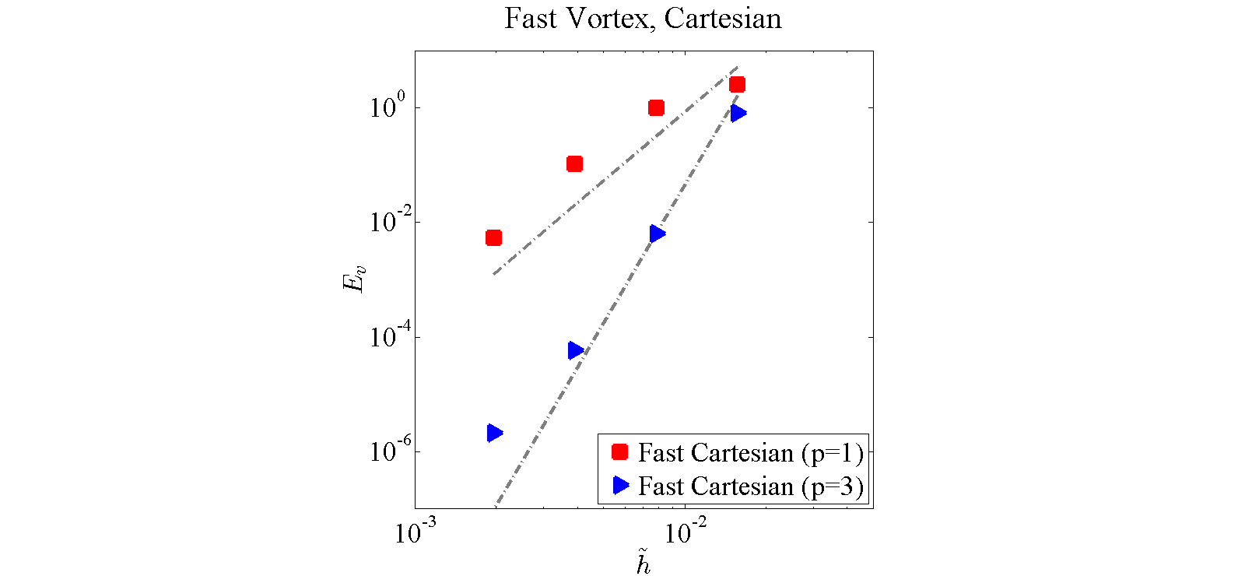
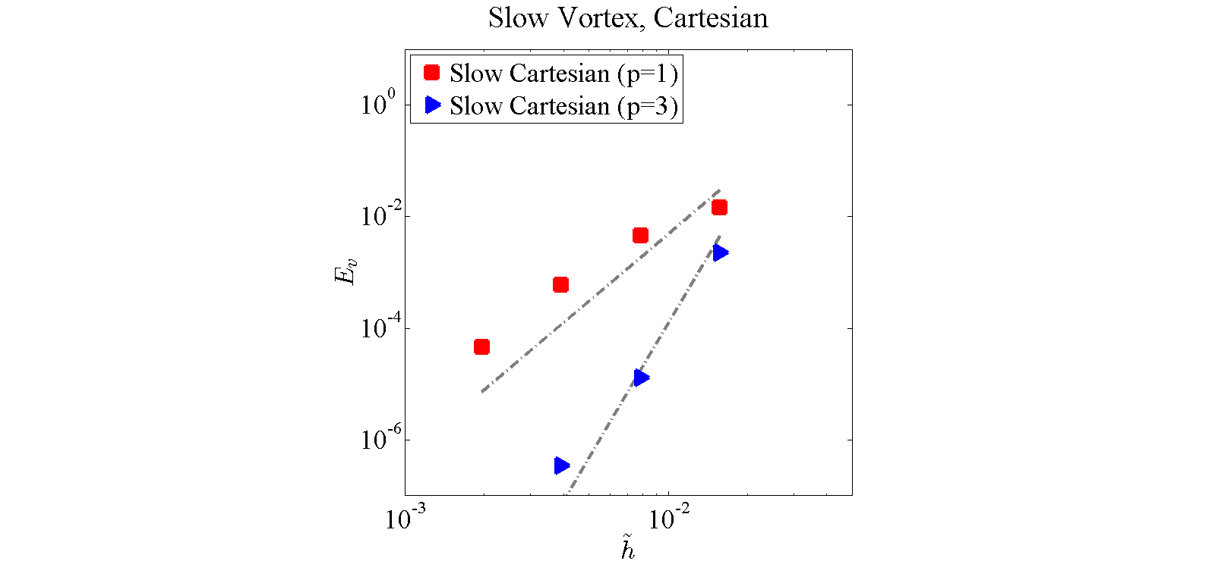
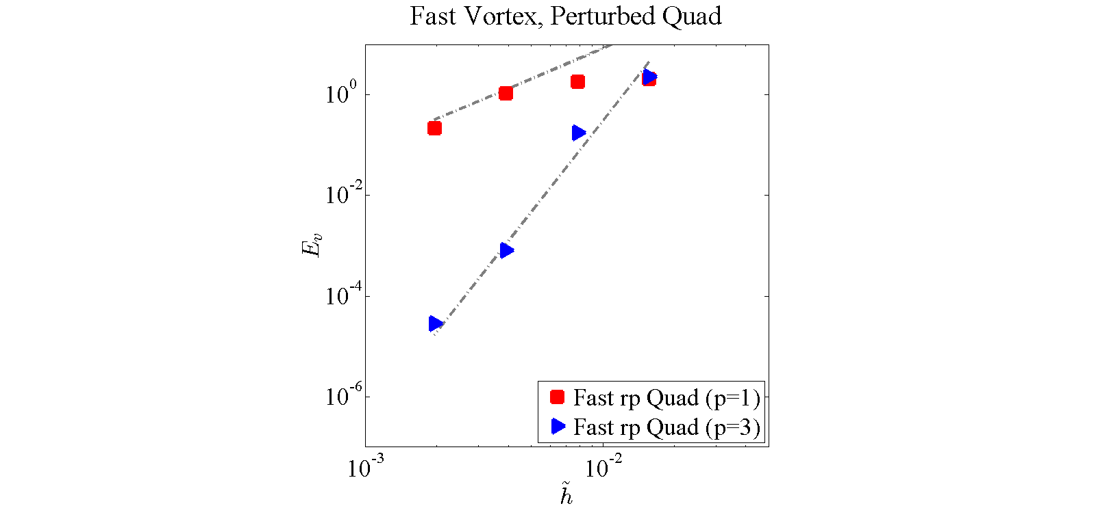
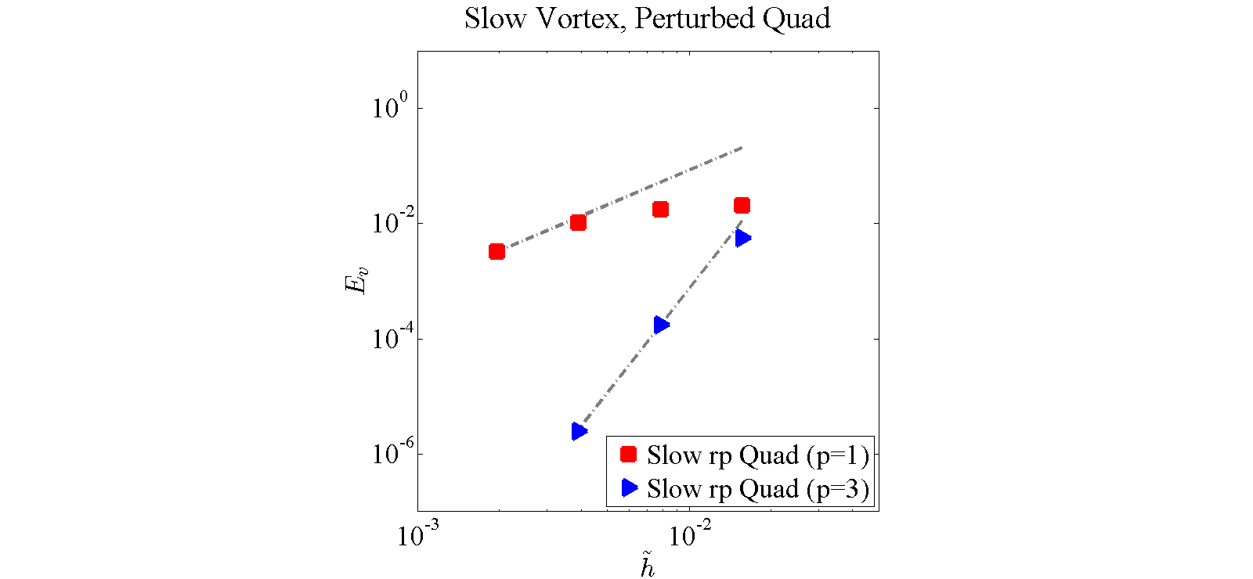
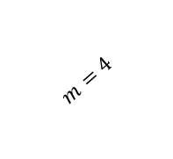
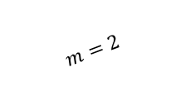
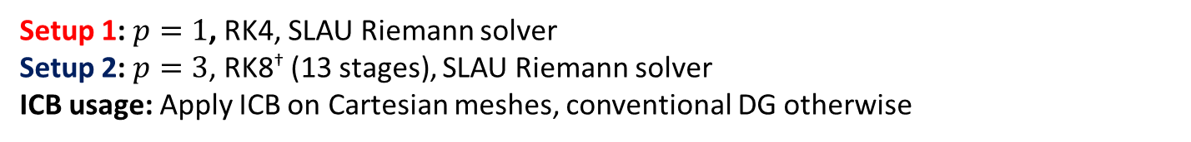
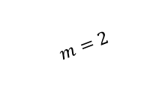
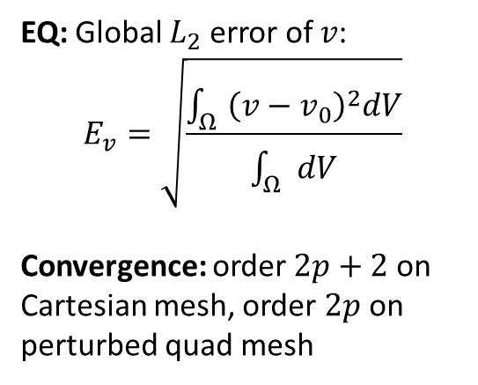
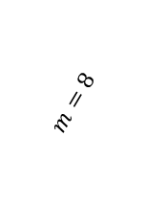
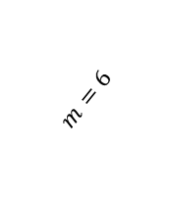
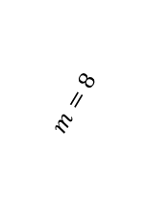
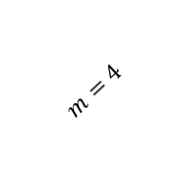
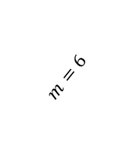
Vortex Transport Case (VI1)
Setup 1: $p=1$, RK4, SLAU Riemann solver
Setup 2: $p=3$, RK8† (13 stages), SLAU Riemann solver
ICB usage: Apply ICB on Cartesian meshes, conventional DG otherwise
EQ: Global $L_{2}$ error of $v$:
$$E_{v}=\sqrt{\frac{\int_{Ω}{{\left(v−v_{0}\right)}^{2}dV}}{\int_{Ω}{dV}}}$$
Convergence: order $2p+2$ on Cartesian mesh, order $2p$ on perturbed quad mesh
$$m=4$$
$$m=8$$
$$m=4$$
$$m=8$$
$$m=2$$
$$m=2$$
$$m=6$$
$$m=6$$
† Cash & Karp, ACMTMS 1990
6

Slide 16
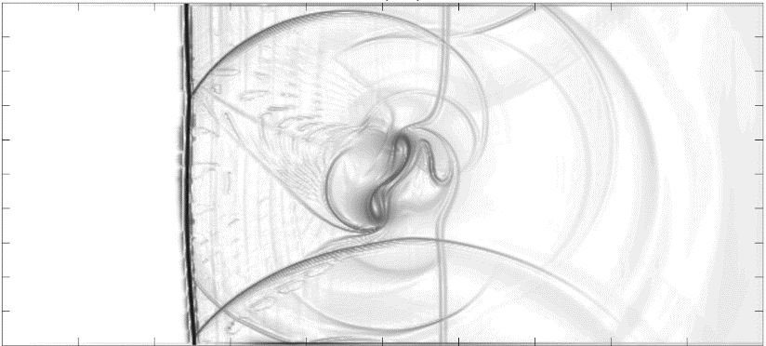
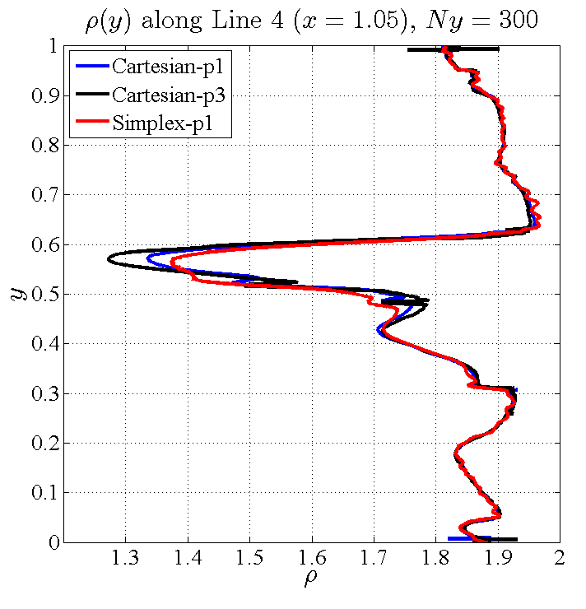
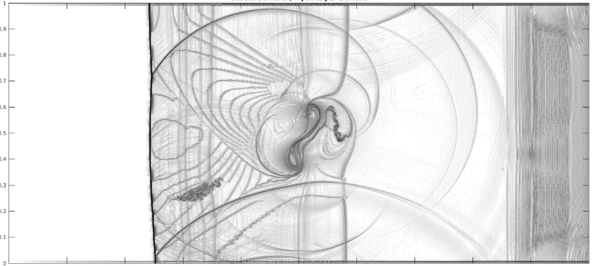
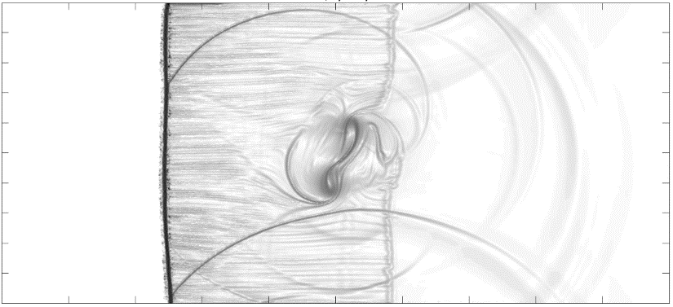

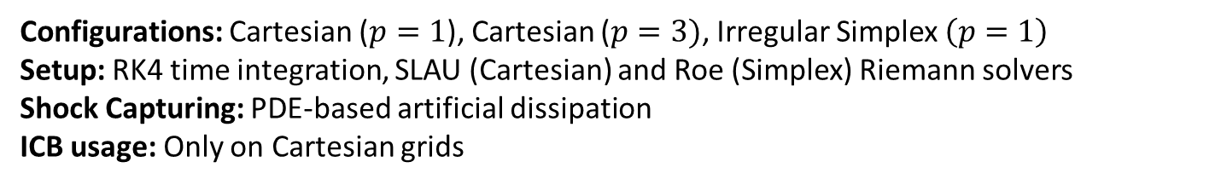


Shock-Vortex Interaction (CI2)
Configurations: Cartesian ($p=1$), Cartesian ($p=3)$, Irregular Simplex $\left(p=1\right)$
Setup: RK4 time integration, SLAU (Cartesian) and Roe (Simplex) Riemann solvers
Shock Capturing: PDE-based artificial dissipation
ICB usage: Only on Cartesian grids
Quad
$$p=1$$
$$Ny=300$$
Quad
$$p=3$$
$$Ny=300$$
Simplex $p=1$
$$Ny=300$$
7

Slide 17
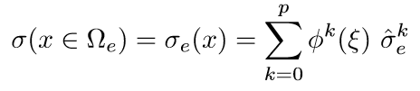



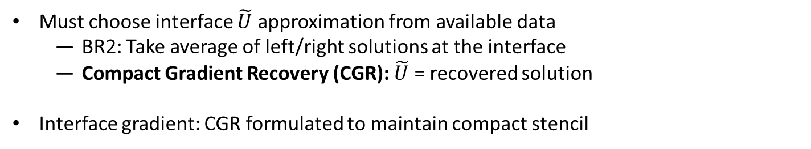


CGR = Mixed Formulation + Recovery
Gradient approximation in $Ω_{e}$:
Weak equivalence with $∇U$:
Integrate by parts for $σ$ weak form:
Must choose interface $\tilde{U}$ approximation from available data
  BR2: Take average of left/right solutions at the interface
  Compact Gradient Recovery (CGR): $\tilde{U}$ = recovered solution
  Interface gradient: CGR formulated to maintain compact stencil
5
Notes:
Mention that you have to jump through some hoops to get the interface gradient for flux terms, but that term is less important than common U with regard to accuracy.

Slide 18

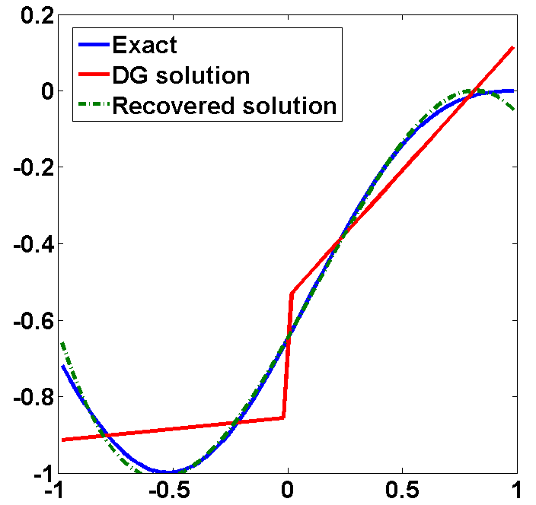

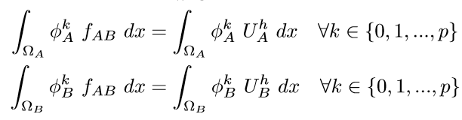


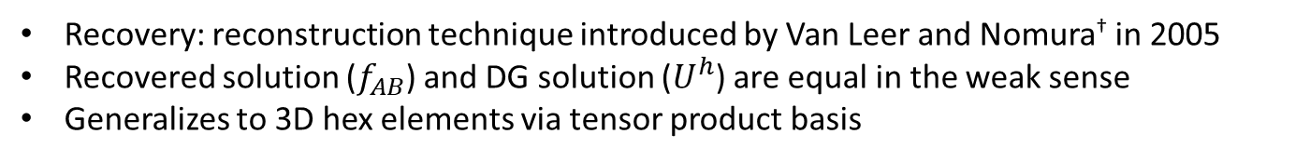




The Recovery Concept
Recovery: reconstruction technique introduced by Van Leer and Nomura† in 2005
Recovered solution ($f_{AB}$) and DG solution ($U^{h}$) are equal in the weak sense
Generalizes to 3D hex elements via tensor product basis
Recovered Solution for :
$K_{R}=2p+2$ constraints for $f_{AB}$:
$$Ω_{A}$$
$$Ω_{B}$$
Interface Solution along :
$$r$$
Representations of $U\left(x\right)=\sin^{3}(x−\frac{π}{3})$
†Van Leer & Nomura, AIAA Conf. 2005
Notes:
Lead in: here is a nice way to calculate the common interface value, Utilde, along an interface

Slide 19
Recovery Demonstration: All Solutions
Notes:
Yes, it is very close to a central discretization, but not quite there.

Slide 20
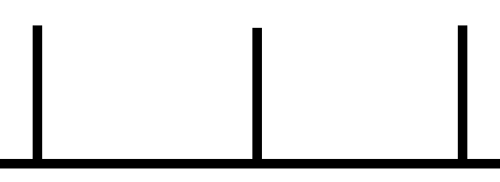
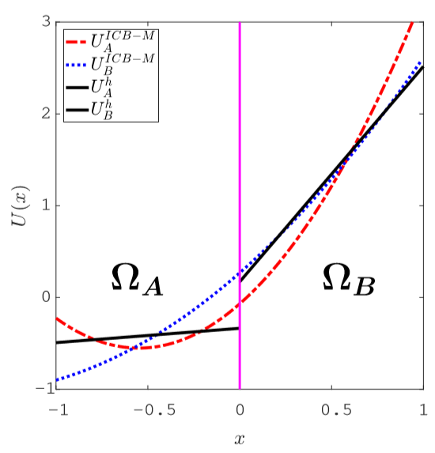
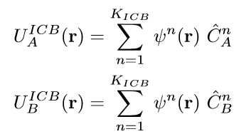
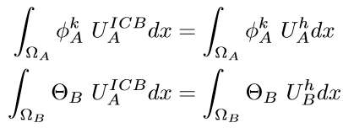
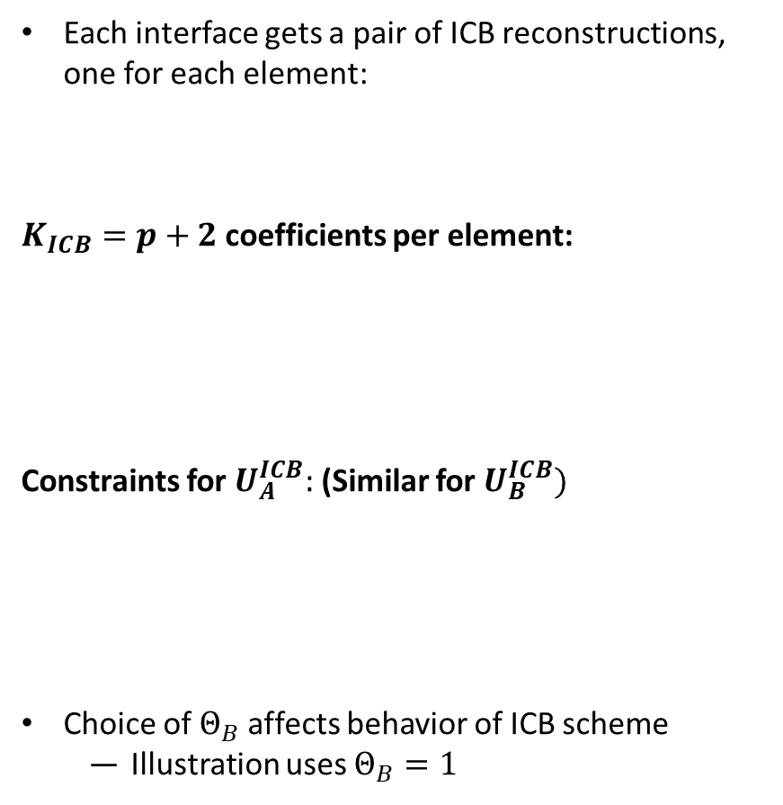


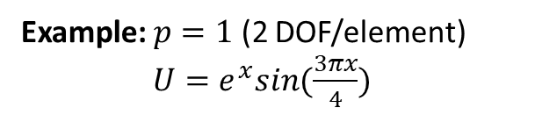


The ICB reconstruction
Each interface gets a pair of ICB reconstructions, one for each element:
  $K_{ICB}=p+2$ coefficients per element:
  Constraints for $U_{A}^{ICB}:$ (Similar for $U_{B}^{ICB})$
  Choice of $Θ_{B}$ affects behavior of ICB scheme
    Illustration uses $Θ_{B}=1$
Example: $p=1$ (2 DOF/element)
$U=e^{x}sin(\frac{3πx}{4})$
$$Ω_{A}$$
$$Ω_{B}$$
$$r$$
$$∀k∈\{0,1,…p\}$$

Slide 21
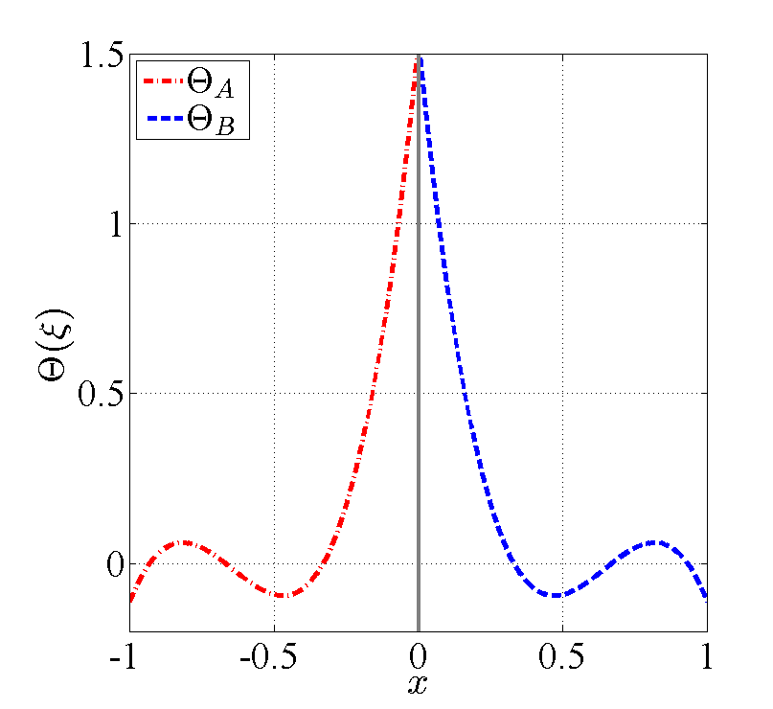



The $Θ$ Function: ICB-Modal vs. ICB-Nodal
ICB-Modal (original): ${Θ_{A}=Θ}_{B}=1$ is lowest mode in each element’s solution
ICB-Nodal (new approach): $Θ$ is degree $p$ Lagrange interpolant
  Use Gauss-Legendre quadrature nodes as interpolation points
  Take $Θ$ nonzero at closest quadrature point
Sample $Θ$ choice for $p=3$:
Each $Θ$ is unity at quadrature point nearest interface

Slide 22



The $Θ$ Function: ICB-Modal vs. ICB-Nodal
ICB-Modal: Each $U^{ICB}$ matches the average of $U^{h}$ in neighboring cell
ICB-Nodal: Each $U^{ICB}$ matches $U^{h}$ at near quadrature point
Notes:
Yes, it is very close to a central discretization, but not quite there.

Slide 23











Fourier Analysis
Fourier analysis performed on 2 configurations:
  Conventional: Upwind DG + BR2
  New: ICB-Nodal + CGR
  Linear advection-diffusion, 1D:
  Define element Peclet number:
  Set Initial condition:
  Cast numerical scheme in matrix-vector form:
Scheme | $$\tilde{F}$$ | $$\tilde{U}$$
uDG + BR2
ICB + CGR
Analysis Procedure † :
† Watkins et al., Computers & Fluids 2016
Notes:
Grab a modified version of the table from paper showing the common F and common U for the two approaches.

Slide 24








Fourier Analysis
  Diagonalize the update matrix:
  Calculate initial expansion weights, $β$:
  Watkins et al. derived estimate for initial error growth:
    $λ^{n}$ = $n^{th}$ eigenvalue of
Eigenvalue corresponding to exact solution:
Eigenvalue Example:
ICB+CGR, $p=2$, $PE_{h}=10$,
$$λ^{ex}=−i\left(10ω\right)−ω^{2}$$
† Watkins et al., Computers & Fluids 2016
Notes:
Grab a modified version of the table from paper showing the common F and common U for the two approaches.

Slide 25



Wavenumber Resolution
To calculate wavenumber resolution:
  Define some error tolerance($ε)$ and Peclet number ($PE_{h}$)
  Identify cutoff wavenumber, $ω_{f}$ according to:
  Calculate resolving efficiency:
† Watkins et al., Computers & Fluids 2016
Notes:
Here, insert a figure demonstrating the exact and consistent eigenvalues diverging from eachother

Slide 26



Scheme Comparison: $PE_{h}=10$
Fourier analysis, Linear advection-diffusion
Resolving efficiency measures effectiveness of update scheme’s consistent eigenvalue
P | Conventional | ICB + CGR
1 | 0.0296 | 0.1103
2 | 0.0531 | 0.0776
3 | 0.0844 | 0.1113
4 | 0.1022 | 0.1225
5 | 0.1196 | 0.1304
P | Conventional | ICB + CGR
1 | 0.0940 | 0.2389
2 | 0.1200 | 0.1793
3 | 0.1451 | 0.1755
4 | 0.1677 | 0.2628
5 | 0.1743 | 0.1874

Slide 27










Compact Gradient Recovery (CGR) Approach
Similar to BR2: Manage flow of information by altering gradient reconstruction
1D Case shown for simplicity: Let $g_{A}$, $g_{B}$ be gradient reconstructions in $Ω_{A},$ $Ω_{B}$
  Perform Recovery over $g_{A}$, $g_{B}$ for $\tilde{σ}$ on the shared interface
$$Ω_{A}$$
$$Ω_{B}$$
Notes:
More equations here. Show the one-sided reconstructions used for gradient reconstruction. Use AIAA equations.

Slide 28



The ICB Approach (Specifically, ICBp[0])
Recovery is applicable ONLY for viscous terms; unstable for advection terms.
Interface-Centered Binary (ICB) reconstruction scheme modifies Recovery approach for hyperbolic PDE.
Example with $p1$ elements:
Representations of $U\left(x\right)=\sin^{3}\left(x\right)+\frac{x^{2}}{2}$
Process Description:
Start with the DG polynomials $U_{A}^{h}$ in $Ω_{A}$ and $U_{b}^{h}$ in $Ω_{B}$.
Ω_{A}
Ω_{B}

Slide 29


The ICB Approach (Specifically, ICBp[0])
Process Description:
Start with the DG polynomials $U_{A}^{h}$ in $Ω_{A}$ and $U_{b}^{h}$ in $Ω_{B}$.
Obtain reconstructed solution $U_{A}^{ICB}$ in $Ω_{A}$, containing $p+2$ DOF.
Example with $p1$ elements:
Representations of $U\left(x\right)=\sin^{3}\left(x\right)+\frac{x^{2}}{2}$
Ω_{A}
Ω_{B}

Slide 30



The ICB Approach (Specifically, ICBp[0])
Process Description:
Start with the DG polynomials $U_{A}^{h}$ in $Ω_{A}$ and $U_{b}^{h}$ in $Ω_{B}$.
Obtain reconstructed solution $U_{A}^{ICB}$ in $Ω_{A}$, containing $p+2$ DOF.
Perform similar operation for $U_{B}^{ICB}$
Use ICB solutions as inputs to ${\hat{H}}_{conv}(U^{+},U^{−})$
Example with $p1$ elements:
Representations of $U\left(x\right)=\sin^{3}\left(x\right)+\frac{x^{2}}{2}$
Ω_{A}
Ω_{B}
ICB Method achieves $2p+2$order of accuracy
Generalizes to 2D via tensor-product basis

Slide 31




Discontinuity Sensor
Approach: Check cell averages for severe density/pressure jumps across element interfaces
Calculate $\overline{U}$=cell average for each element
At each interface, use sensor of Lombardini to check for shock wave:
  If Lax entropy condition satisfied (hat denotes Roe average at interface):
  Check pressure jump:
  If $Φ>0.01$, tag both elements as “troubled”
At each interface, check for contact discontinuity
  Calculate wave strength propagating the density jump:
  Check relative strength:
  If $Ξ>0.01$, tag both elements as “troubled”

