Slide 1
HiOCFD5
5th International Workshop on High-Order CFD Methods
Authors: Vijay Sudharshanam , Samuel Ebenezer , Peter Eiseman

Slide 2
Overview
GridPro technology
Salient features
Higher order Meshes in GridPro
Validation cases
Challenges

Slide 3
Technology

Slide 4
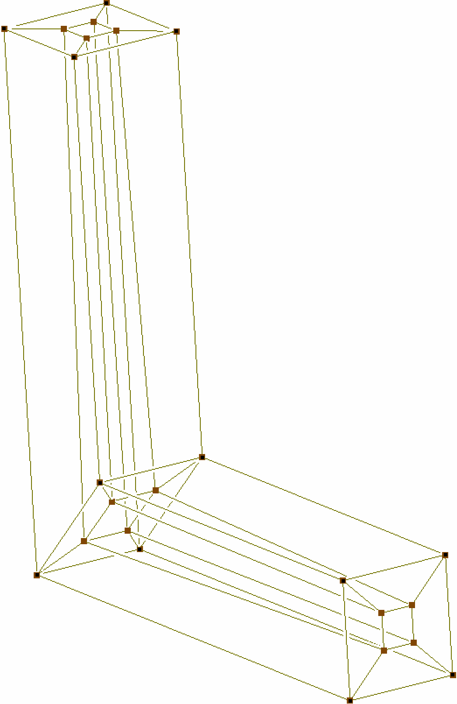
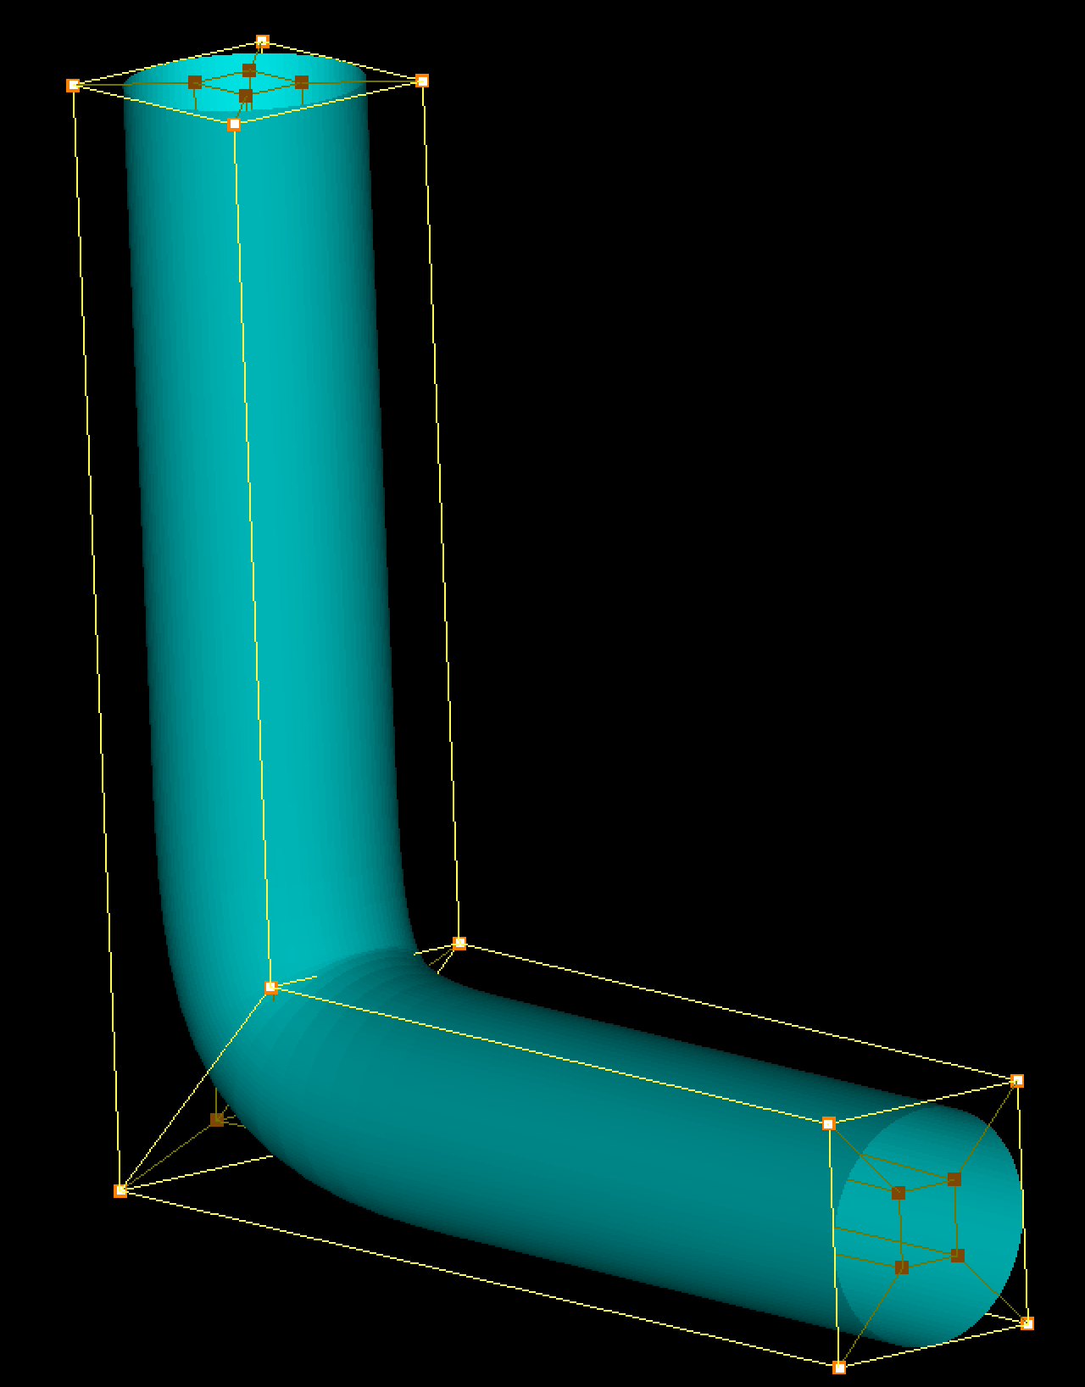
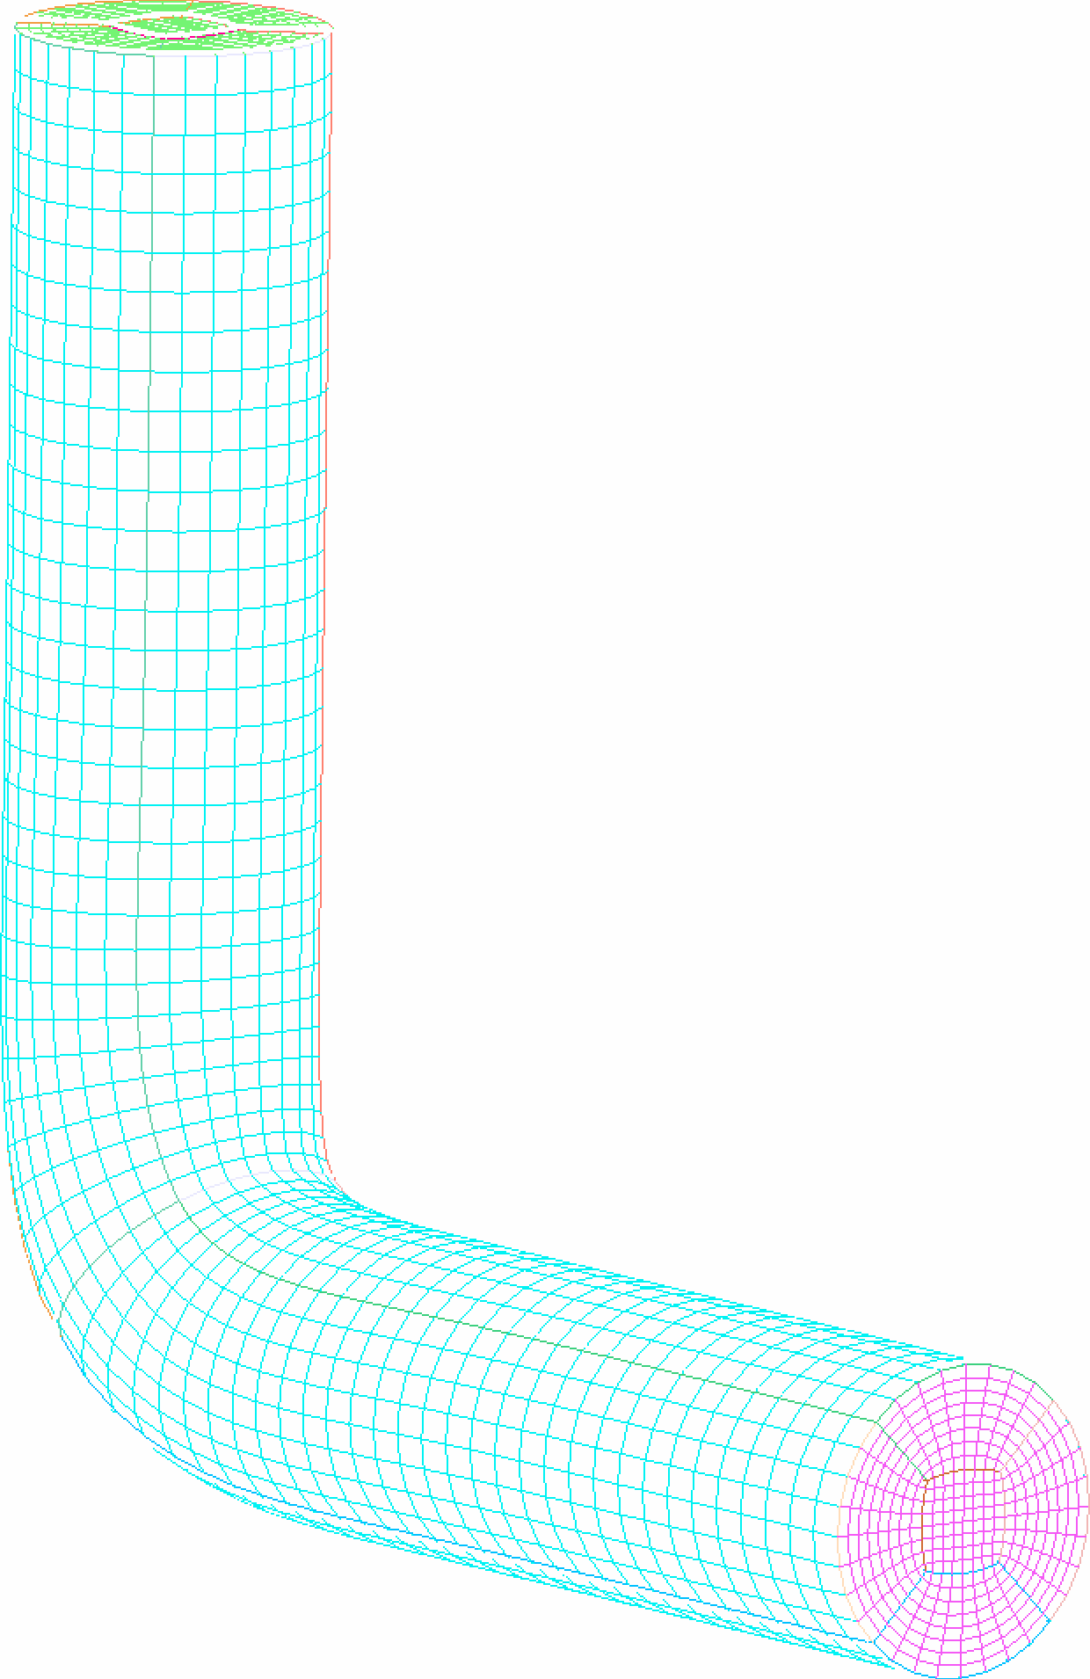
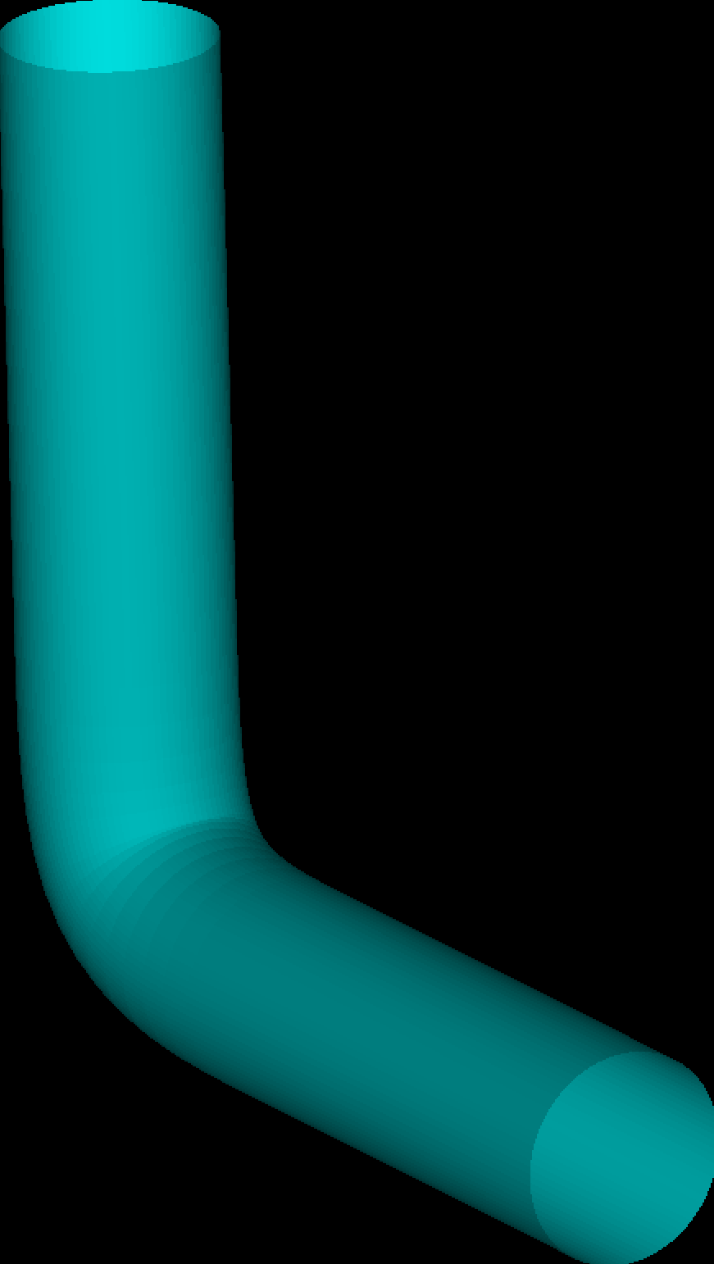
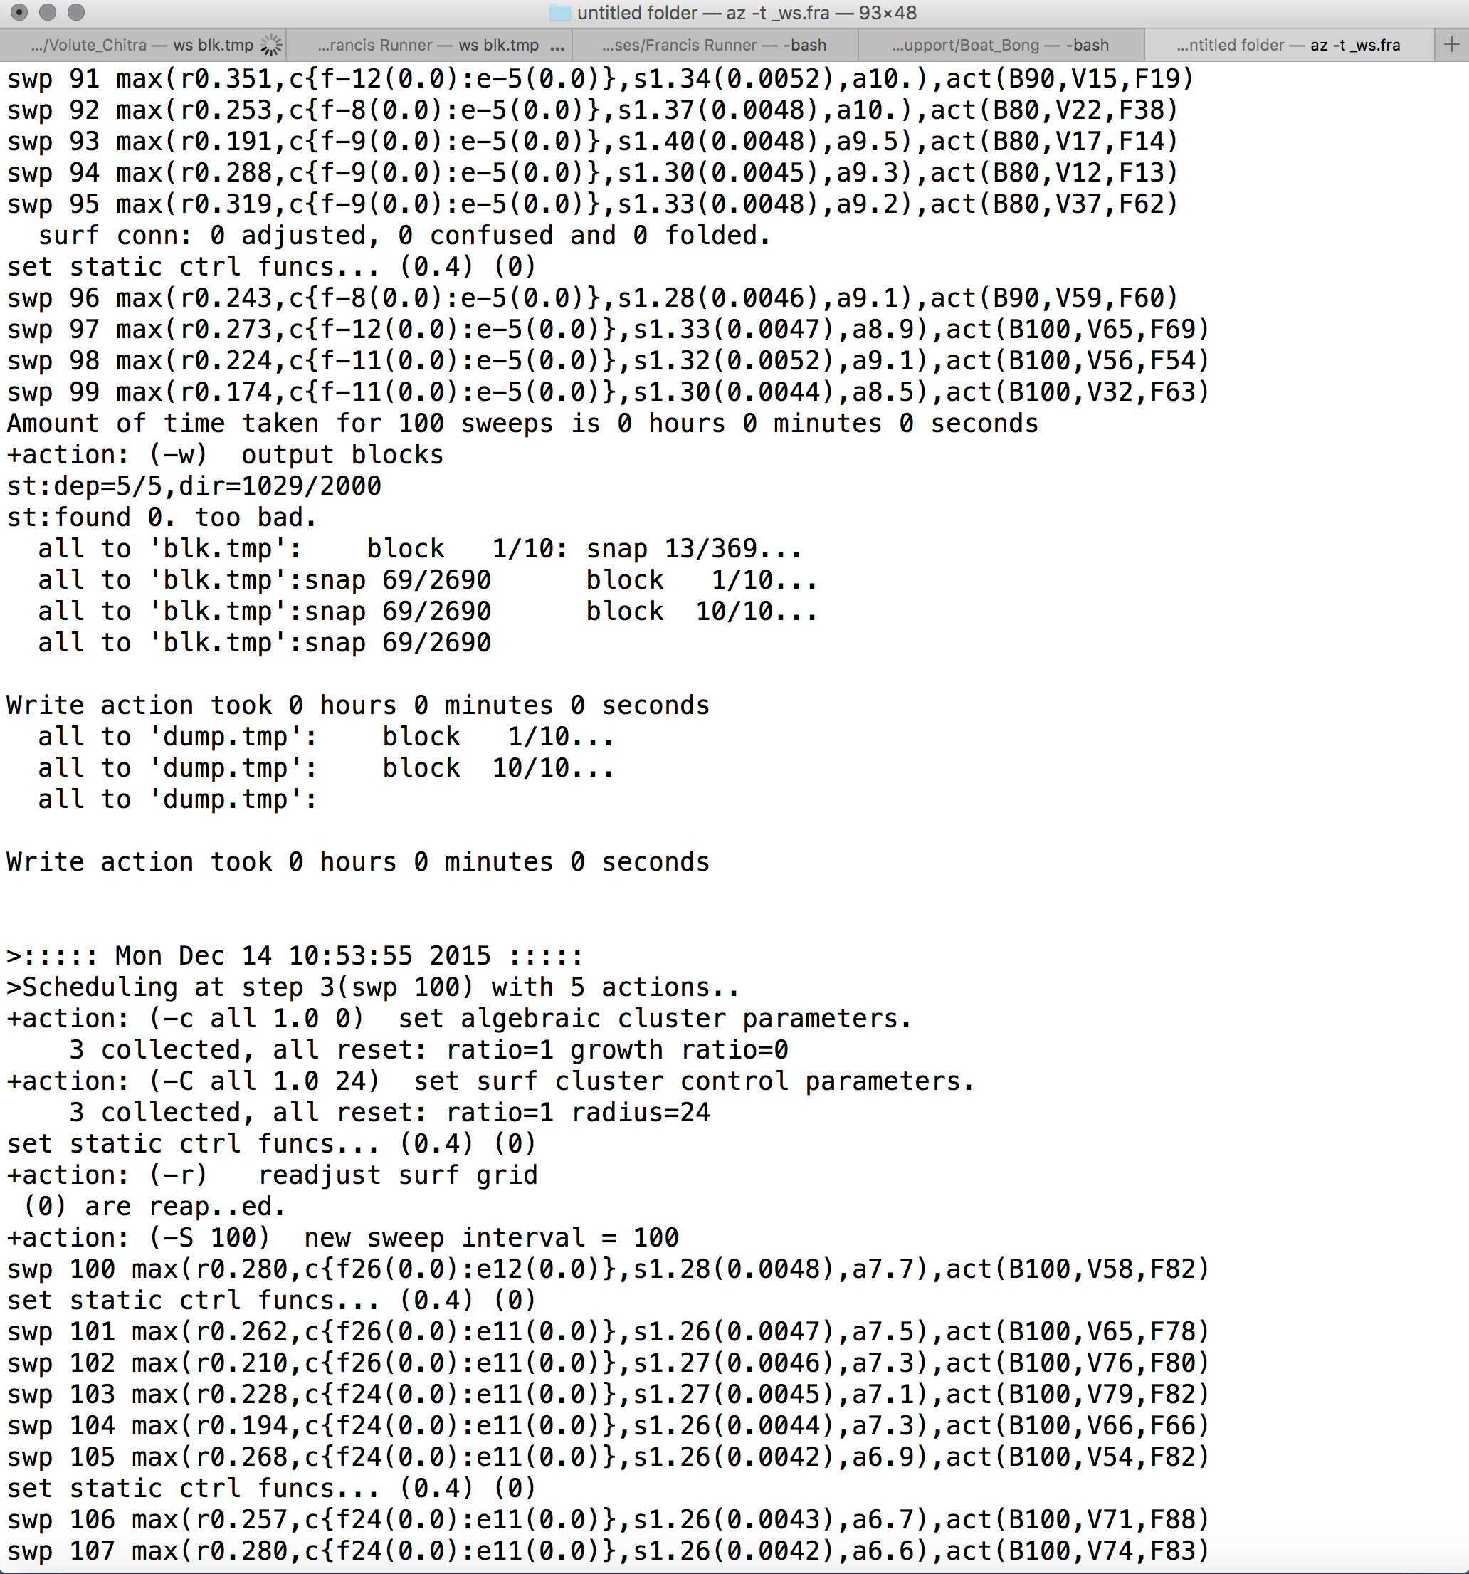
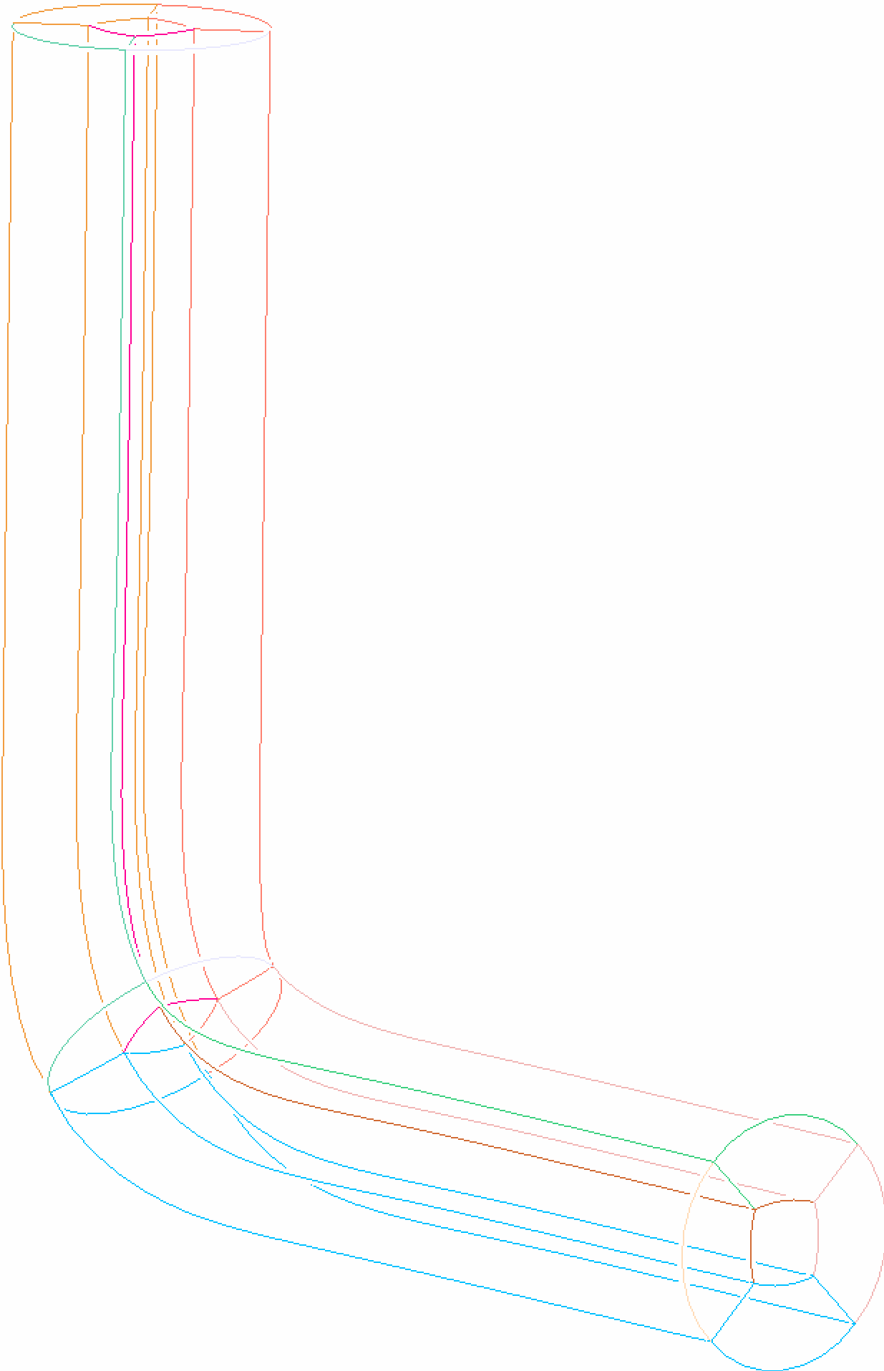
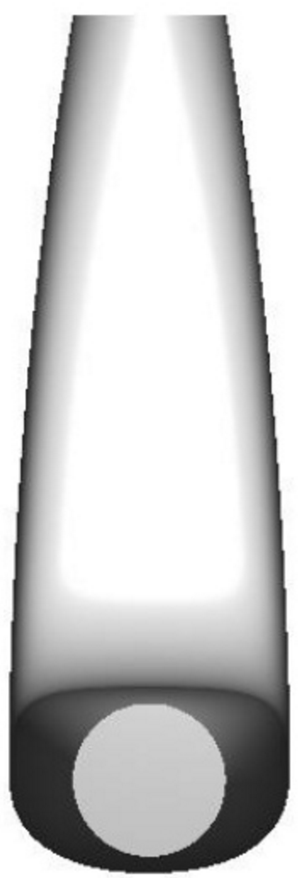
Meshing process in GridPro
Topology
Geometry
Import
Wireframe
Assignment
Grid generation Engine
Grid
Variable
Geometry
Optimiser

Slide 5
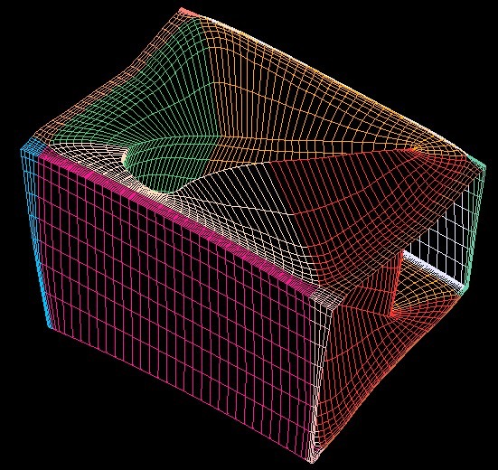
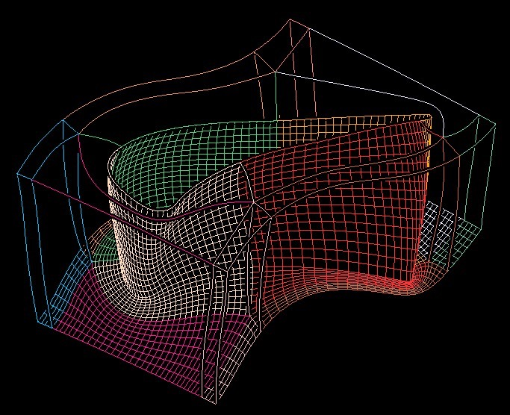
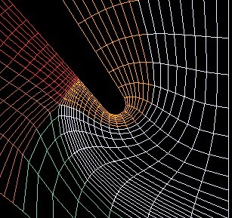
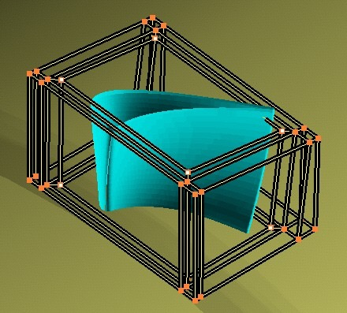
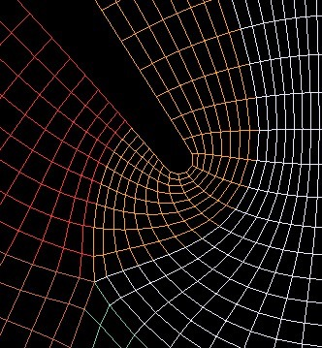
Grid Solver
Grid generator automatically projects and moves grid points to optimal locations to create a smooth orthogonal grid.
Topology
Grid

Slide 6
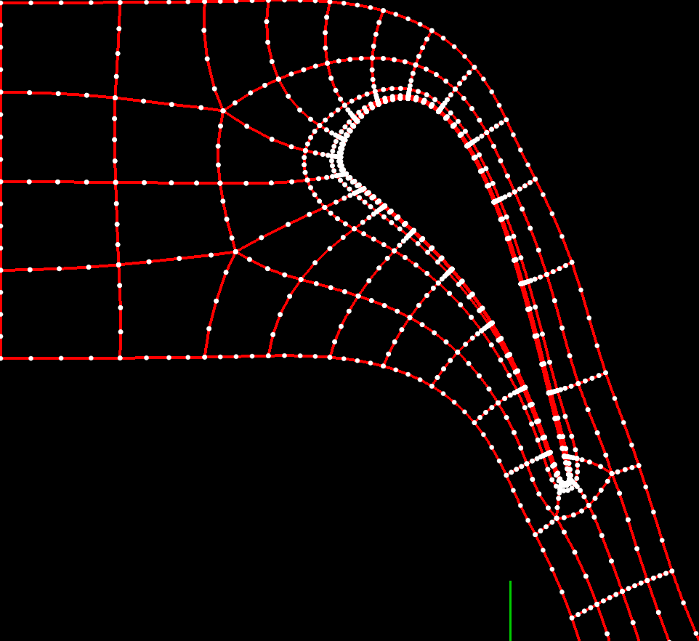
Salient features of GridPro
Topology based approach
Ability to handle grid adaptations
Orthogonal and smooth meshes
Highly complex geometries
Turbine Blade

Slide 7
Highlights of the Higher order grid generation in GridPro
Higher order grid - created using a dense linear mesh.
No post processing of Grid Required .
Tandem Spheres

Slide 8
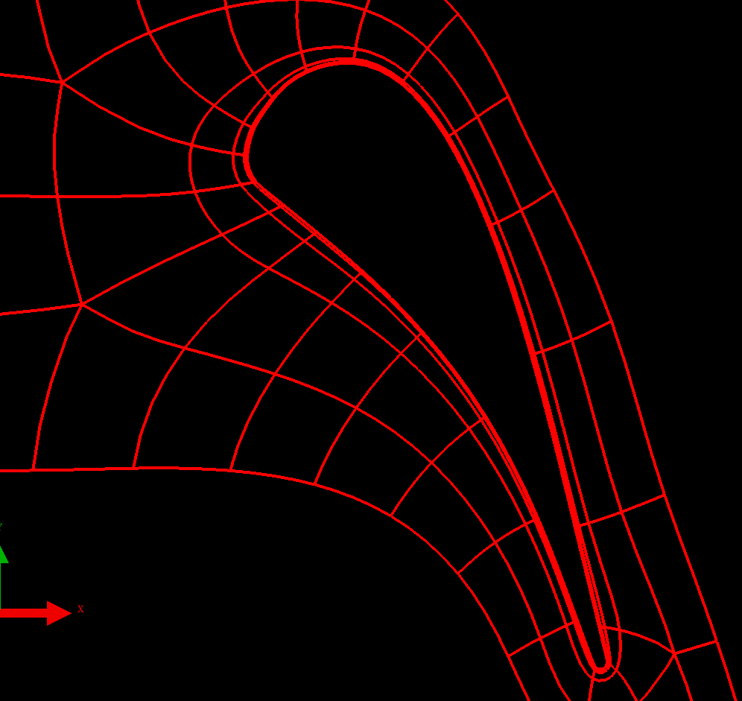
Highlights of the Higher order grid generation in GridPro
Ggrid generated Grid conforms to the geometry.
Conforms more accurately, compared to a mesh with same number of linear elements.

Slide 9
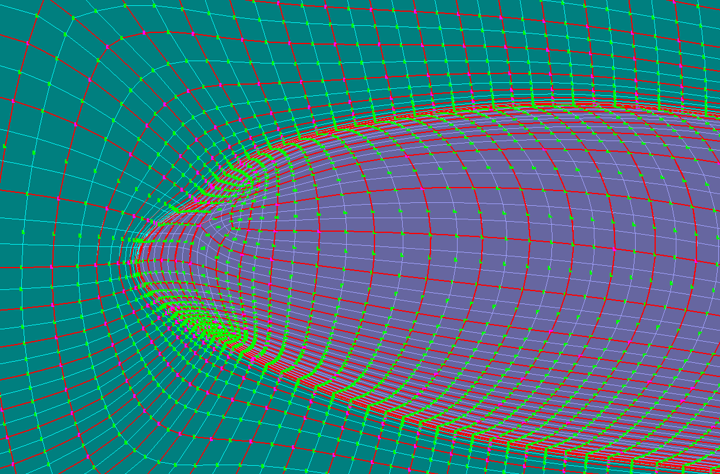
Highlights of the Higher order grid generation in GridPro
The grid generation engine ensures that the curvature is well captured if the density is large enough.
NASA CRM
Fuselage+ Symmetry plane

Slide 10
Highlights of the Higher order grid generation in GridPro
Clustering is specified as apart of grid generation process.
If done as post-processing step, clustering parameters like growth ratio can be modified.

Slide 11
Highlights of the Higher order grid generation in GridPro
Provides flexibility to change edge densities of the grid without losing grid quality.
Ideal for higher order elements

Slide 12
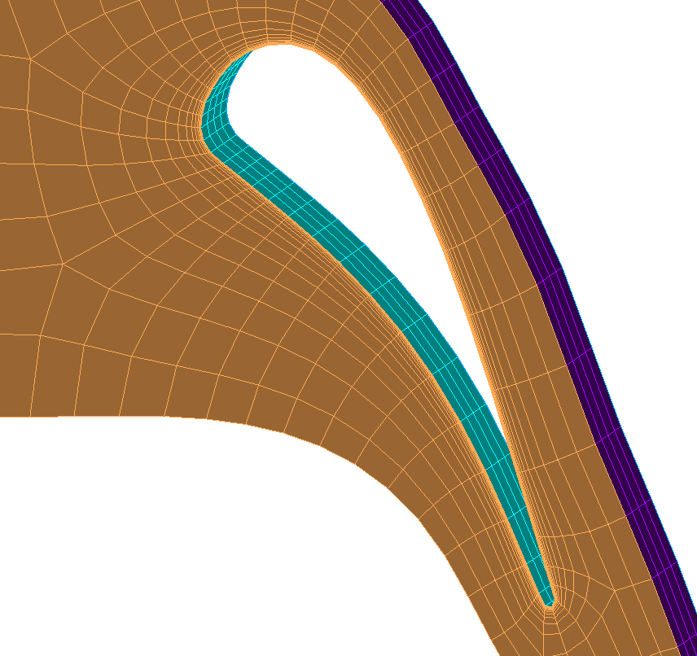
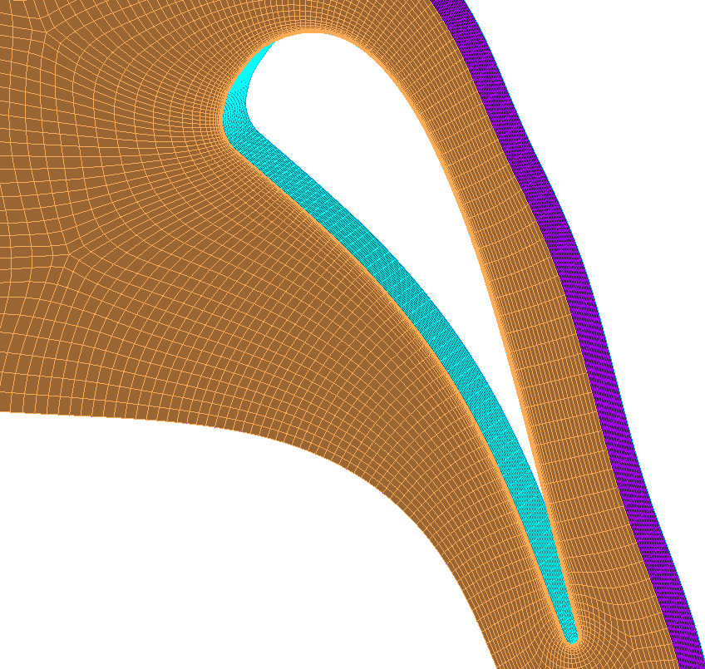
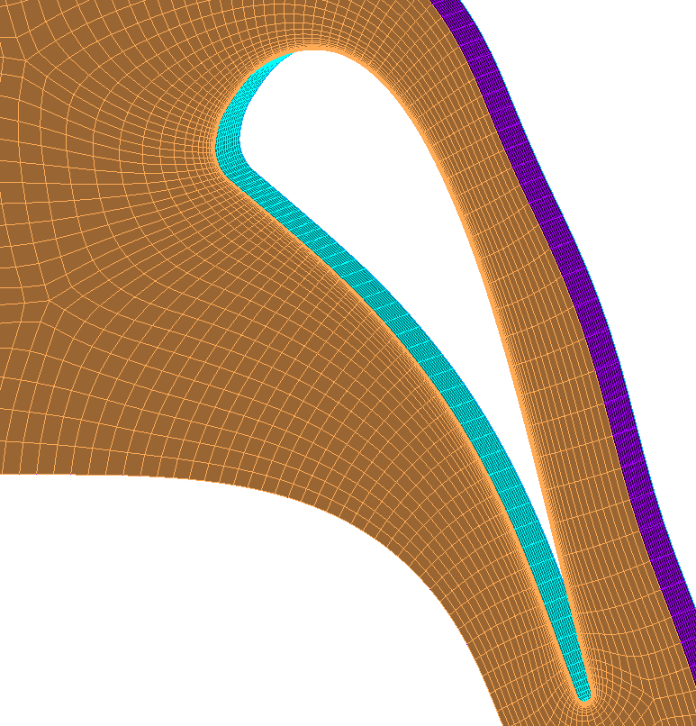
Highlights of the Higher order grid generation in GridPro
Flexibility to change edge densities while grid generation (using schedule file) can be readily used to generate different higher order elements.

Slide 13
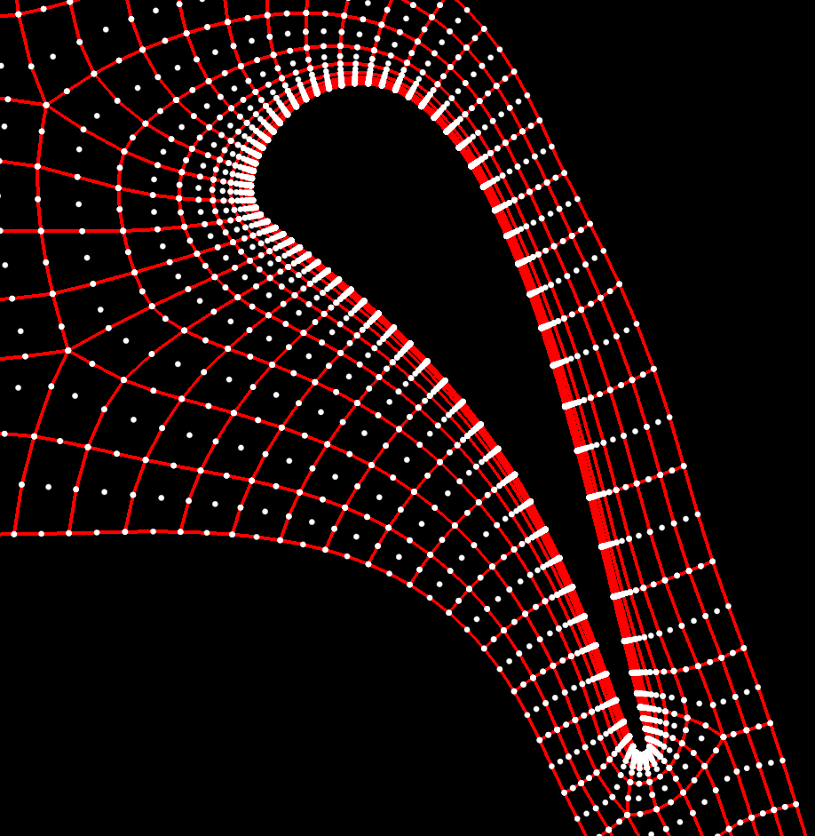
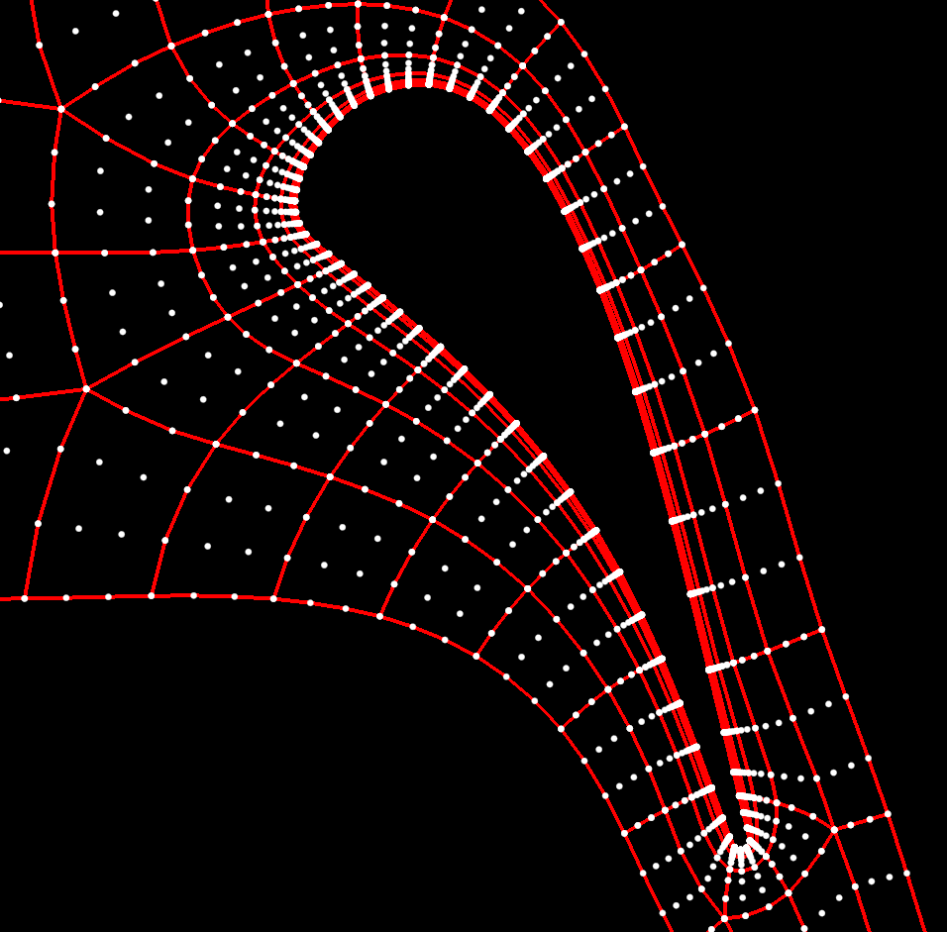
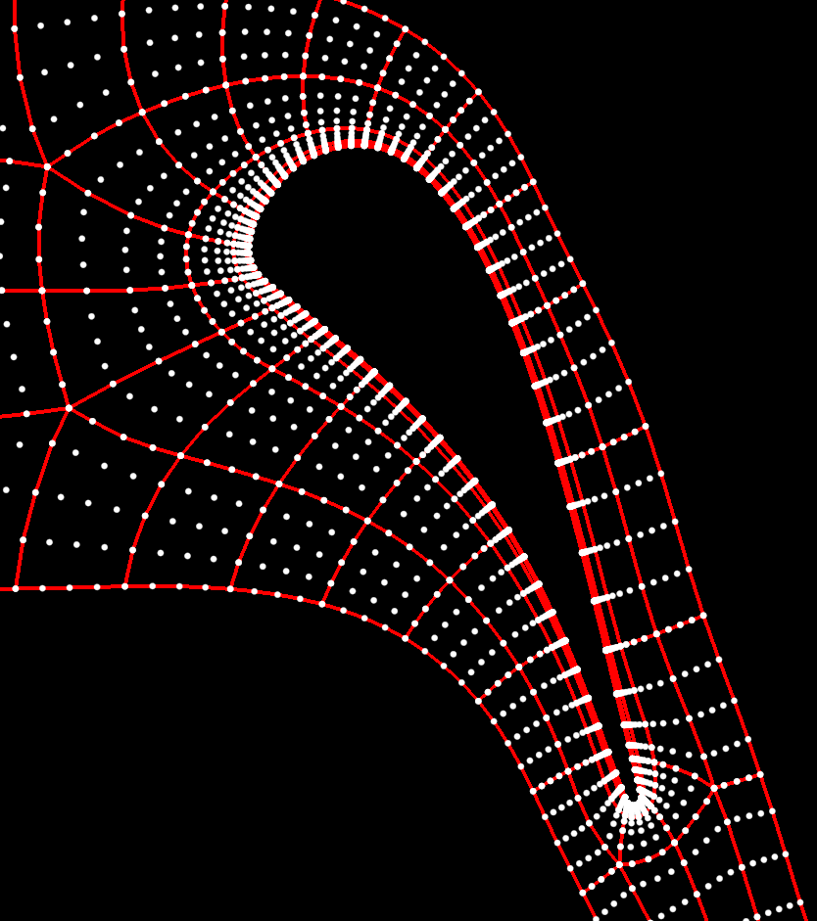
Supports P2, P3, P4

Slide 14
VALIDATION CASES

Slide 15
CS 1 - Tandem Spheres
Sphere diameter: 1 unit
Distance between the spheres center: 10units
Far field dimension: 100*100*100
Family of grids: 7 (Mesh 1 - 7)
Each grid is generated based on the no. of edge nodes derived for the family.
Grid resolution → 1.5x in each direction
Normal spacing → 1.5x for each grid starting from 0.010125
Courtesy ZJ.Wang

Slide 16
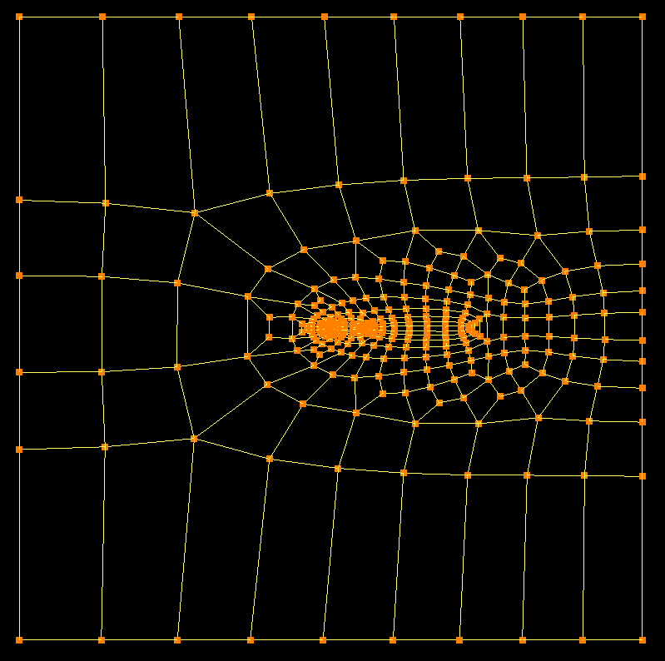
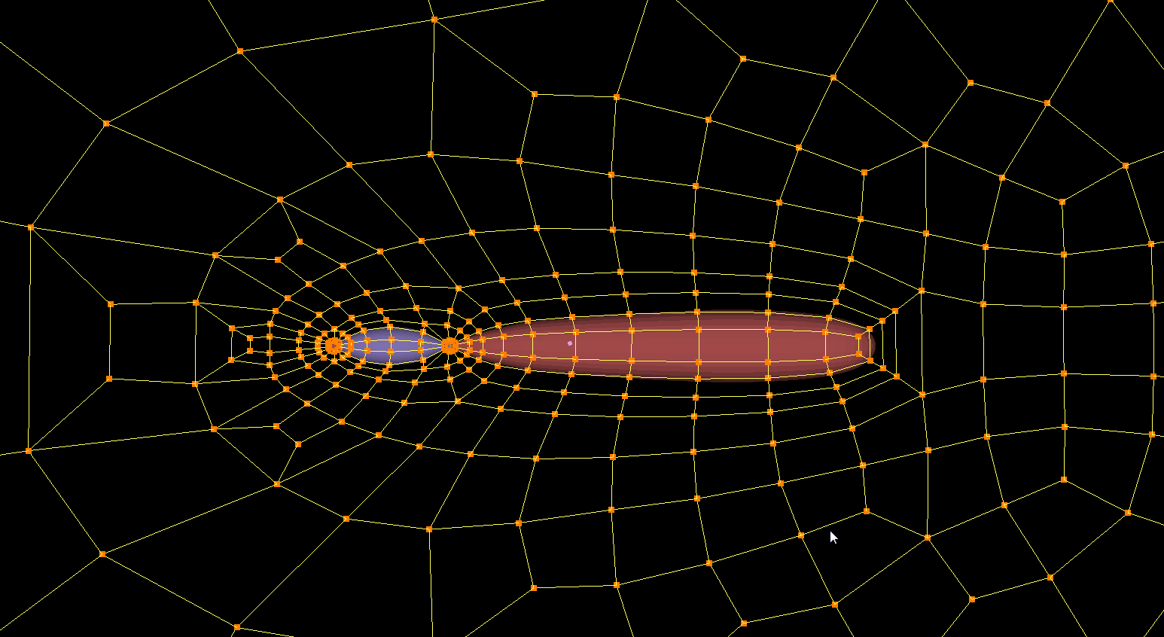
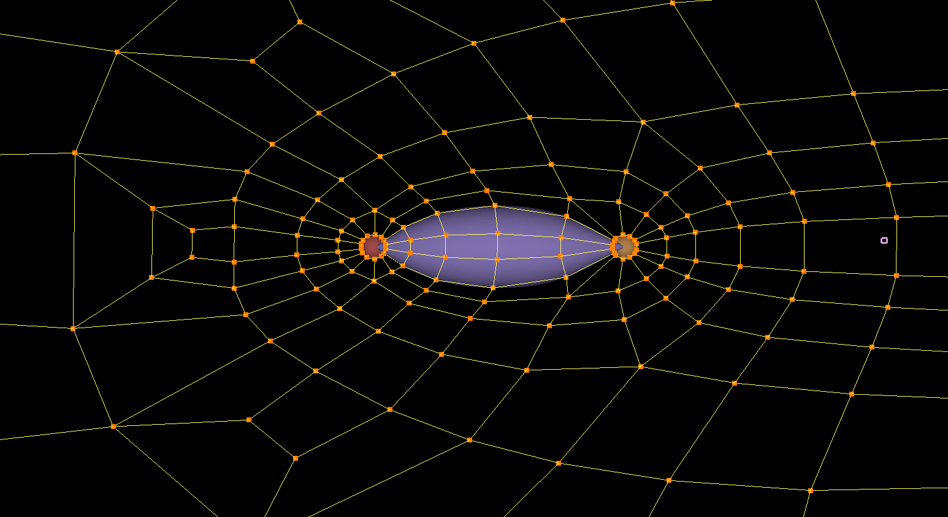
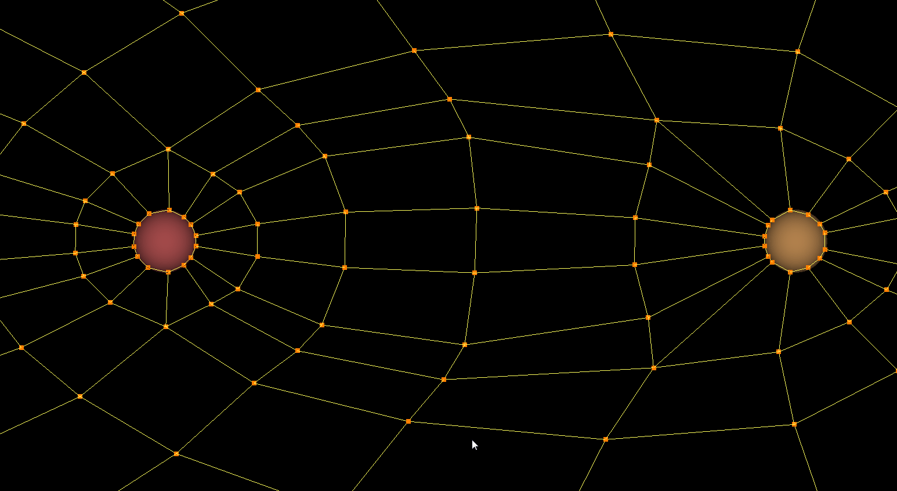
Tandem Spheres-Topology
Local refinement
Around the spheres
Between the spheres
Along the downstream
On the upstream

Slide 17
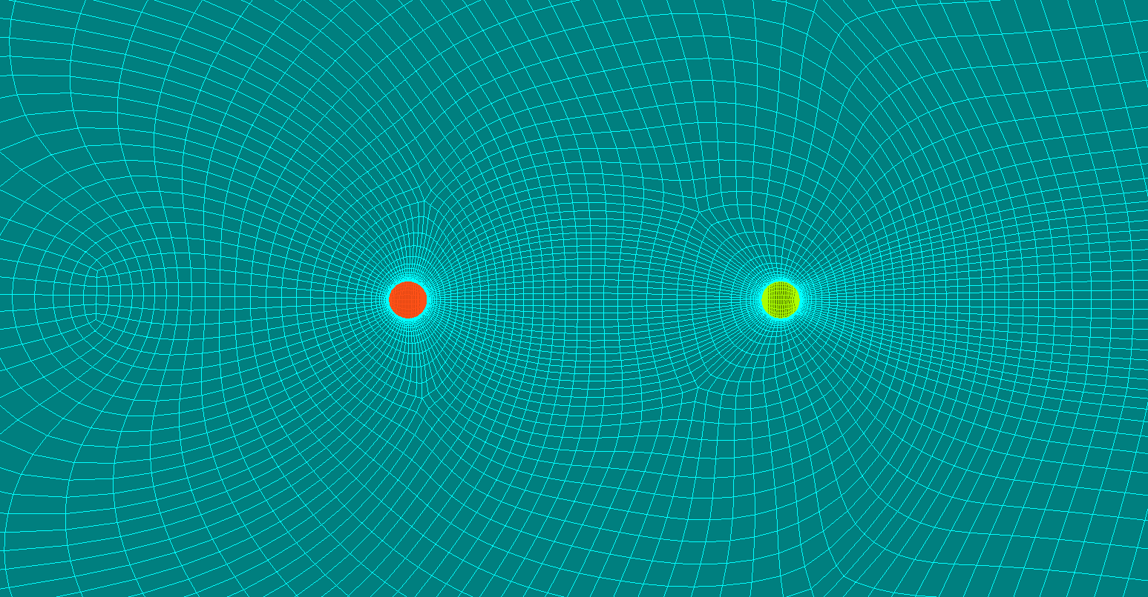
Tandem Spheres-Grid

Slide 18
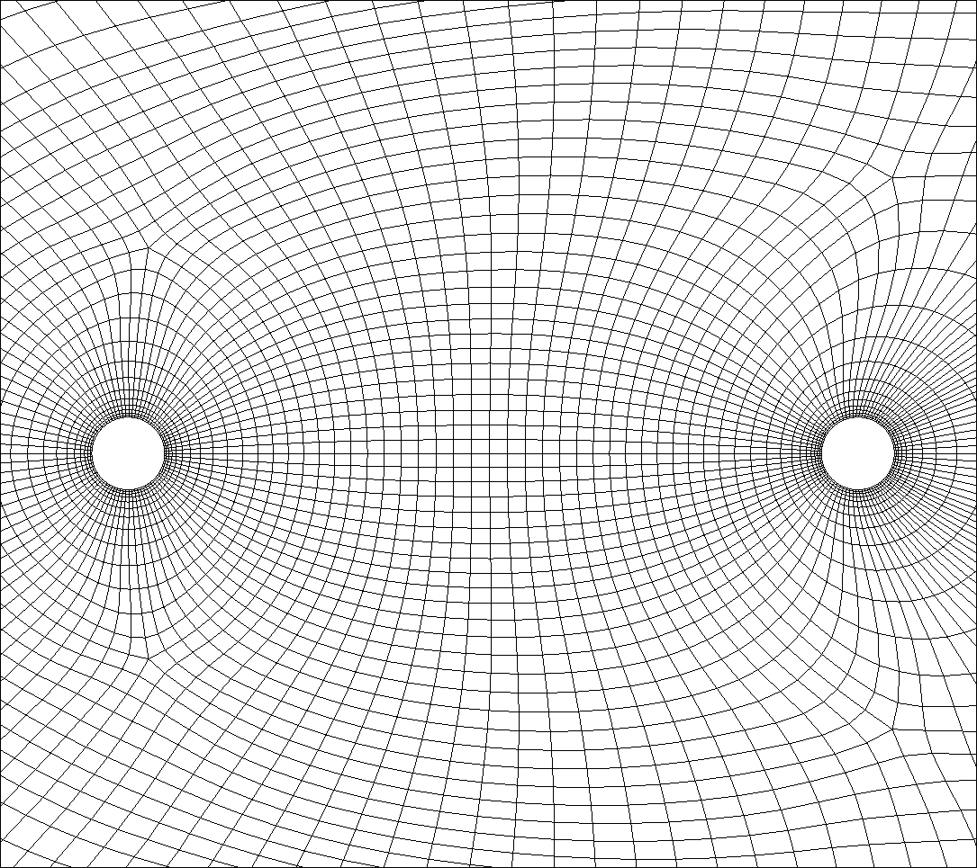
Test Case – Tandem Spheres
P2 mesh generated by GridPro used
192,640 elements
Δy = 0.024 (y+ ~ 7.4, based on element height)
Similar to Mesh 5, but not exactly the same
Courtesy ZJ.Wang

Slide 19
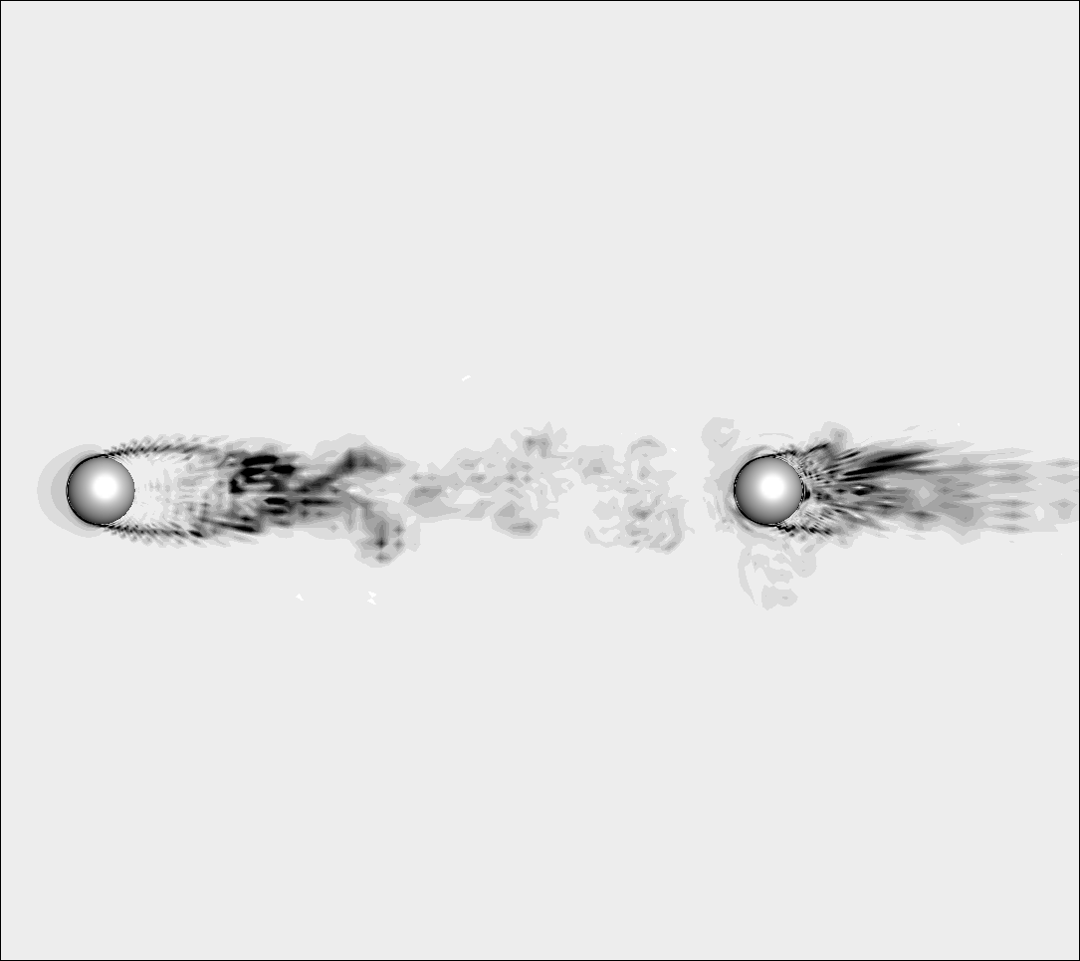
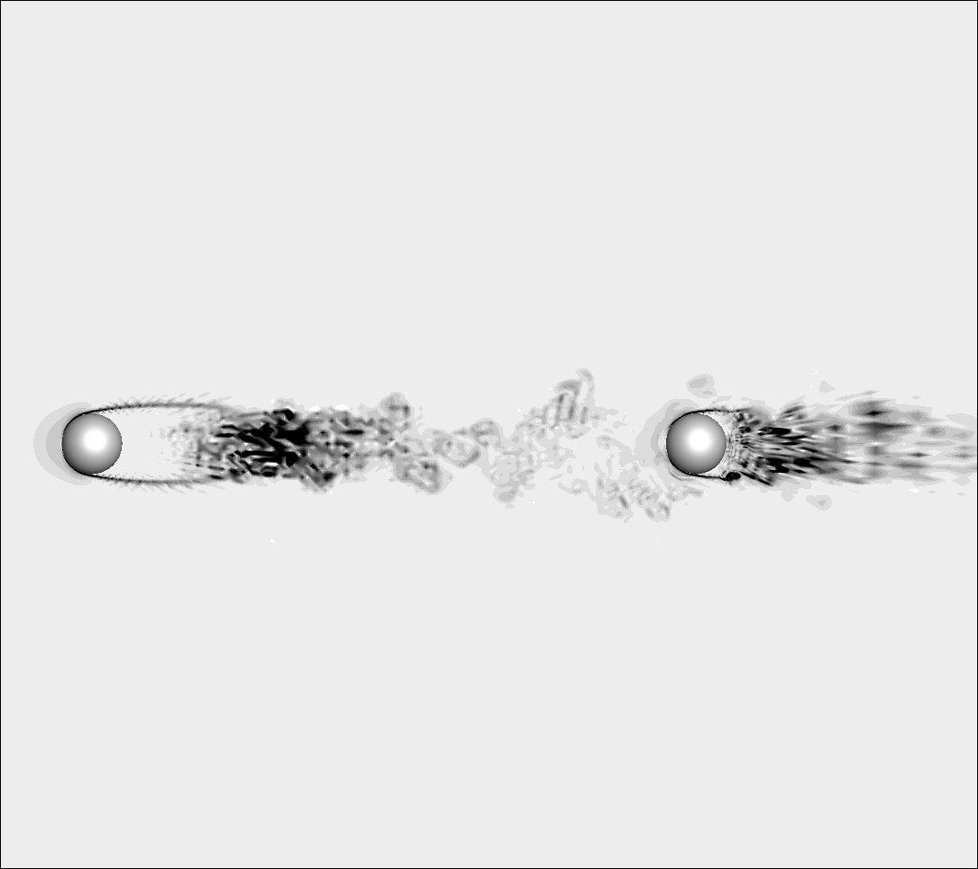
Schlieren
P2
P3
Courtesy ZJ.Wang

Slide 20
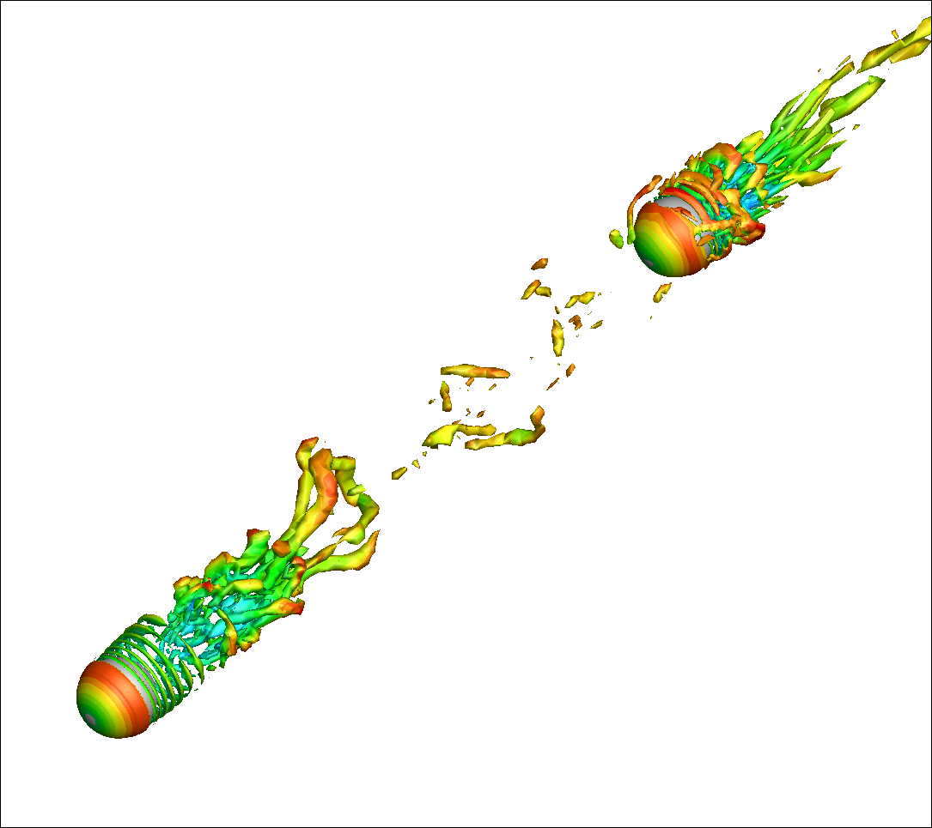
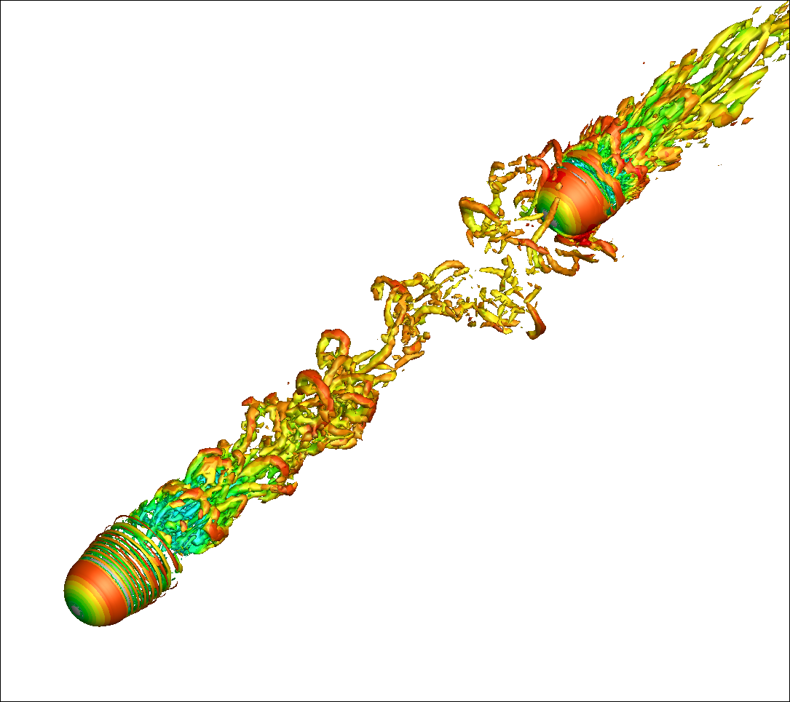
Q-criterion
P2
P3
Courtesy ZJ.Wang

Slide 21
Q-criterion + Schlieren Movie
Courtesy ZJ.Wang

Slide 22
Demonstration Problem– Generic Car Mirror (CAA)
Side View
Top View
(-3, 3)
(-3, 3.1)
z
x
Plate
y
x
(6, 0)
(-3, -3.1)
(6, -3.1)
(-3, 0)
(0, 0)
Diameter of the cylinder and sphere D = 0.2
Courtesy ZJ.Wang

Slide 23
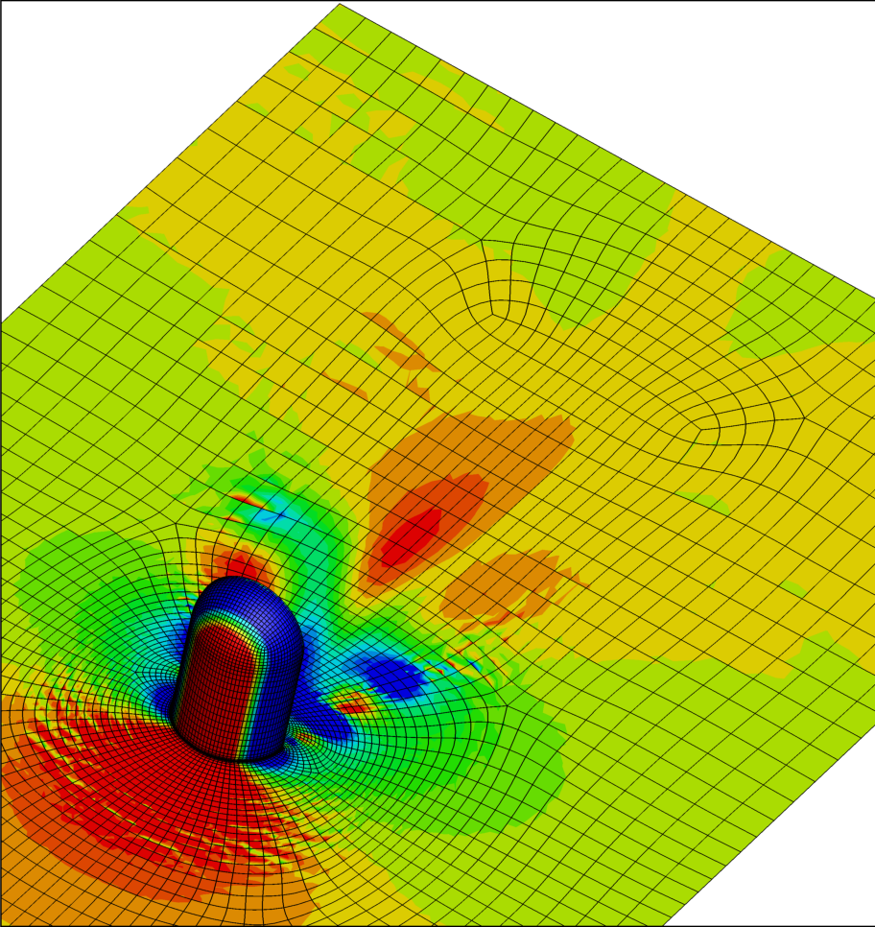
Generic Car Mirror (cont.)
A well known benchmark
M = 0.11, Re_{D} = 5.2x10⁵
Experimental data available for comparison
A high-order P2 mesh was successfully generated by GridPro
All hex mesh with 284,224 cells
Simulation details
FR/CPR p1 and p2 simulations carried out with GMRES-BDF2
Wall-resolved ILES performed
~710 cells/core (400 cores)
Courtesy ZJ.Wang

Slide 24
Q-Criteria Colored by Stream-wise Velocity
Hair-pin vortices clearly visible
P2 – 3rd order
7.67M DOFs/equation
P3 – 4th order
18.2M DOFs/equation
Courtesy ZJ.Wang

Slide 25
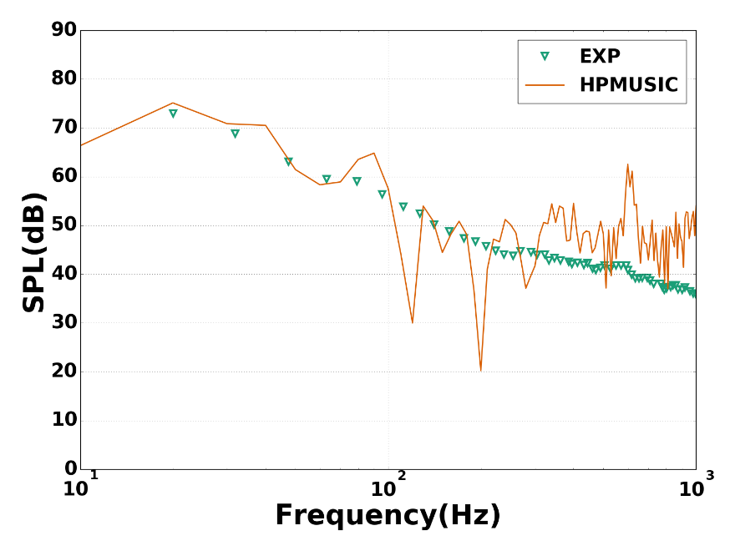
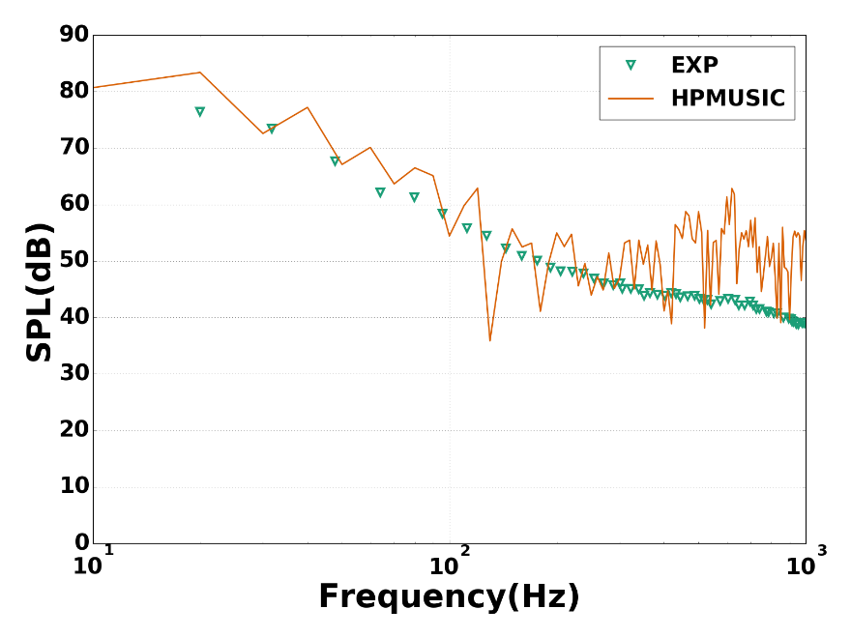
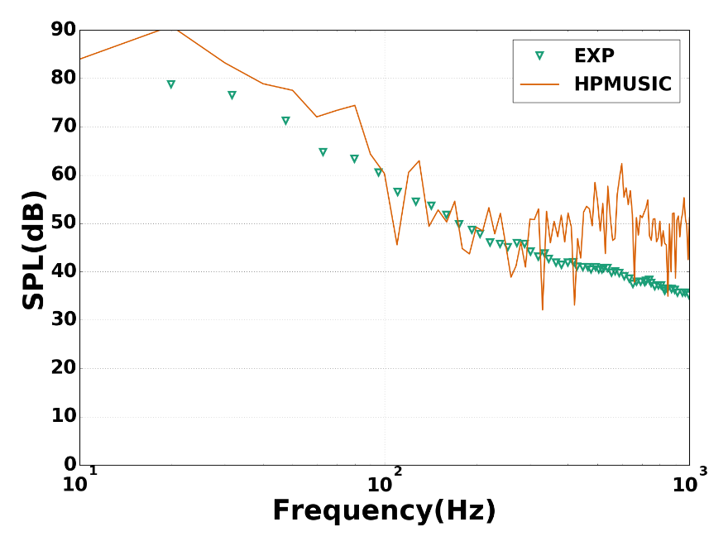
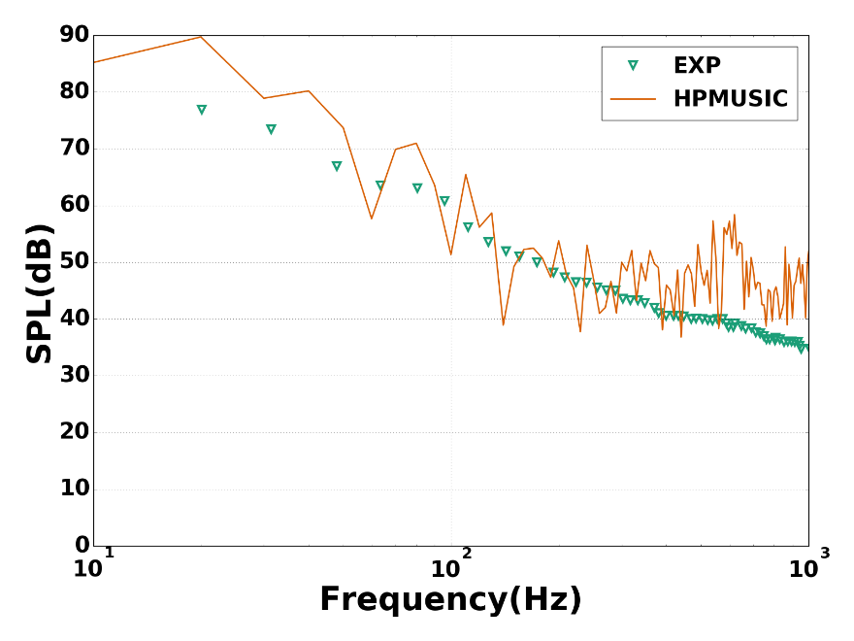
Comparison with Experimental Data
Courtesy ZJ.Wang

Slide 26
Challenges:
Tension between Cell Thickness, Curvature, and Foot Print

Slide 27
Thank you!
Questions?

